Slide 1
Population A geographic “BIG IDEA” with many consequences IN china
Population density helps us understand many other geographic features in China,
including patterns of crop production,
dynasties, inventions, large building projects,
highways, factories, trade, pollution,
disease, and human rights.
.

Slide 2
Note to Teachers
1. This presentation has a specific purpose. It is designed as an illustrated teacher guide to provide content background
about the “layers of information” on the clickable map of China.
It is not designed for use in class “as is” – to tailor it for a specific class, you might shorten it, edit frames, add pictures or discussion questions, etc.
(see below)
2. This presentation has two parts – explanation and question. You can cut-and-paste to put question frames where you want them in order to promote class discussion or identify misconceptions.
The question frames can also serve as reviews, assessments,
or prompts for inquiry activities (individual or group).
3. This presentation is much too long. There is a good reason for this – your computer has a DELETE key,
but it does not have a CREATE key.
This is important, because many teachers have reviewed this presentation. If anyone suggested an addition (like a definition, explanation, or example), we usually put it in – because other teachers might also find it useful,
and it takes much less time to delete a frame than to make one!
(PS. You can delete this frame now!)
?
DELETE

Slide 3
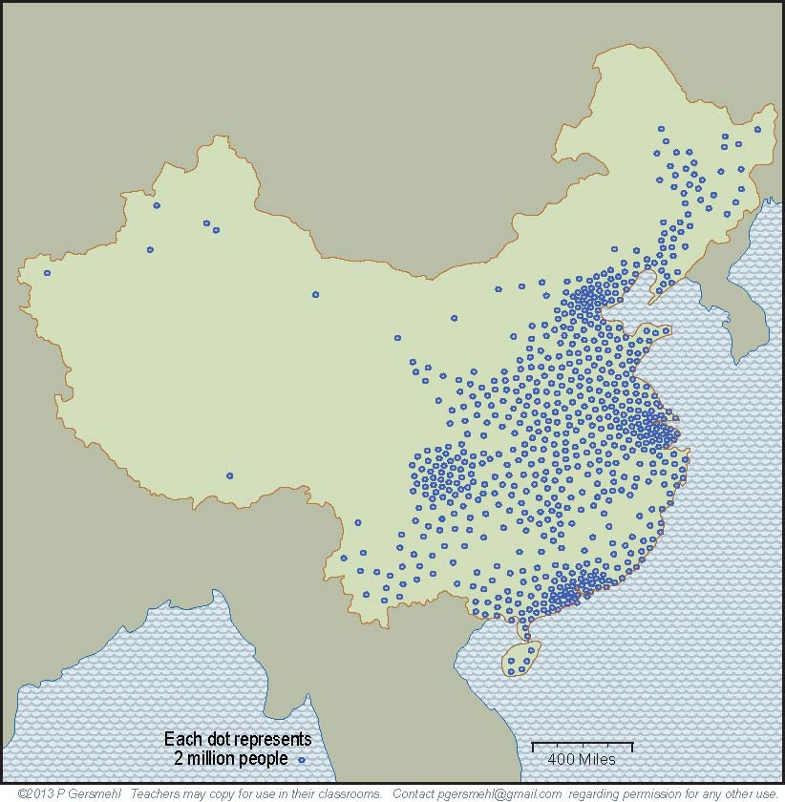
China is a good choice as a “GeoLab”
to study consequences of population density,
because it has had a large population for thousands of years.

Slide 4
China is a good choice as a “GeoLab”
to study consequences of population density,
because it has had a large population for thousands of years.
Curriculum note.
There is an activity
and presentation
that examine the
population history
of China.

Slide 5
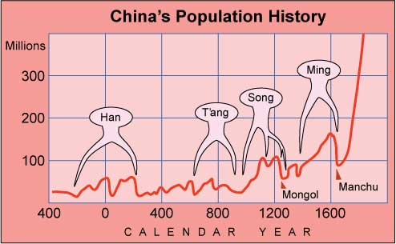
Several times in its long history
China lost more than a third of its population,
to warfare, disease, or starvation.

Slide 6
Several times in its long history
China lost more than a third of its population,
to warfare, disease, or starvation.
What happened around 200CE?
or around 650? 1650?
Studying times like these
might help us understand what causes collapses like that.

Slide 7
Several times in its long history
China lost more than a third of its population,
to warfare, disease, or starvation.
What happened around 200CE?
or around 650? 1650?
Studying times like these
might help us understand what causes collapses like that.
Curriculum note.
There is a presentation
and reading activity
that examine the Fall
of the Ming Dynasty.

Slide 8
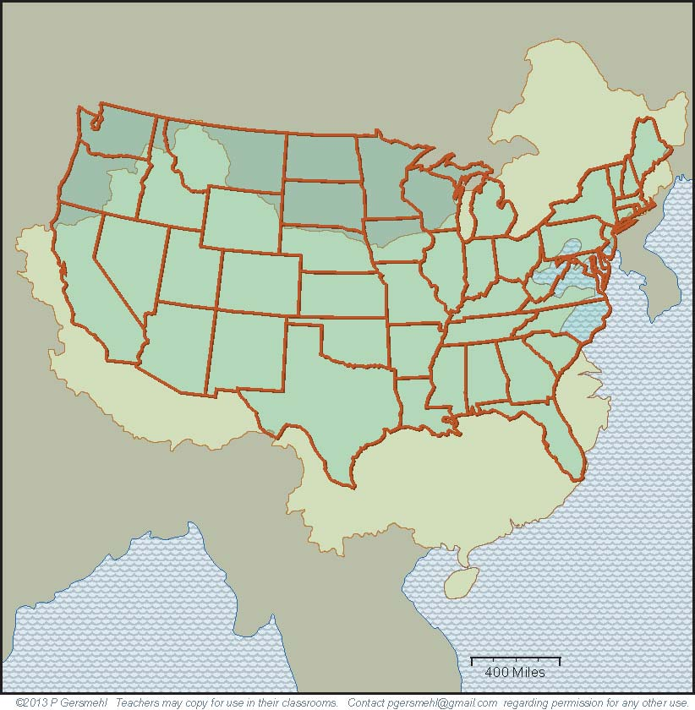
Part 1
Comparing China
and the United States

Slide 9
China has about the same area as the United States,
but it has more than four times as many people.

Slide 10
Both countries
cover roughly
the same latitude
and general position
on the east coast
of their continents.

Slide 11
Both countries
cover roughly
the same latitude
and general position
on the east coast
of their continents.
As a result,
many places
in China
are similar to
places in the
United States.

Slide 12
For example,
Hong Kong and Miami are both
- on the east coast,
- near the same latitude,
and
- close to warm ocean.

Slide 13
For example,
Hong Kong and Miami are both
- on the east coast,
- near the same latitude,
and
- close to warm ocean.
Not surprisingly,
both cities have
mild winters,
hot summers,
and occasional
hurricanes
in the fall.

Slide 14
For example,
Hong Kong and Miami are both
- on the east coast,
- near the same latitude,
and
- close to warm ocean.
Not surprisingly,
both cities have
mild winters,
hot summers,
and occasional
hurricanes
in the fall.
Curriculum note.
There is an activity
that uses climagraphs
to compare the countries.

Slide 15
Shanghai and
Savannah, GA,
have almost
identical climates.

Slide 16
The capital cities,
Beijing and
Washington,
also have
very similar
weather.

Slide 17
Shenyang and
Pittsburgh are
two more cities
with similar
climates.

Slide 18
Shenyang and
Pittsburgh are
two more cities
with similar
climates.
These two cities
have even more similarities –
both were centers for steelmaking,

Slide 19
Shenyang and
Pittsburgh are
two more cities
with similar
climates.
These two cities
have even more similarities –
both were centers for steelmaking,
and both became hi-tech centers
when the steel
industry faded.

Slide 20
Here is another pair of cities with very similar conditions:
the old Silk Road city of Kashgar and Reno, Nevada.
Both cities are located more than 4000 feet above sea level,
in small irrigated oases on major transcontinental routes,
between high mountains to the west and desert to the east.

Slide 21
But Kashgar
(also called Kashi)
is a much older city
and it has ten times
as many people
as Reno.
Here is another pair of cities with very similar conditions:
the old Silk Road city of Kashgar and Reno, Nevada.
Both cities are located more than 4300 feet above sea level,
in small irrigated oases on major transcontinental routes,
between high mountains to the west and desert to the east.

Slide 22
Much of China’s environment
is like the United States,
BUT
there are also some
important differences
in environmental conditions.
Notes:
Differences

Slide 23
Much of China’s environment
is like the United States,
BUT
there are also some
important differences
in environmental conditions.
For example, China does not have an ocean
next to its western border.
China’s west is much drier than California, Oregon,
Washington, or Alaska.
Notes:
Differences

Slide 24
Much of China’s environment
is like the United States,
BUT
there are also some
important differences
in environmental conditions.
For example, China does not have an ocean
next to its western border.
China’s west is much drier than California, Oregon,
Washington, or Alaska.
And remember,
California is by far
the number one
food-producing state
in the United States.
Notes:
Differences

Slide 25
Another huge difference:
China does not have
anything like
the Great Lakes.

Slide 26
Manchuria
Mongolia
Another huge difference:
China does not have
anything like
the Great Lakes.
As a result, China’s “northlands”
(Mongolia and Manchuria)
are much colder and drier
than Maine or Wisconsin.

Slide 27
Manchuria
Mongolia
Another huge difference:
China does not have
anything like
the Great Lakes.
As a result, China’s “northlands”
(Mongolia and Manchuria)
are much colder and drier
than Maine or Wisconsin.
This fact was important
throughout China’s history,
from the first dynasties
to the Mongol invasion
and the fall of the Ming.

Slide 28
The Great Lakes
are a big benefit for
farming and transportation
in the United States.

Slide 29
The Great Lakes
are a big benefit for
farming and transportation
in the United States.
China does not have
any large region
of prime farmland
like the Corn Belt
in the United States.

Slide 30
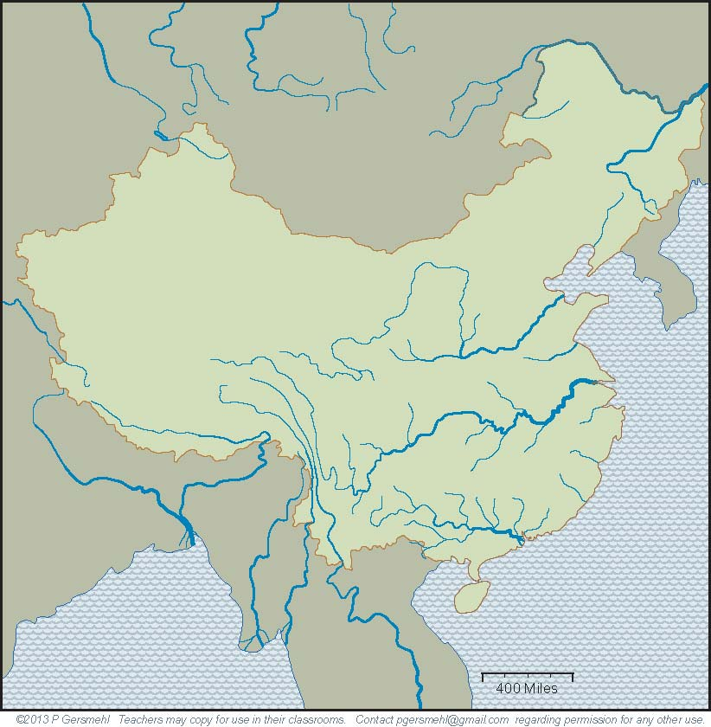
Part 2
The River Systems
of China

Slide 31
China has four giant river systems.

Slide 32
China has four giant river systems.
The Amur
on the border
with Russia.

Slide 33
China has four giant river systems.
The Amur
on the border
with Russia.
The Huang He -
“He” means
muddy river.

Slide 34
China has four giant river systems.
The Amur
on the border
with Russia.
The Huang He -
“He” means
muddy river.
The Yangtze Jiang –
“Jiang” means
clear blue river.

Slide 35
China has four giant river systems.
The Amur
on the border
with Russia.
The Huang He -
“He” means
muddy river.
The Yangtze Jiang –
“Jiang” means
clear blue river.
The Zhu Jiang
(also known
by an English name,
the Pearl River).

Slide 36
Note also: these parallel rivers,
flowing between high mountains,
made it all but impossible to travel
over land from China to India
CHINA
INDIA

Slide 37
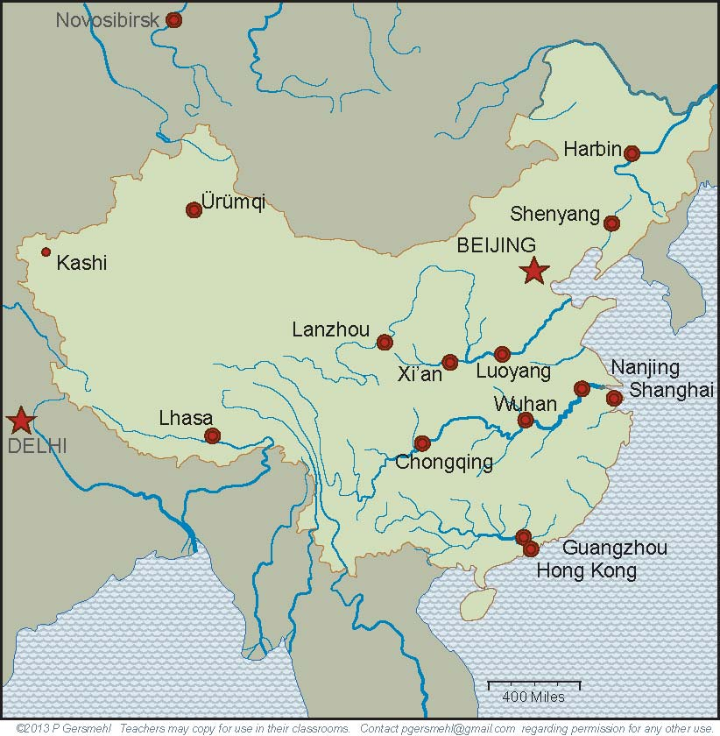
The floodplains of three rivers have had
large populations throughout Chinese history.

Slide 38
The floodplains of three rivers have had
large populations throughout Chinese history.
The old capitals
of Luoyang
and Xi’an
are on the
Huang He.

Slide 39
The floodplains of three rivers have had
large populations throughout Chinese history.
The old capitals
of Luoyang
and Xi’an
are on the
Huang He.
Four great cities
are spaced along
the Yangtze.

Slide 40
The floodplains of three rivers have had
large populations throughout Chinese history.
The old capitals
of Luoyang
and Xi’an
are on the
Huang He.
Four great cities
are spaced along
the Yangtze.
Guangzhou (Canton)
and Hong Kong
are near the mouth
of the Pearl.

Slide 41
The floodplains of three rivers have had
large populations throughout Chinese history.
The old capitals
of Luoyang
and Xi’an
are on the
Huang He.
Four great cities
are spaced along
the Yangtze.
Curriculum note.
There is a presentation
and map activity
called “Ancient Cities
and Temperatures.”
Guangzhou (Canton)
and Hong Kong
are near the mouth
of the Pearl.

Slide 42
Part 3
Areas of Large Population
in China

Slide 43
Today, six of these old cities
are the urban cores of areas
of especially large population.

Slide 44
Today, six of these old cities
are the urban cores of areas
of especially large population.
Beijing

Slide 45
Today, six of these old cities
are the urban cores of areas
of especially large population.
Beijing
Nanjing,
Shanghai

Slide 46
Today, six of these old cities
are the urban cores of areas
of especially large population.
Beijing
Nanjing,
Shanghai
Guangzhou,
Hong Kong

Slide 47
Today, six of these old cities
are the urban cores of areas
of especially large population.
Beijing
Chongqing
Nanjing,
Shanghai
Guangzhou,
Hong Kong

Slide 48
And remember, the climate
of these cities is very similar
to places in the United States.
Beijing
Chongqing
Nanjing,
Shanghai
Guangzhou,
Hong Kong

Slide 49
And remember, the climate
of these cities is very similar
to places in the United States.
Beijing’s climate
is like Washington
or New York City.
Beijing
Chongqing
Nanjing,
Shanghai
Guangzhou,
Hong Kong

Slide 50
And remember, the climate
of these cities is very similar
to places in the United States.
Beijing’s climate
is like Washington
or New York City.
Beijing
Shanghai
is like
Georgia
Chongqing
Nanjing,
Shanghai
Guangzhou,
Hong Kong

Slide 51
And remember, the climate
of these cities is very similar
to places in the United States.
Beijing’s climate
is like Washington
or New York City.
Beijing
Shanghai
is like
Georgia
Chongqing
Nanjing,
Shanghai
Hong Kong
is like Miami
Guangzhou,
Hong Kong

Slide 52
And remember, the climate
of these cities is very similar
to places in the United States.
Beijing’s climate
is like Washington
or New York City.
and Chongqing
is like Dallas
(with rainier summers
and drier winters)
Beijing
Shanghai
is like
Georgia
Chongqing
Nanjing,
Shanghai
Hong Kong
is like Miami
Guangzhou,
Hong Kong

Slide 53
In the past, different dynasties
had their capital cities
in different regions.

Slide 54
In the past, different dynasties
had their capital cities
in different regions.
Imagine being in a country
where the capital city moved
every few hundred years,
and sometimes more often!

Slide 55
In the past, different dynasties
had their capital cities
in different regions.
Imagine being in a country
where the capital city moved
every few hundred years,
and sometimes more often!
Go on,
to see why
this would matter.

Slide 56
Part 4
Economic Regions
of China

Slide 57
Different parts of China
had different economies,
lifestyles, and cultures.

Slide 58
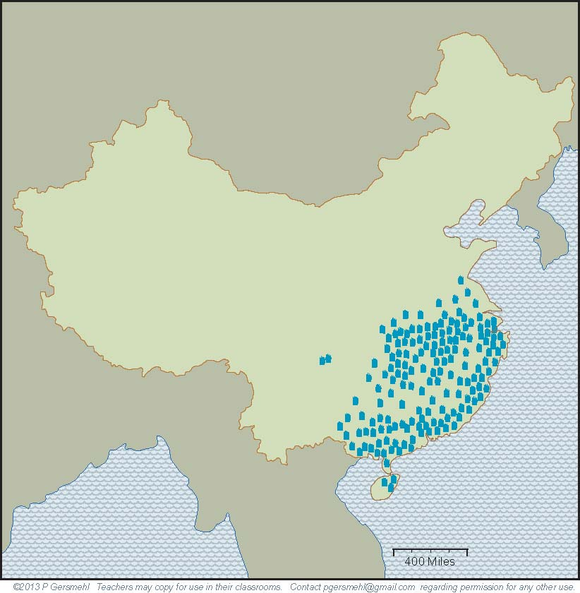
The southern region
has a long summer.
Farmers can grow
several crops of rice,
but plant diseases
are a problem
in wet years.

Slide 59
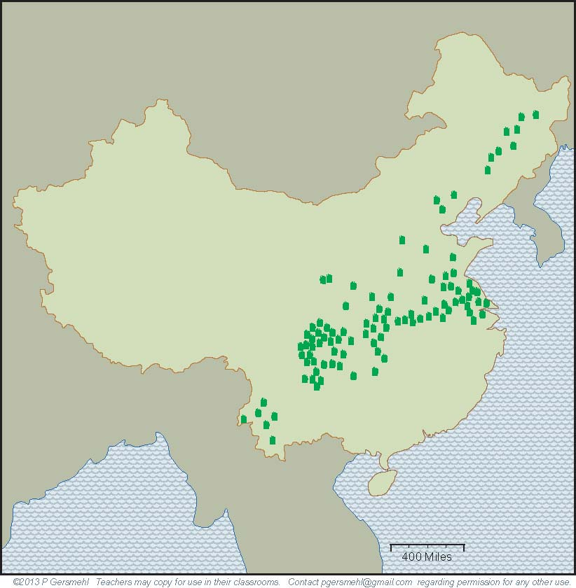
To the north and west,
the growing season
gets shorter.
Farmers can harvest
only one crop of rice
in a typical year.

Slide 60
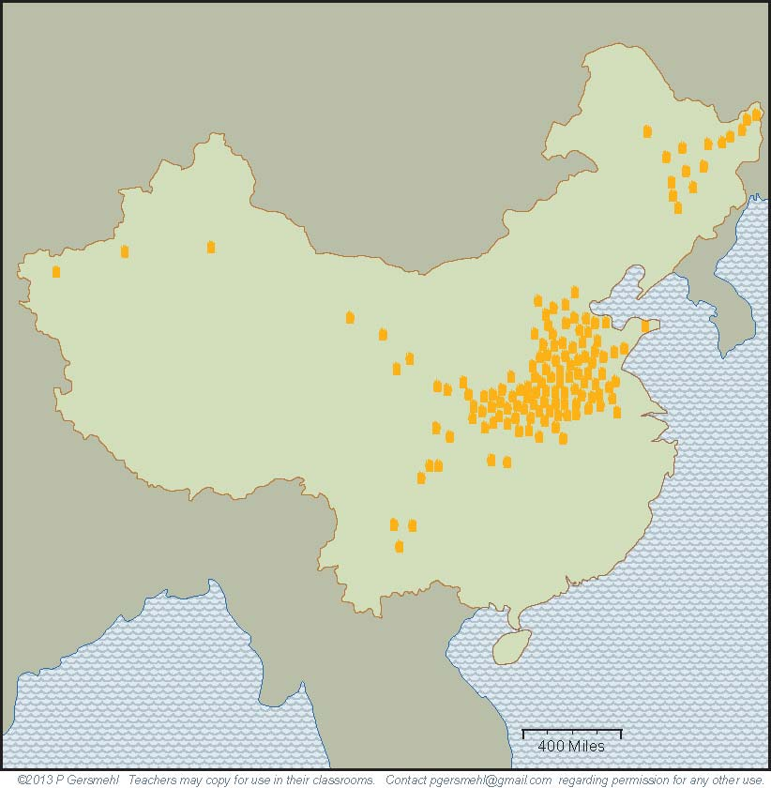
Still farther north,
on the floodplain
of the Huang He,
wheat and millet are
the preferred crops,
and drought is a risk
(in years when the river
does not flood!)

Slide 61
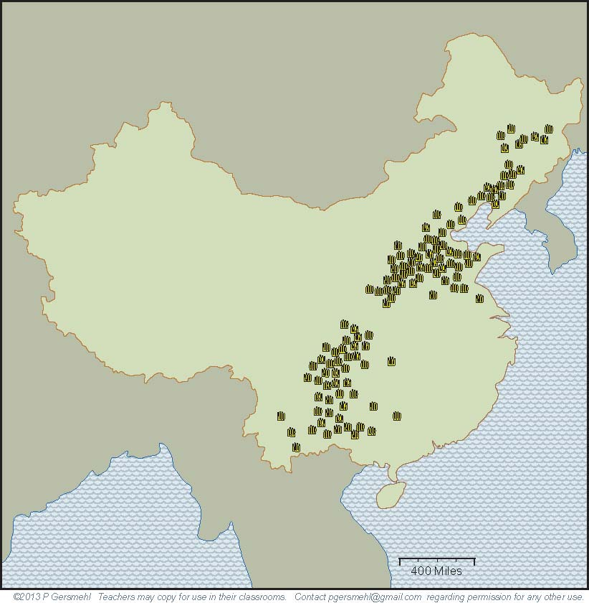
Farther inland,
corn has recently become widely grown.
It has the same use
as in the United States,
as feed for pigs.

Slide 62
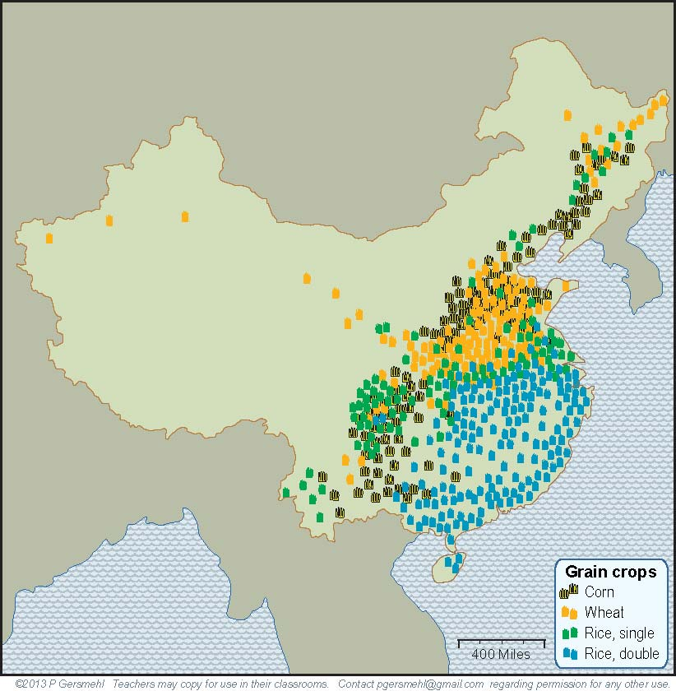
Put all four crops
on one map,
and you see
some overlap,
but you still see
distinct regions.

Slide 63
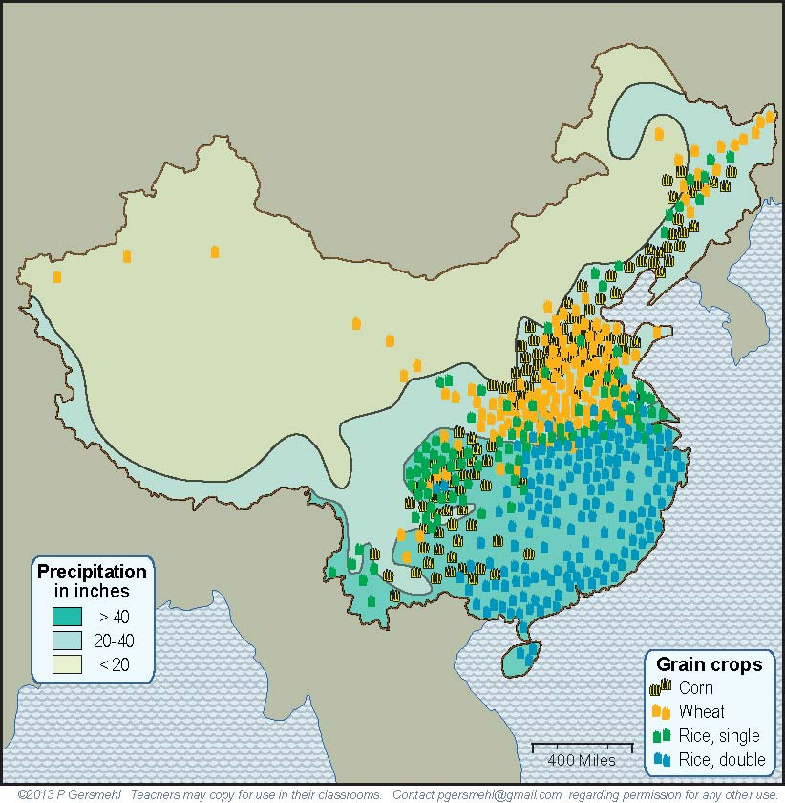
We’ve added a map layer
to show the amount of rain.

Slide 64
Northwestern China is
generally dry, with only a few
small areas of irrigated farming.

Slide 65
Northwestern China is
generally dry, with only a few
small areas of irrigated farming.
This helps explain
why very few people
live out here.

Slide 66
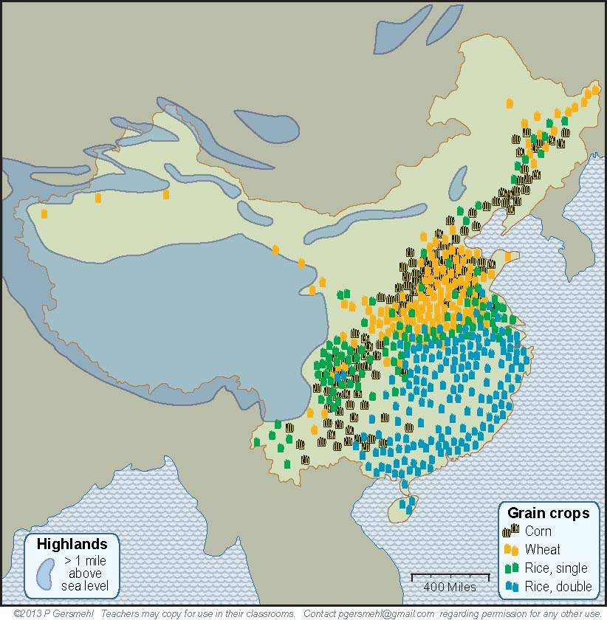
The southwestern area
has another problem -
very high elevation.
These cold mountains
have very little land
that is suitable
for crop farming.

Slide 67
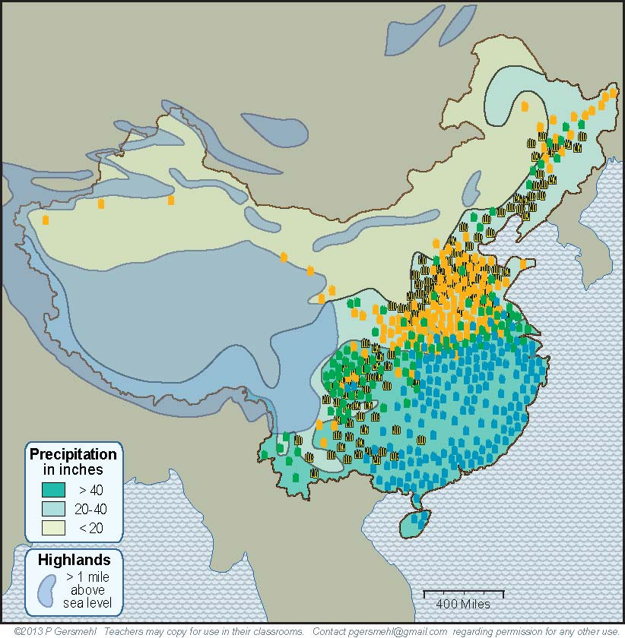
When the map shows
the high areas
and the dry areas,
you can see why China
has only about half
as much good cropland
as the United States.

Slide 68
Remember, China does not have
a West Coast.

Slide 69
And it
does not have
a Great Lakes
farming region.

Slide 70
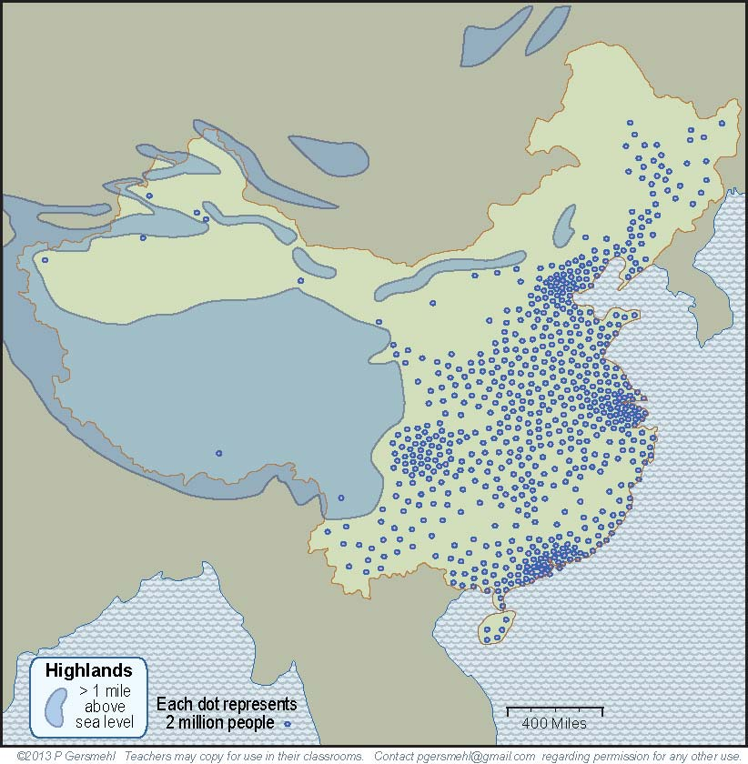
With all of this
as background,
it is easy to see
why the population
is crowded together
in about one-third
of the country.

Slide 71
With all of this
as background,
it is easy to see
why the population
is crowded together
in about one-third
of the country.
What are some
consequences
of a large
but crowded
population?

Slide 72
A large population
(if people work together)
can plan and accomplish
large building projects.

Slide 73
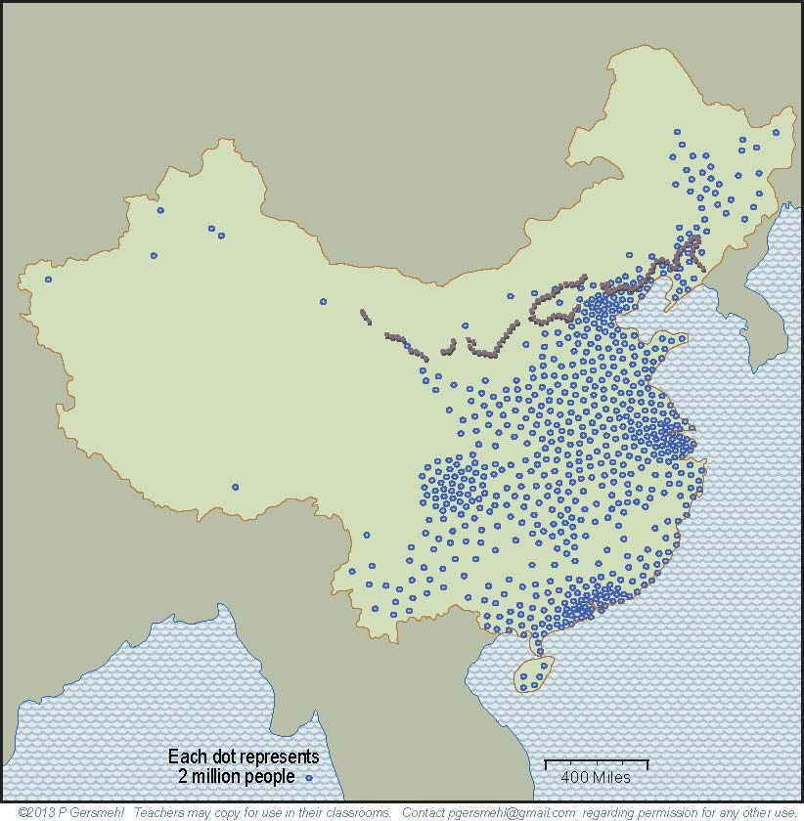
A large population
(if people work together)
can plan and accomplish
large building projects.
Here is the famous
Great Wall of China.
The Chinese people
started building a wall
more than 2000 years ago,
to protect the farm villages
from the nomadic people
who lived in the cold
and dry country
to the north.

Slide 74
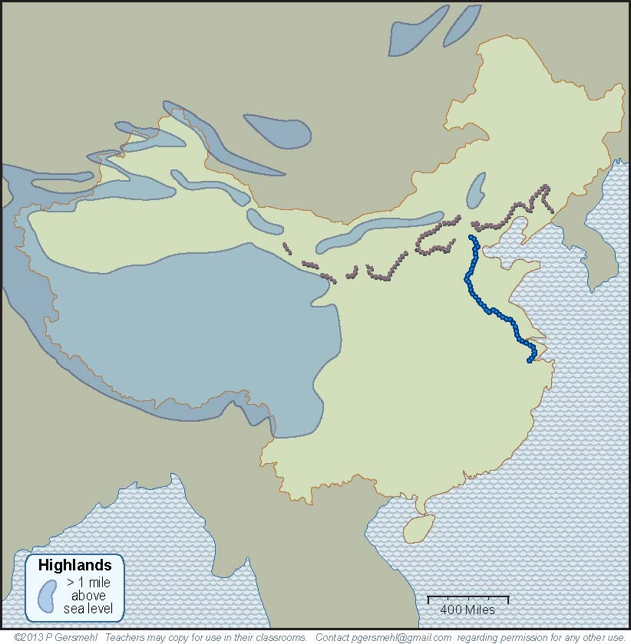
Another important
early project
(also started 2000 years ago)
was the Grand Canal.

Slide 75
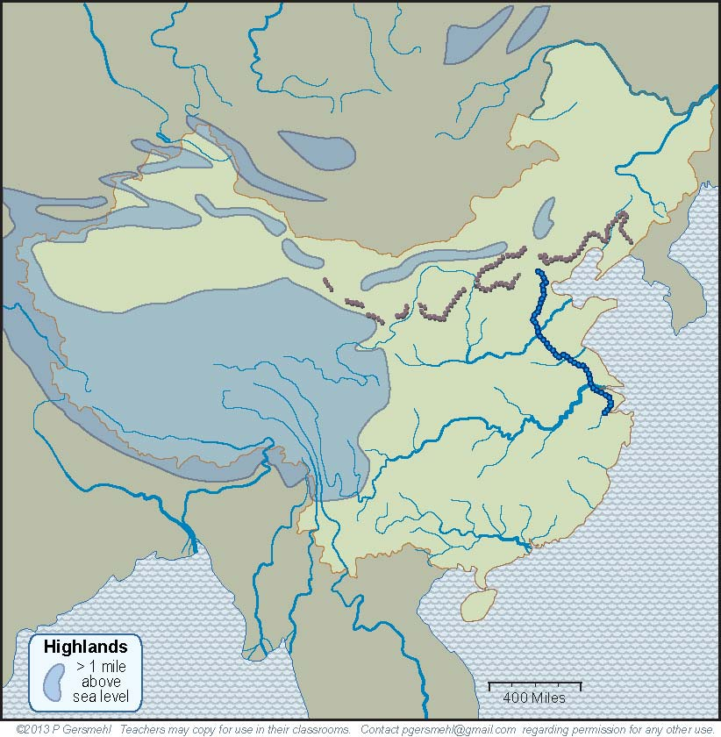
Textbooks usually
describe this canal
as a way for ships
to go between the
two large rivers.

Slide 76
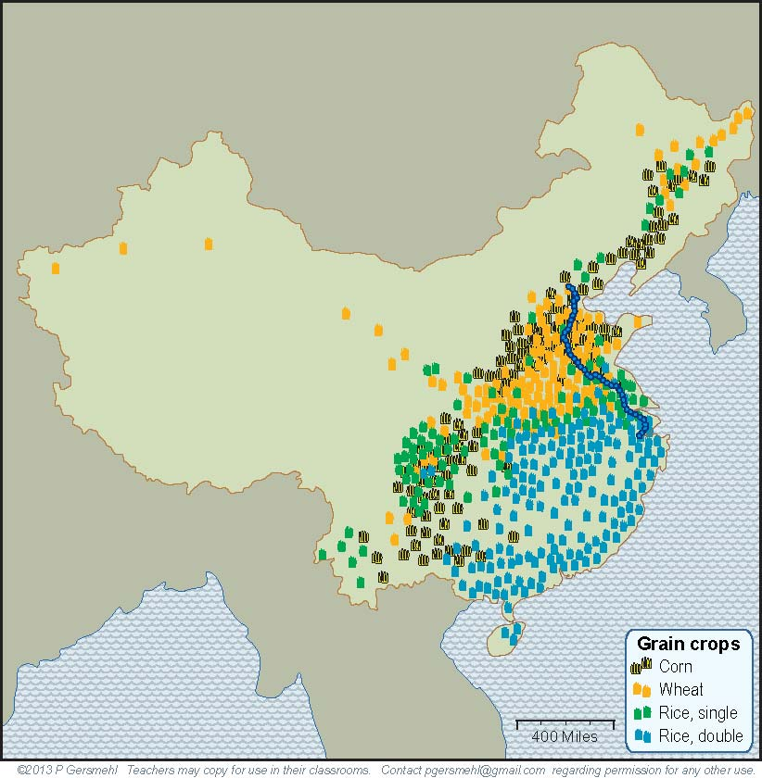
The real purpose
of this long canal,
however, was to
connect regions
that could grow different crops.
The real purpose
of this long canal,
however, was to
connect regions
that could grow different crops.

Slide 77
The real purpose
of this long canal,
however, was to
connect regions
that could grow different crops.
The real purpose
of this long canal,
however, was to
connect regions
that could grow different crops.
If one area had
a crop failure,
people could
use the canal
to move food
from other areas.

Slide 78
In short, it is important
to realize that China
is not homogeneous
(the same everywhere).
All through history,
different parts of China
had different languages,
economies, and lifestyles.
They often cooperated,
but sometimes fought.

Slide 79
In short, it is important
to realize that China
is not homogeneous
(the same everywhere).
All through history,
different parts of China
had different languages,
economies, and lifestyles.
They often cooperated,
but sometimes fought.
What are some
other consequences
of a large population?

Slide 80
A large population is likely to have a lot of smart people
who can invent things. On the internet, you can find many lists
of important Chinese inventions, including silk cloth, paper,
porcelain, magnetic compasses, gunpowder, and rockets.

Slide 81
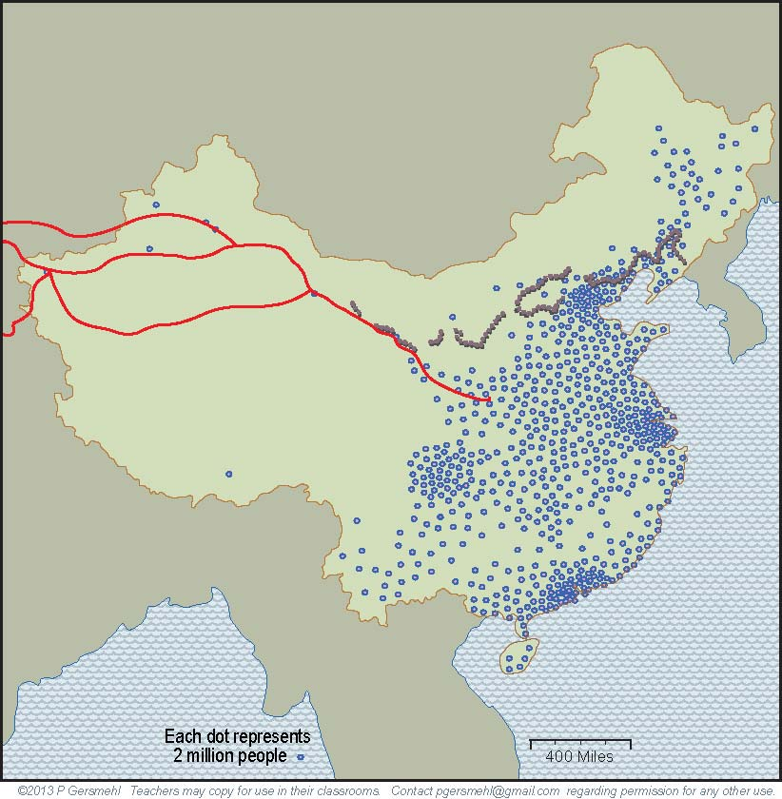
Silk was so important
that it gave its name
to some trading roads
that went all the way
to Rome and Africa,
2000 years ago!

Slide 82
Silk was so important
that it gave its name
to some trading roads
that went all the way
to Rome and Africa,
2000 years ago!
Roman rulers
actually tried to limit
the amount of silk
people could wear –
because they thought
people were spending
too much money buying
imported silk from China!
Do people still say
things like that today?

Slide 83
Silk was so important
that it gave its name
to some trading roads
that went all the way
to Rome and Africa,
2000 years ago!
Roman rulers
actually tried to limit
the amount of silk
people could wear –
because they thought
people were spending
too much money buying
imported silk from China!
Do people still say
things like that today?
Part of the Great Wall
was built to protect
traders on the Silk Roads
from attacks by bandits.

Slide 84
Curriculum note.
There is an activity called “Silk Road Traders.”
Silk was so important
that it gave its name
to some trading roads
that went all the way
to Rome and Africa,
2000 years ago!
Part of the Great Wall
was built to protect
traders on the Silk Roads
from attacks by bandits.

Slide 85
The Silk Roads illustrate another consequence
of a large population –
people often need
to trade products
that they make
in order to get
resources they need
(like horses in ancient times,
or iron or oil today).

Slide 86
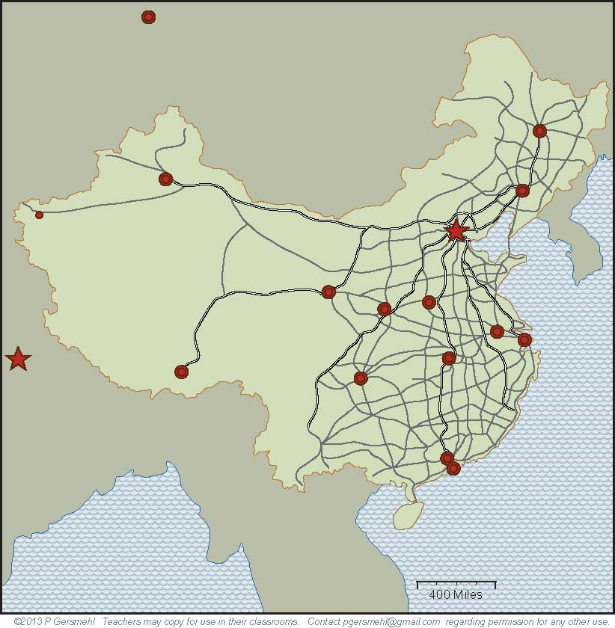
Remember the point
about large populations
being able to do
large building projects?
In just a few years, China has built
a network of highways
with as many miles
as the entire system
of Interstate Highways
in the United States.
(It took nearly 40 years to
build the American system).

Slide 87
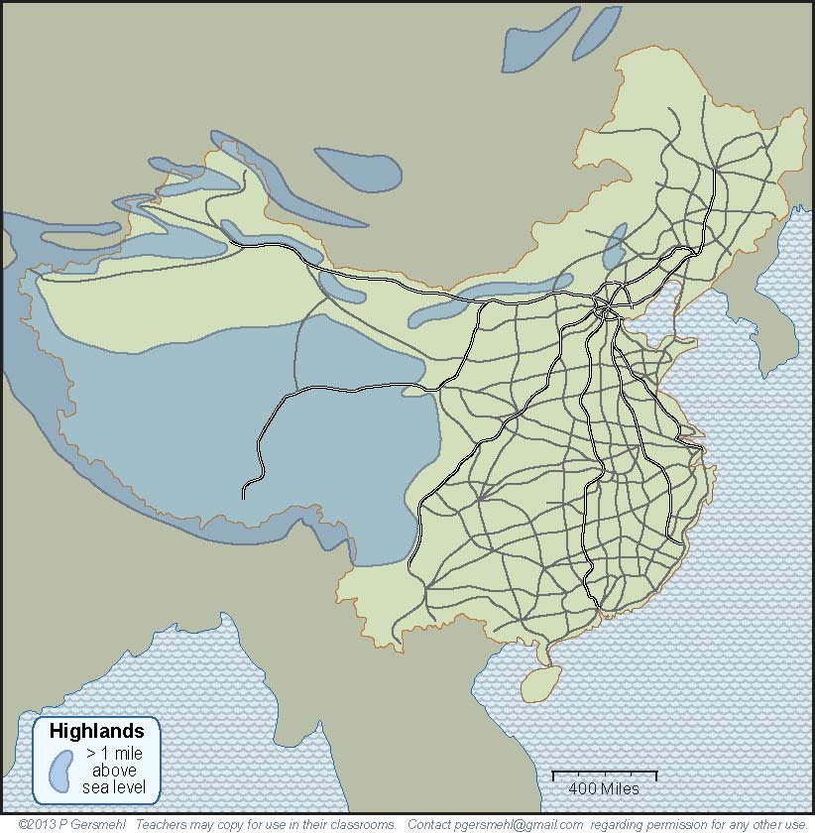
A map of this road system clearly shows how China
is divided into a crowded East and a nearly empty West.

Slide 88
Large populations
have other consequences
that are described in the text.
These include more use of resources,
greater risk of air and water pollution,
origin and rapid spread of disease,
and many complicated effects
on personal freedom.

Slide 89
The big challenge for China
is to maintain economic growth
while limiting the pollution
and other side-effects
of crowded populations.

Slide 90
The big challenge for China
is to maintain economic growth
while limiting the pollution
and other side-effects
of crowded populations.
In the 1970s, the Chinese government
decided to try to limit the growth
of population in the country.
They made a law
that made it illegal for most families
to have more than one child.

Slide 91
This law (the “one-child policy”)
helped trigger an economic boom,
by making it possible for people
to invest money in businesses
(rather than spending it to feed children).

Slide 92
This law (the “one-child policy”)
helped trigger an economic boom,
by making it possible for people
to invest money in businesses
(rather than spending it to feed children).
Now, this policy adds to the challenge,
because the people are getting older.
Every year, there are more old people
for every worker to help support.

Slide 93
This law (the “one-child policy”)
helped trigger an economic boom,
by making it possible for people
to invest money in businesses
(rather than spending it to feed children).
Now, this policy adds to the challenge,
because the people are getting older.
Every year, there are more old people
for every worker to help support.
Definition:
the demographic transition is the change
from high birth rates and short lives
to low birth rates and long lives.
As countries go through this transition,
the average age tends to go up.

Slide 94
This law (the “one-child policy”)
helped trigger an economic boom,
by making it possible for people
to invest money in businesses
(rather than spending it to feed children).
Now, this policy adds to the challenge,
because the people are getting older.
Every year, there are more old people
for every worker to help support.
Definition:
the demographic transition is the change
from high birth rates and short lives
to low birth rates and long lives.
As countries go through this transition,
the average age tends to go up.
Curriculum note.
There is a presentation
and activity about
Population Graphs.

Slide 95
Meanwhile,
the challenge for people in other countries
is to figure out how to grow in a world
where a large, rich country like China
can buy any resource that is in short supply,
such as oil, wood, metal ores, or water.

Slide 96
This presentation showed one way to use
the clickable map of China - to help us investigate
some consequences of the big idea of population density.
Population density has an influence on:

Slide 97
This presentation showed one way to use
the clickable map of China - to help us investigate
some consequences of the big idea of population density.
Population density has an influence on:
Military strength – dense populations are harder to attack,
because they can mobilize more defenders

Slide 98
This presentation showed one way to use
the clickable map of China - to help us investigate
some consequences of the big idea of population density.
Population density has an influence on:
Military strength – dense populations are harder to attack,
because they can mobilize more defenders
Inventions – large populations are more likely to have
many thinkers, artists, inventors, etc.

Slide 99
This presentation showed one way to use
the clickable map of China - to help us investigate
some consequences of the big idea of population density.
Population density has an influence on:
Military strength – dense populations are harder to attack,
because they can mobilize more defenders
Inventions – large populations are more likely to have
many thinkers, artists, inventors, etc.
Construction – large populations are able to provide
plenty of workers for large building projects

Slide 100
This presentation showed one way to use
the clickable map of China - to help us investigate
some consequences of the big idea of population density.
Population density has an influence on:
Military strength – dense populations are harder to attack,
because they can mobilize more defenders
Inventions – large populations are more likely to have
many thinkers, artists, inventors, etc.
Construction – large populations are able to provide
plenty of workers for large building projects
Resource use – more people need more resources to maintain the same living standard

Slide 101
This presentation showed one way to use
the clickable map of China - to help us investigate
some consequences of the big idea of population density.
Population density has an influence on:
Military strength – dense populations are harder to attack,
because they can mobilize more defenders
Inventions – large populations are more likely to have
many thinkers, artists, inventors, etc.
Construction – large populations are able to provide
plenty of workers for large building projects
Resource use – more people need more resources to maintain the same living standard
Disease – diseases can spread quickly through areas that have high population density

Slide 102
This presentation showed one way to use
the clickable map of China - to help us investigate
some consequences of the big idea of population density.
Population density has an influence on:
Military strength – dense populations are harder to attack,
because they can mobilize more defenders
Inventions – large populations are more likely to have
many thinkers, artists, inventors, etc.
Construction – large populations are able to provide
plenty of workers for large building projects
Resource use – more people need more resources to maintain the same living standard
Disease – diseases can spread quickly through areas that have high population density
Personal freedom – dense populations allow individuals less freedom to act without affecting others

Slide 104
Questions section

Slide 105
Why is China a good choice as a “GeoLab”
to study consequences of population density?

Slide 106
What happened near the end
of nearly every major dynasty
in the long history of China?

Slide 107
How does China compare to the United States
in area and in population?

Slide 108
How are
Hong Kong and Miami
similar in location
and in climate?

Slide 109
How are Shanghai and
Savannah, GA,
similar in location
and in climate?

Slide 110
How are the capital cities,
Beijing and
Washington,
similar in location
and in climate?

Slide 111
How are
Shenyang and
Pittsburgh
similar in location
and in climate?

Slide 112
How are
Shenyang and
Pittsburgh
similar in location
and in climate?
In what
other ways
are these
two cities
similar?

Slide 113
How are the cities of Kashgar and Reno, Nevada
similar in location and in climate?
How are they different?

Slide 114
Why doesn’t China
have any places that are like California, Oregon,
Washington, or Alaska?
Notes:
Differences

Slide 115
What other
natural features
are very important
in the United States
but absent in China?

Slide 116
Manchuria
Mongolia
How are China’s “northlands”
(Mongolia and Manchuria)
different from places like
Minnesota, Wisconsin,
Michigan, or Maine?

Slide 117
Manchuria
Mongolia
How are China’s “northlands”
(Mongolia and Manchuria)
different from places like
Minnesota, Wisconsin,
Michigan, or Maine?
Why was this fact important
in the history of China?

Slide 118
Partly because China
has no Great Lakes,
what important
farming region
has no equivalent
in China?

Slide 119
What China does have is four giant river systems.

Slide 120
What China does have is four giant river systems.
What river is
on the border
with Russia?

Slide 121
What China does have is four giant river systems.
What river is
on the border
with Russia?
What does the Chinese word “He” mean?

Slide 122
What China does have is four giant river systems.
What river is
on the border
with Russia?
What does the Chinese word “He” mean?
What does the word “Jiang” mean?

Slide 123
What China does have is four giant river systems.
What river is
on the border
with Russia?
What does the Chinese word “He” mean?
What does the word “Jiang” mean?
What is
the English name
of the Zhu Jiang?

Slide 124
What six cities are
the urban cores of areas
of especially large population?
1
6
2, 3
4, 5

Slide 125
What cities in the United States
have weather conditions
like these Chinese cities?
Beijing
Nanjing,
Shanghai
Chongking
Guangzhou,
Hong Kong

Slide 126
Which of these cities
were the capital of China
at some time in the past?

Slide 127
What food crop
grows in this area?
What environmental
conditions favor
its production?

Slide 128
What food crop
grows in this area?
What environmental
conditions favor
its production?

Slide 129
What food crop
grows in this area?
What environmental
conditions favor
its production?

Slide 130
What food crop
is shown on this map?
What role does it play
in the Chinese diet?

Slide 131
What
generalization
can you make
about food production
in China?

Slide 132
Why is there
such a small amount
of food production in the
northwestern part of China?

Slide 133
How does elevation limit food production
in the southwestern part of China?

Slide 134
When the map shows
the high areas
and the dry areas,
you can see that China
has only about half
as much good cropland
as the United States.

Slide 135
What major
food-producing area
does the United States
have in this general position?

Slide 136
What feature
does the
United States
have in this area
to enhance
food production?

Slide 137
What important
building project
is shown on this map?
Why is it located
where it is?

Slide 138
What important
building project
is this?
Why is it located
where it is?

Slide 139
Textbooks usually
describe this canal
as a way for ships
to go between the
two large rivers.

Slide 140
What is the value
of a ship canal
that connects
these areas?

Slide 141
What important ancient feature is represented
by these red lines?

Slide 142
What important ancient feature is represented
by these red lines?
What is the relationship
between these
building projects?

Slide 143
What important ancient feature is represented
by these red lines?
What is the relationship
between these
building projects?
List several impacts
that the Silk Roads had
on the Roman Empire.

Slide 144
Compare
the road network
shown on this map
with the system of
Interstate Highways
in the United States.

Slide 145
What are some relationships between terrain,
precipitation, population, and highways in China?

Slide 146
What are some other consequences
of large populations?
What did Chinese rulers do
to try to limit population growth?
How effective was this policy?

Slide 147
What is the
Demographic Transition?
Why is this change
especially important
in China today?

Slide 148
What is the
Demographic Transition?
Why is this change
especially important
in China today?
Definition:
the demographic transition is the change
from high birth rates and short lives
to low birth rates and long lives.
As countries go through this transition,
the average age tends to go up.

Slide 149
What are some challenges
posed by the large population of China . . .
to China itself?
to other countries?

Slide 150
Here are a few questions for individual inquiry:
1. Why could ancient China have many more people than Egypt?
2. What is the importance of the Grand Canal in China?
3. What major religions started in China long ago?
4. How could the Silk Road aid the spread of disease to Europe?
5. Who was Admiral Zheng He and why was he important?
6. What are some good and bad effects of the one-child policy?
7. What was the importance of the Great Cultural Revolution?
8. What is China doing about global warming?

Slide 152
Copyright 2019, Phil and Carol Gersmehl
Teachers who saw this presentation at a workshop
or downloaded it from our internet site have permission
to make a copy on their own computers for these purposes:
1. to help them review the workshop,
2. to show the presentation in their own classrooms, at sessions they present at teacher conferences, or to administrators in their own school or district,
3. to use individual frames (with attribution) in their own class or conference presentations.
For permission for any other use,
including posting frames on a personal blog or uploading to any network or website that can be accessed from outside your school,
contact pgersmehl@gmail.com

