Slide 1
AREA A geographic “Big IDEA” with many consequences IN Russia
Area (size) is a big idea that can help us understand many other geographic features in Russia,
including mineral wealth, sparse population,
costly transportation, late development as a country,
ability to resist invasion, persistence of nomadic herders,
and difficulty in governing.

Slide 2
Note to Teachers
1. This presentation has a specific purpose. It is designed as an illustrated teacher guide to provide content background
about the “layers of information” on the clickable map of Russia.
It is not designed for use in class “as is” – to tailor it for a specific class, you might shorten it, edit frames, add pictures or discussion questions, etc.
(see below)
2. This presentation has two parts – explanation and question. You can cut-and-paste to put question frames where you want them in order to promote class discussion or identify misconceptions.
The question frames can also serve as reviews, assessments,
or prompts for inquiry activities (individual or group).
3. This presentation is much too long. There is a good reason for this – your computer has a DELETE key,
but it does not have a CREATE key.
This is important, because many teachers have reviewed this presentation. If anyone suggested an addition (like a definition, explanation, or example), we usually put it in – because other teachers might also find it useful,
and it takes much less time to delete a frame than to make one!
(PS. You can delete this frame now!)
?
DELETE

Slide 3
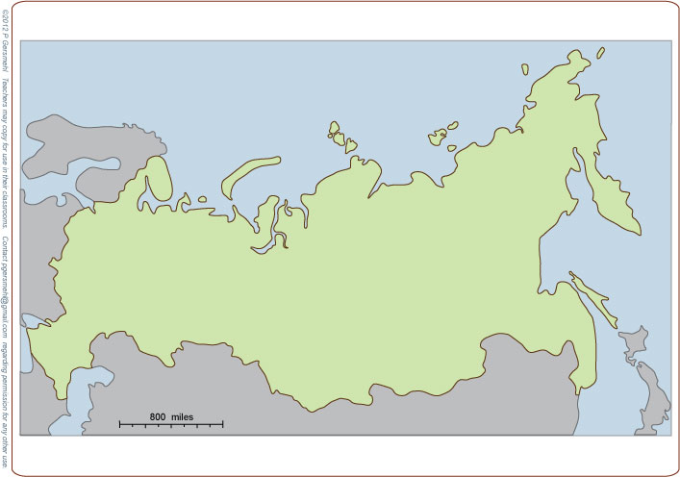
Russia is big
(much larger than China and the U.S.
put together)

Slide 4
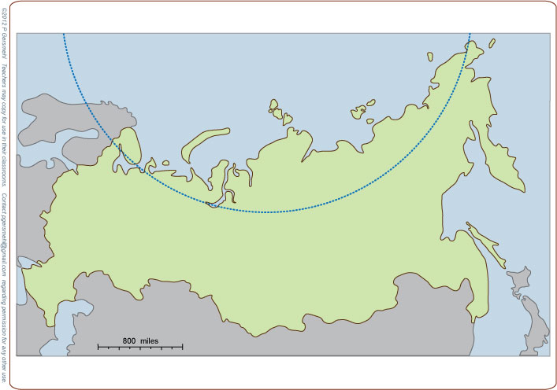
Russia is also
very far north
(nearly a quarter of it is
north of the Arctic Circle)

Slide 5
Russia is also
very far north
(nearly a quarter of it is
north of the Arctic Circle)
All of that area has
at least one day with
24 hours of darkness
in winter – it’s cold!

Slide 6
Russia is also
very far north
(nearly a quarter of it is
north of the Arctic Circle)
All of that area has
at least one day with
24 hours of darkness
in winter – it’s cold!
Curriculum note.
There is an activity called
“Russia Size and
Temperature Range”

Slide 7
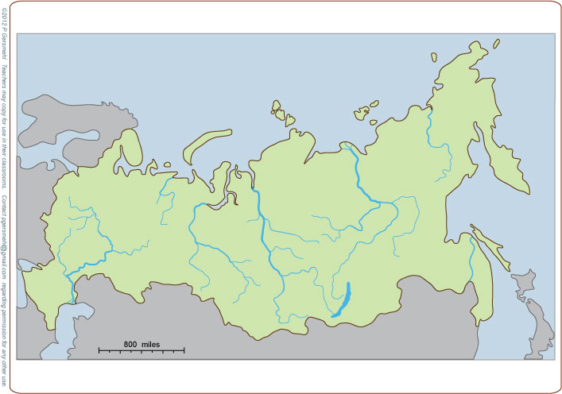
Five giant rivers
flow north to
the Arctic Ocean

Slide 8
Five giant rivers
flow north to
the Arctic Ocean
Kolyma
Lena
Pechora
Yenisei
Ob

Slide 9
Five giant rivers
flow north to
the Arctic Ocean
Kolyma
Lena
Pechora
Yenisei
Ob
Each of these rivers has more water
than the famous Nile River in Egypt,
or the Missouri in North America,
or the Rhine in Europe.

Slide 10
Kolyma
Lena
Pechora
Yenisei
Ob
Very few people live
near these rivers,
however, because
it is so cold there.
Each of these rivers has more water
than the famous Nile River in Egypt,
or the Missouri in North America,
or the Rhine in Europe.

Slide 11
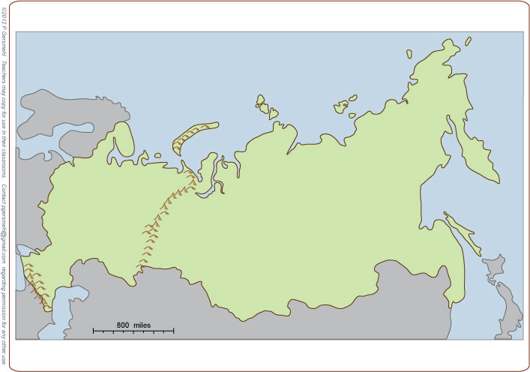
The Ural Mountains
form part of the border between
Europe and Asia.

Slide 12
These mountains are the worn-down
“stumps” of ancient
crustal collisions.

Slide 13
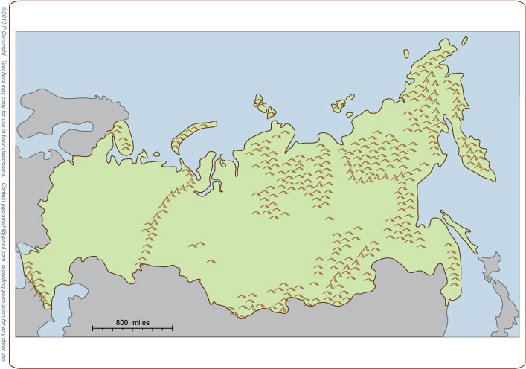
Farther east are the remnants
of several even
older collisions.

Slide 14
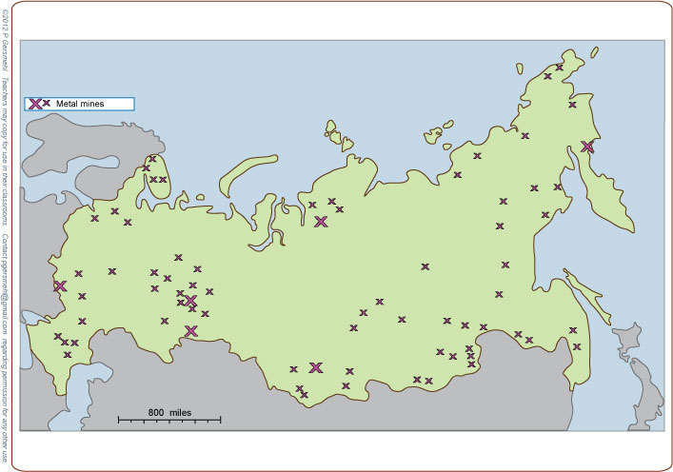
This long and complex geologic history gave
this enormous country
even more minerals
than you might expect
based only on its size.

Slide 15
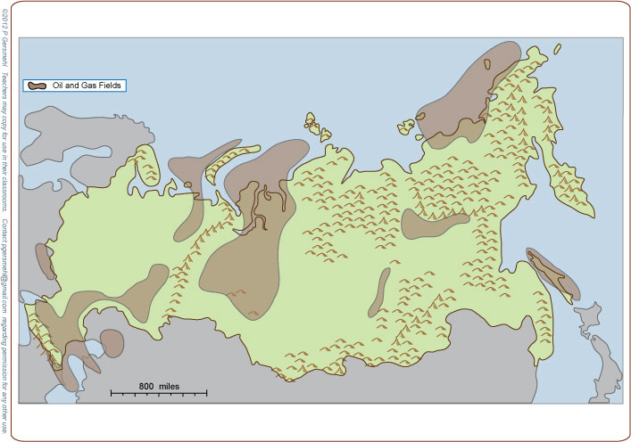
Between those
ancient mountains
are several huge
oil and gas fields.

Slide 16
Between those
ancient mountains
are several huge
oil and gas fields.
Curriculum note.
There is a presentation and clickable map called
“World Economic Geology”

Slide 17
This is what you should expect:
big country, big resources,
BUT . . .

Slide 18
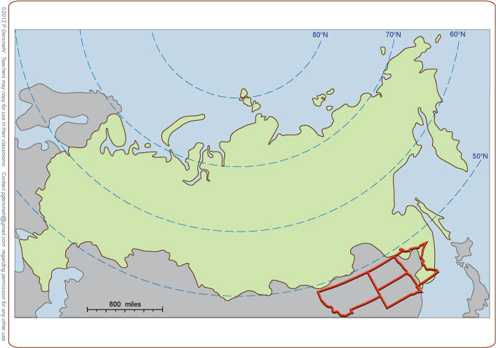
The resources can be hard to get,
because nearly all of Russia is
much farther from the equator
than Montana, the Dakotas,
or Minnesota.

Slide 19
The resources can be hard to get,
because nearly all of Russia is
much farther from the equator
than Montana, the Dakotas,
or Minnesota.
That’s cold !

Slide 20
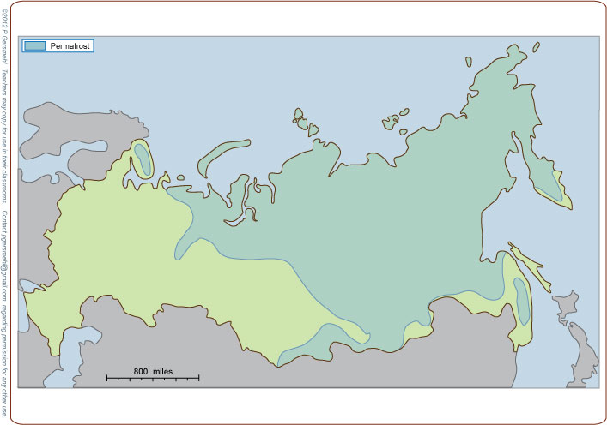
In fact, the soil
in more than half of Russia is permanently frozen.
(It’s called permafrost.)

Slide 21
In fact, the soil
in more than half of Russia is permanently frozen.
(It’s called permafrost.)
Definition: permafrost is
a thick layer of soil and broken rock
that remains permanently frozen
even while a thin surface layer
thaws during the short summer

Slide 22
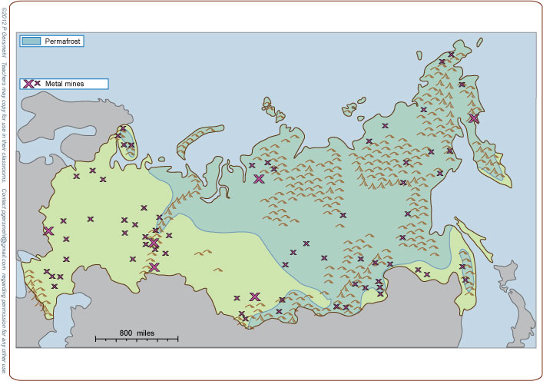
Add the transportation problems caused by the ancient mountains
and the sheer size of the country,
and you can see why
it is really hard to get some of those minerals.

Slide 23
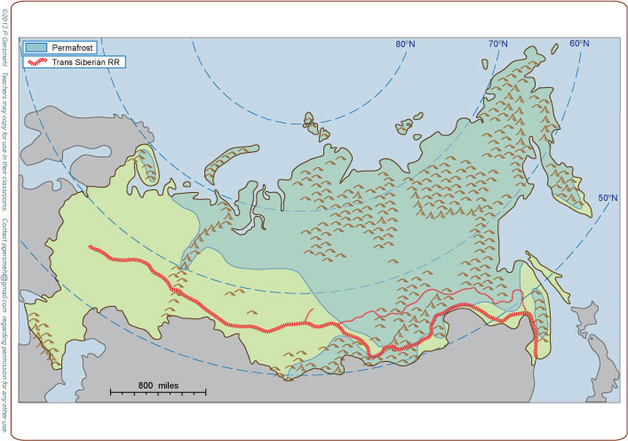
The Trans-Siberian Railroad
from Moscow to Vladivostok was a difficult and expensive engineering job.
M
V

Slide 24
The Trans-Siberian Railroad
from Moscow to Vladivostok was a difficult and expensive engineering job.
M
V
P.S. Vladivostok
means “East City”

Slide 25
This railroad had four problems:
1. the great size of the country
2. rugged terrain
3. permafrost
4. sparse population
(few people to pay for track or operation)
M
V

Slide 26
This railroad had four problems:
1. the great size of the country
2. rugged terrain
3. permafrost
4. sparse population
(few people to pay for track or operation)
M
Project idea: You might compare
the Trans-Siberian Railroad
with the Trans-Canada railroad
or the Trans-continental Railroad
in the United States.
One main purpose of each project
was to help link a large country together.
V

Slide 27
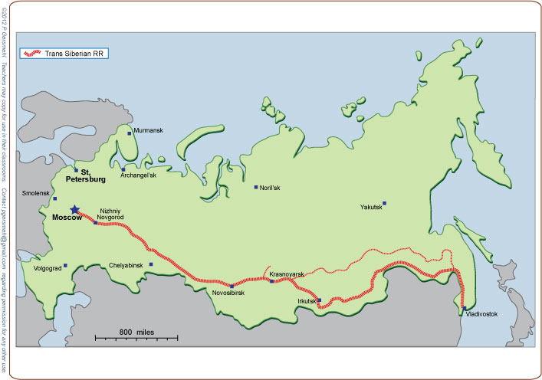
The long Trans-Siberian RR
goes through the major cities of southern Siberia.

Slide 28
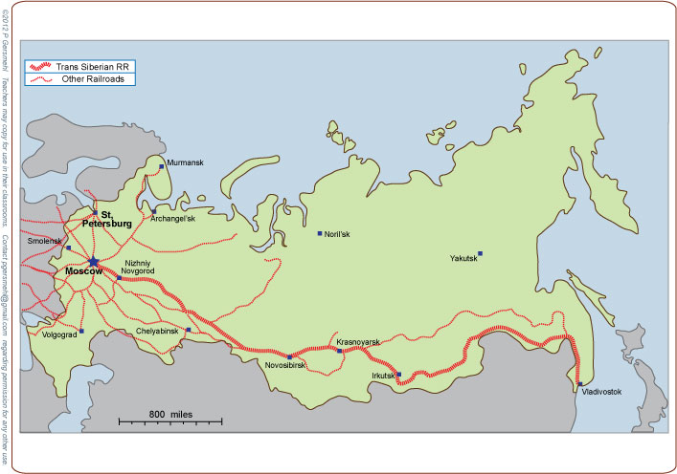
Most of the other railroads
are built around Moscow
in a radial pattern, like
spokes on a bicycle wheel.

Slide 29
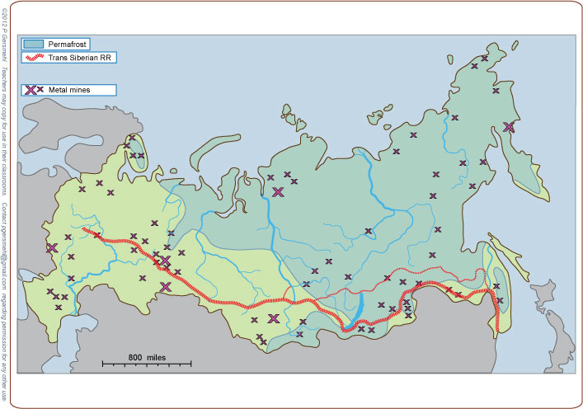
The Trans-Siberian Railroad
does go near the metal mines in the southern Ural Mountains,
but many minerals farther east
are still more than 500 miles
from any road or railroad.

Slide 30
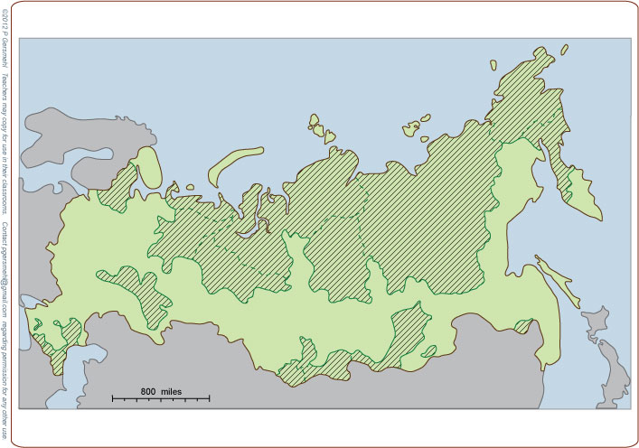
In fact, many of the minerals are on land occupied by people
who live inside Russia
but are not Russian.
These are called autonomous (self-governing) ethnic areas.

Slide 31
In fact, many of the minerals are on land occupied by people
who live inside Russia
but are not Russian.
These are called autonomous (self-governing) ethnic areas.
Curriculum note.
There is a presentation,
activity, and clickable map
“Russia Spread to Pacific”

Slide 32
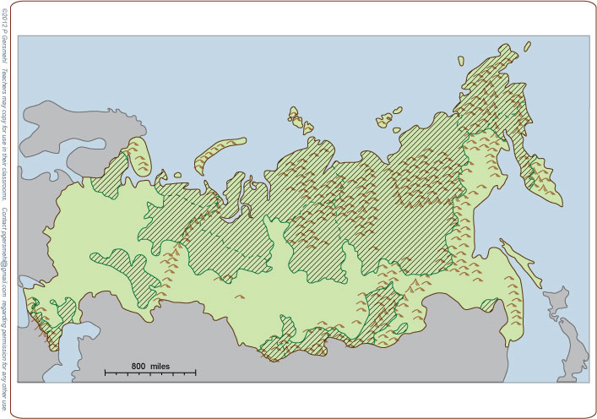
Much of the land
in the autonomous areas
is cold, mountainous, or both.

Slide 33
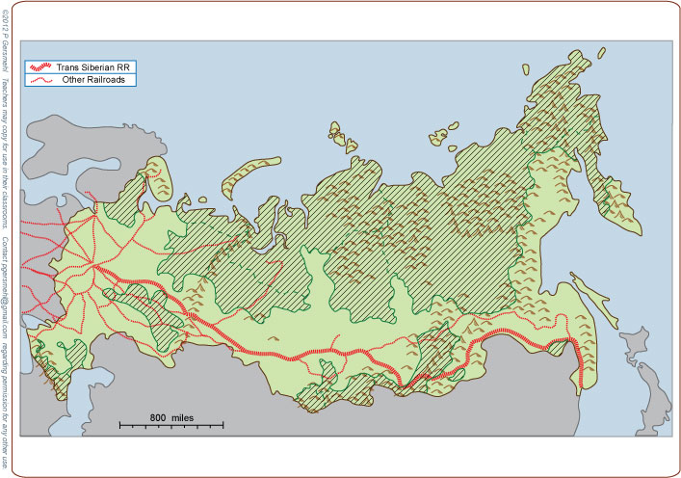
Many of these
autonomous areas
cannot be reached
by road or railroad.

Slide 34
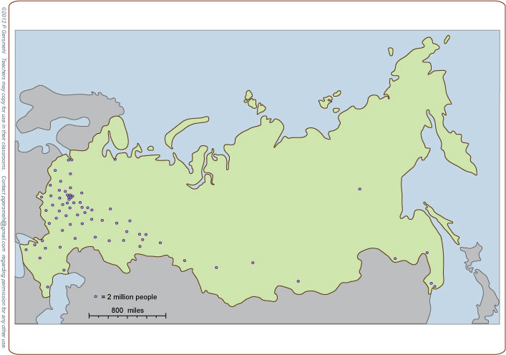
The autonomous areas
have very few people.
Most of Russia’s population
is in the southwestern part
of this huge country.

Slide 35
The autonomous areas
have very few people.
Most of Russia’s population
is in the southwestern part
of this huge country.
This leads logically
to one more consequence
of geographic size.

Slide 36
Many history books describe
how its size and cold climate
helped Russia resist invasions,
by Mongols from the east,
Huns and Crimeans from the south,
and Napoleon and the Nazis from the west.

Slide 37
This map, however, shows why
this “success” came at great cost.
The recent invasions crossed areas
where almost half of the people
in this huge country lived.

Slide 38
This map, however, shows why
this “success” came at great cost.
The recent invasions crossed areas
where almost half of the people
in this huge country lived.
In World War II, for example,
more than 22 million people
died in the Soviet Union.
For comparison, the United States had
about 430,000 men and women killed.
That’s a great loss, but the USSR lost
about 50 times as many people!

Slide 39
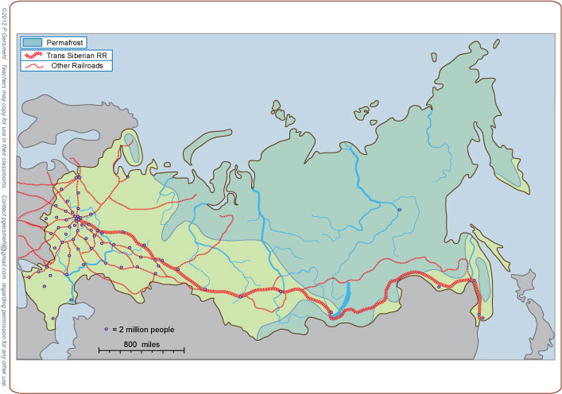
Even today, most people in Russia live
near or south of the Trans-Siberian railroad.
In spite of government programs to encourage
people to move to places farther from the railroad,
the permafrost areas remain nearly empty.

Slide 40
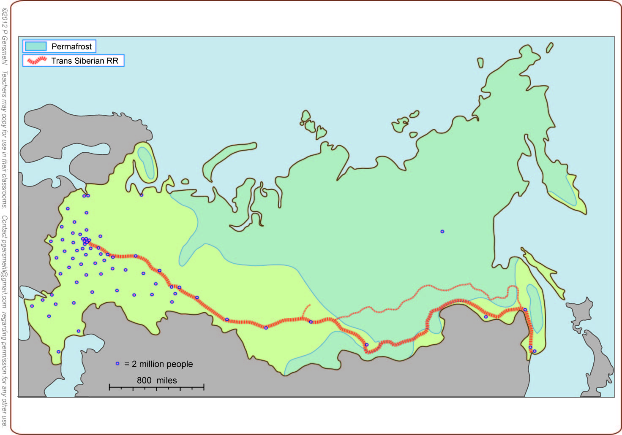
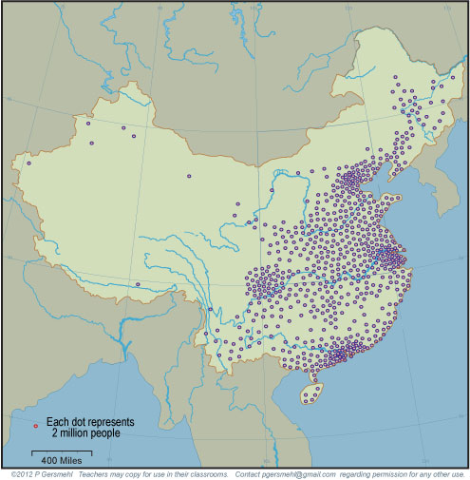
Here is a useful comparison:
China has nearly ten times
as many people, packed
into one-third of a country
that is less than half as big.

Slide 41
This is the geographic basis for what may become
one of the most important international issues
in the last half of the 21st century.
One of the world’s longest borders separates:
China (a very crowded country
with a rapidly growing economy
that needs more and more resources)
and
Russia (a huge country
with a lot of resources but relatively few people).

Slide 42
This presentation showed one way to use
the clickable map of Russia - to help us investigate
some consequences of the big idea of size.
The size of a country can affect:

Slide 43
This presentation showed one way to use
the clickable map of Russia - to help us investigate
some consequences of the big idea of size.
The size of a country can affect:
Climate – because a large area tends to have
more extreme temperatures and less precipitation.

Slide 44
This presentation showed one way to use
the clickable map of Russia - to help us investigate
some consequences of the big idea of size.
The size of a country can affect:
Climate – because a large area tends to have
more extreme temperatures and less precipitation.
Mineral resources – because a large area was probably
“put together” by crustal collisions
that also tend to make metal ores

Slide 45
This presentation showed one way to use
the clickable map of Russia - to help us investigate
some consequences of the big idea of size.
The size of a country can affect:
Climate – because a large area tends to have
more extreme temperatures and less precipitation.
Mineral resources – because a large area was probably
“put together” by crustal collisions
that also tend to make metal ores
Transportation – because it costs more to serve
a larger area with roads and railroads

Slide 46
This presentation showed one way to use
the clickable map of Russia - to help us investigate
some consequences of the big idea of size.
The size of a country can affect:
Climate – because a large area tends to have
more extreme temperatures and less precipitation.
Mineral resources – because a large area was probably
“put together” by crustal collisions
that also tend to make metal ores
Transportation – because it costs more to serve
a larger area with roads and railroads
Land use planning – because it costs more to gather
information about a larger area

Slide 47
This presentation showed one way to use
the clickable map of Russia - to help us investigate
some consequences of the big idea of size.
The size of a country can affect:
Climate – because a large area tends to have
more extreme temperatures and less precipitation.
Mineral resources – because a large area was probably
“put together” by crustal collisions
that also tend to make metal ores
Transportation – because it costs more to serve
a larger area with roads and railroads
Land use planning – because it costs more to gather
information about a larger area
Defense – because people who occupy a large area
have more room to retreat and regroup,
while the supply lines of invaders are stretched

Slide 49
Here are two optional postscripts,
followed by the questions section.
Postscript 1 – about the end of the Cold War
Postscript 2 – about Arctic rivers

Slide 50
Optional postscript 1 - about the end of the Cold War
There are some people
who seem to think that the Soviet Union fell apart
only because it was unable to compete with the U.S.
They say the Communist planned economy of the USSR
was inherently less productive than a capitalist system.

Slide 51
Optional postscript 1 - about the end of the Cold War
There are some people
who seem to think that the Soviet Union fell apart
only because it was unable to compete with the U.S.
They say the Communist planned economy of the USSR
was inherently less productive than a capitalist system.
As a highly placed American government official said:
“It is the basic superiority of the capitalist system
that allows American farmers to out-produce
their Russian counterparts – as a result,
they have to buy emergency food from us.”
We sold them 50 million tons of grain that year.

Slide 52
“The Soviet Union fell apart
because a Communist planned economy is inherently
less productive than a capitalist system.”
This statement is partly true.
Soviet agriculture was notoriously inefficient.
But that is not the whole truth,
and it is a huge mistake
to think it is the whole truth.

Slide 53
Remember . . .
Nearly all of Russia is
farther from the equator
than Montana, the Dakotas,
or Minnesota.

Slide 54
Remember . . .
Nearly all of Russia is
farther from the equator
than Montana, the Dakotas,
or Minnesota.
And this area gets less rain
than western Kansas.

Slide 55
Remember . . .
Nearly all of Russia is
farther from the equator
than Montana, the Dakotas,
or Minnesota.
And this area gets less rain
than western Kansas.
And this area is mostly high mountains.

Slide 56
In other words,
nearly all Russian farmers
are working with land that is like North Dakota,
(or even colder and drier).
Is it reasonable to think that they can produce
as much per acre as farmers in Iowa, California, or Texas?

Slide 57
In other words,
nearly all Russian farmers
are working with land that is like North Dakota,
(or even colder and drier).
Is it reasonable to think that they can produce
as much per acre as farmers in Iowa, California, or Texas?
And even if they have
a really good year,
their transportation
is much more expensive,
because Russia is so big.

Slide 58
The Main Point of This Postscript:
To be effective, foreign policy must be based
on the realization that most things in the world
have multiple causes and complicated effects.

Slide 59
The Main Point of This Postscript:
To be effective, foreign policy must be based
on the realization that most things in the world
have multiple causes and complicated effects.
In this case,
the “competition” between American and Russian farmers
was NOT just about capitalism versus communism.
It was also about differences in soil and climate.

Slide 60
The Main Point of This Postscript:
To be effective, foreign policy must be based
on the realization that most things in the world
have multiple causes and complicated effects.
In this case,
the “competition” between American and Russian farmers
was NOT just about capitalism versus communism.
It was also about differences in soil and climate.
And the “winner”
was not just a free market,
or a strong President –
it was also a better environment
and cheaper transportation.

Slide 61
The Main Point of This Postscript:
To be effective, foreign policy must be based
on the realization that most things in the world
have multiple causes and complicated effects.
The key to success in foreign policy
is to figure out how important
each of those influences was –
because there was more than one simple reason for the end of the Cold War.

Slide 62
The second postscript
is about Arctic Rivers.

Slide 63
As we said earlier,
Russia has five giant rivers
that flow north to the Arctic Ocean.
Kolyma
Lena
Pechora
Yenisei
Ob

Slide 64
In autumn, the northern “ends”
of these rivers freeze up
several weeks before
their southern “beginnings.”
Kolyma
Lena
Pechora
Yenisei
Ob

Slide 65
In autumn, the northern “ends”
of these rivers freeze up
several weeks before
their southern “beginnings.”
In winter, the frozen rivers
can actually be used as roads, even for big trucks.
Kolyma
Lena
Pechora
Yenisei
Ob

Slide 66
In autumn, the northern “ends”
of these rivers freeze up
several weeks before
their southern “beginnings.”
In winter, the frozen rivers
can actually be used as roads, even for big trucks.
Then, in spring, the southern parts
of the rivers begin to flow
while the northern parts are still frozen.
Kolyma
Lena
Pechora
Yenisei
Ob

Slide 67
In autumn, the northern “ends”
of these rivers freeze up
several weeks before
their southern “beginnings.”
In winter, the frozen rivers
can actually be used as roads, even for big trucks.
Then, in spring, the southern parts
of the rivers begin to flow
while the northern parts are still frozen.
As a result,
these rivers make huge floods across the frozen land.
Kolyma
Lena
Pechora
Yenisei
Ob

Slide 68
In autumn, the northern “ends”
of these rivers freeze up
several weeks before
their southern “beginnings.”
In winter, the frozen rivers
can actually be used as roads, even for big trucks.
Then, in spring, the southern parts
of the rivers begin to flow
while the northern parts are still frozen.
As a result,
these rivers make huge floods across the frozen land.
Kolyma
Lena
Pechora
Yenisei
These floods make it even less likely
that many people would live there
(and even harder to get
the oil and minerals out
to the world markets).
Ob

Slide 70
Questions Section

Slide 71
What is a consequence
for a place that is located
north of the Arctic Circle?

Slide 72
Kolyma
Lena
Pechora
Yenisei
Ob
Why do very few people
live near the five giant rivers
that flow northward in Russia?

Slide 73
What mountains
form part of the border between
Europe and Asia?

Slide 74
What is the
geologic history
of these mountains?

Slide 75
Farther east are the remnants
of several even
older collisions.

Slide 76
Farther east are the remnants
of several even
older collisions.
What is
an economic
consequence
of this history?

Slide 77
How does Russia’s
mineral resources
compare with
the rest of the world?

Slide 78
What often forms
in the low areas
around formerly
separate crustal plates?

Slide 79
How does the latitude
of Russia compare
to the United States?

Slide 80
How does the latitude
of Russia compare
to the United States?
What is a consequence
of this latitudinal position?

Slide 81
What is the term for soil
that is permanently frozen
below a thin surface layer
that occasionally thaws?

Slide 82
What is the term for soil
that is permanently frozen
below a thin surface layer
that occasionally thaws?
Definition: permafrost is
a thick layer of soil and broken rock
that remains permanently frozen
even while a thin surface layer
thaws during the short summer

Slide 83
List several reasons why
it is really hard to get some of the minerals
that occur in Russia.

Slide 84
What is the name
of the long railroad that goes
from Moscow to Vladivostok?
M
V

Slide 85
What is the name
of the long railroad that goes
from Moscow to Vladivostok?
Describe some problems
faced by the railroad builders.
M
V

Slide 86
What is the relationship
between the Trans-Siberian RR
and the major cities of southern Siberia?

Slide 87
How would you describe
the pattern of railroads
near the capital of Moscow?

Slide 88
The Trans-Siberian Railroad
goes near these metal mines; what is the name
of this mining district?

Slide 89
What does the darker pattern
represent on this map?

Slide 90
How would you describe
the environmental conditions
in the autonomous areas?

Slide 91
How would you compare
the geographic pattern
of railroads with the pattern
of autonomous ethnic areas?

Slide 92
Why do most Russian people
live in the southwestern part
of this huge country?

Slide 93
What major military powers
invaded Russia from the west
in the last two centuries?

Slide 94
What major military powers
invaded Russia from the west
in the last two centuries?
What were some
consequences
of those invasions?

Slide 95
Compare the populations
of Russia and China.

Slide 96
Compare the populations
of Russia and China.
What are some policy issues
that may arise because
of these differences?

Slide 97
Here are a few questions for individual inquiry:
1. Why do large continents have more extreme temperatures?
2. Why do crustal collisions make mountains (and metal ores)?
3. What major minerals does Russia sell to other countries?
4. What was the importance of fur trapping in Russian history?
5. Why was eastern Russia so vulnerable to invasion?
6. Why did the Trans-Siberian Railroad go so far south?
7. Why is it hard for Russian farmers to compete with farmers in countries in Europe and North America?
8. What is life like for an “ice-road trucker” in Russia?

Slide 99
Copyright 2019, Phil and Carol Gersmehl
Teachers who saw this presentation at a workshop
or downloaded it from our internet site have permission
to make a copy on their own computers for these purposes:
1. to help them review the workshop,
2. to show the presentation in their own classrooms, at sessions they present at teacher conferences, or to administrators in their own school or district,
3. to use individual frames (with attribution) in their own class or conference presentations.
For permission for any other use,
including posting frames on a personal blog or uploading to any network or website that can be accessed from outside your school,
contact pgersmehl@gmail.com

