Slide 1
CULTURAL DIFFERENCES A geographic “big idea” with many consequences in south asia
Cultural differences can help us understand many of the geographic features in South Asia,
including patterns of invasions, language, empires,
British colonialism, cotton production, railroads,
trade, population, post-colonial partition,
and modern territorial disputes.

Slide 2
Note to Teachers
1. This presentation has a specific purpose. It is designed as an illustrated teacher guide to provide content background
about the “layers of information” on the clickable map of South Asia.
It is not designed for use in class “as is” – to tailor it for a specific class, you might shorten it, edit frames, add pictures or discussion questions, etc.
(see below)
2. This presentation has two parts – explanation and question. You can cut-and-paste to put question frames where you want them in order to promote class discussion or identify misconceptions.
The question frames can also serve as reviews, assessments,
or prompts for inquiry activities (individual or group).
3. This presentation is much too long. There is a good reason for this – your computer has a DELETE key,
but it does not have a CREATE key.
This is important, because many teachers have reviewed this presentation. If anyone suggested an addition (like a definition, explanation, or example), we usually put it in – because other teachers might also find it useful,
and it takes much less time to delete a frame than to make one!
(PS. You can delete this frame now!)
?
DELETE

Slide 3
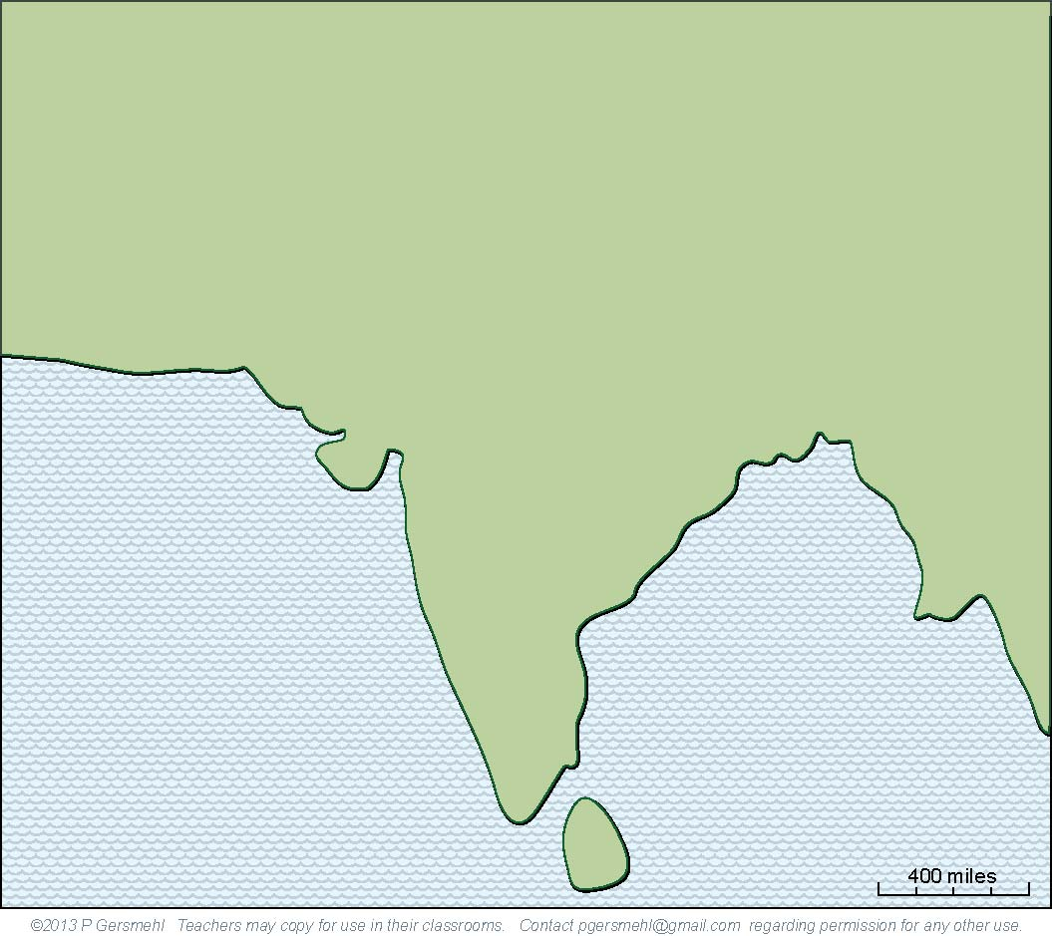
The subcontinent
of South Asia is
about half as large as Europe.

Slide 4
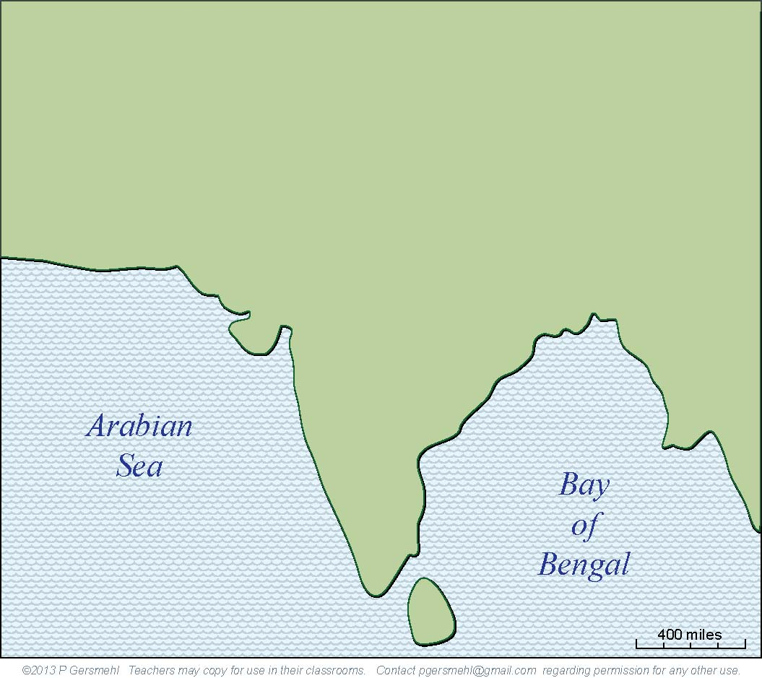
Like Europe, South Asia
is basically a large peninsula.
It extends out from Eurasia
into the Indian Ocean, where
it separates the Arabian Sea
from the Bay of Bengal.

Slide 5
Like Europe, South Asia
is basically a large peninsula.
It extends out from Eurasia
into the Indian Ocean, where
it separates the Arabian Sea
from the Bay of Bengal.
Definition: a peninsula
is like a “finger” of land
(or leg, arm, thumb, nose)
connected to a larger landmass
on one side, and surrounded
by water on the other three sides.

Slide 6
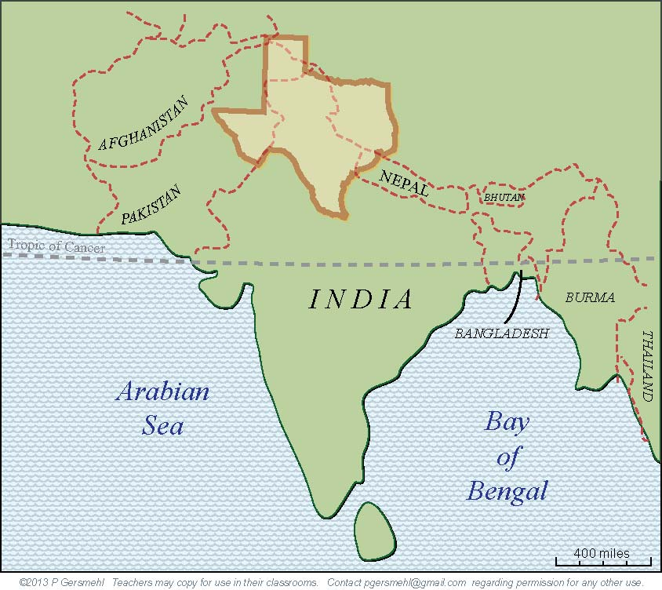
Here is Texas,
at the same scale
and proper latitude.

Slide 7
Here is Texas,
at the same scale
and proper latitude.
You could put about eight states
as big as Texas into South Asia,
BUT
most of South Asia
is closer to the equator
(and therefore hotter)
than South Texas.

Slide 8
Geologically,
South Asia
is a separate
crustal plate.

Slide 9
Geologically,
South Asia
is a separate
crustal plate.
Definition:
a crustal plate is a moving piece
of the rocky outer “shell” of the earth;
the crust is 3-7 miles thick under oceans
and 15-35 miles thick under continents.

Slide 10
Geologically,
South Asia
is a separate
crustal plate.
In fact,
South Asia
used to be
connected to
Antarctica,
Australia,
and Africa.

Slide 11
Geologically,
South Asia
is a separate
crustal plate.
In fact,
South Asia
used to be
connected to
Antarctica,
Australia,
and Africa.
Now, it is moving
northward
at a speed
of about
2 inches
per year.

Slide 12
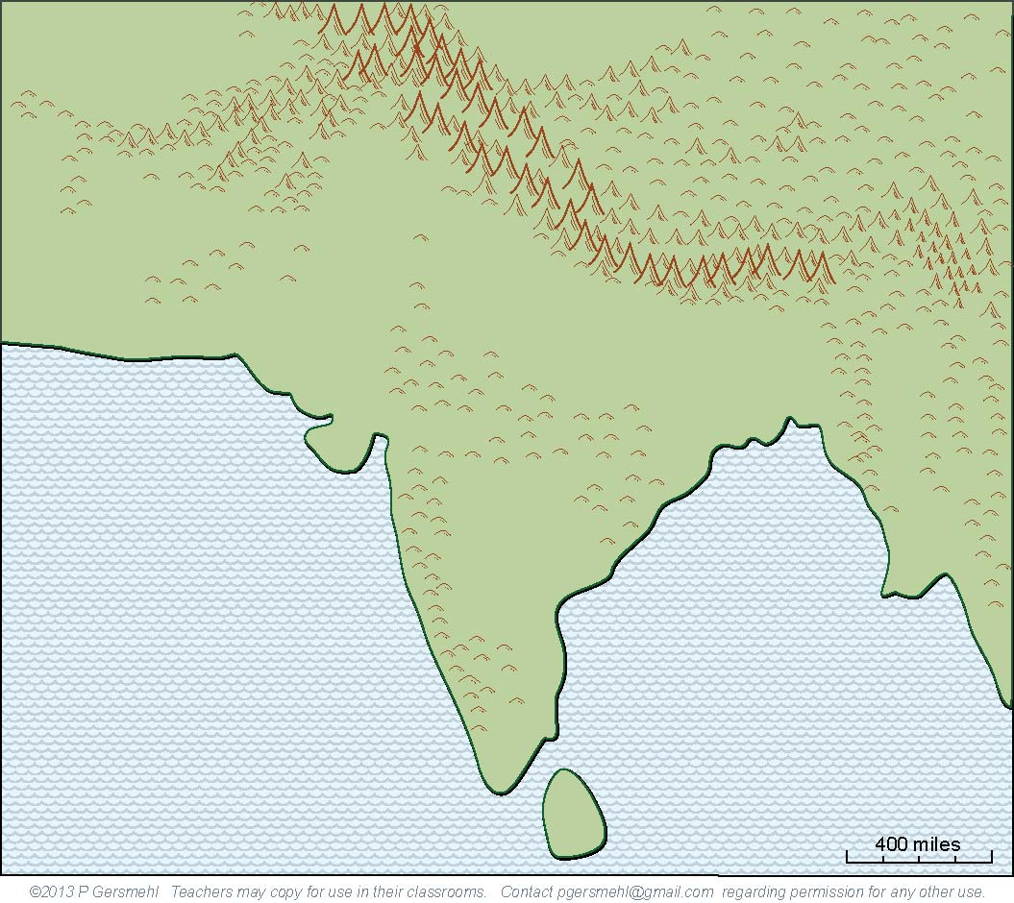
That is about as fast
as fingernails grow,
but it is very fast
(for a geologic process).

Slide 13
That is about as fast
as fingernails grow,
but it is very fast
(for a geologic process).
It is fast enough
to push up
the highest
mountain range
in the world.

Slide 14
That is about as fast
as fingernails grow,
but it is very fast
(for a geologic process).
It is fast enough
to push up
the highest
mountain range
in the world.
Curriculum note.
There is a student activity called
“Where are the mountains?”

Slide 15
The Himalaya Mountains
average more that four miles high.
The highest peaks are
almost twice as high
as the tallest mountains
in Colorado or California.

Slide 16
That is high enough
to block the jet stream,
the west-to-east flow of air
high in the atmosphere.
The jet stream has to go
around the mountains.

Slide 17
That is high enough
to block the jet stream,
the west-to-east flow of air
high in the atmosphere.
The jet stream has to go
around the mountains.
This combination of conditions
jet stream + mountains
is what causes
the famous Indian monsoon.

Slide 18
That is high enough
to block the jet stream,
the west-to-east flow of air
high in the atmosphere.
The jet stream has to go
around the mountains.
This combination of conditions
jet stream + mountains
is what causes
the famous Indian monsoon.
Definition: a monsoon is
a seasonal reversal of wind direction
that brings heavy rain in summer
and dry weather in winter.

Slide 19
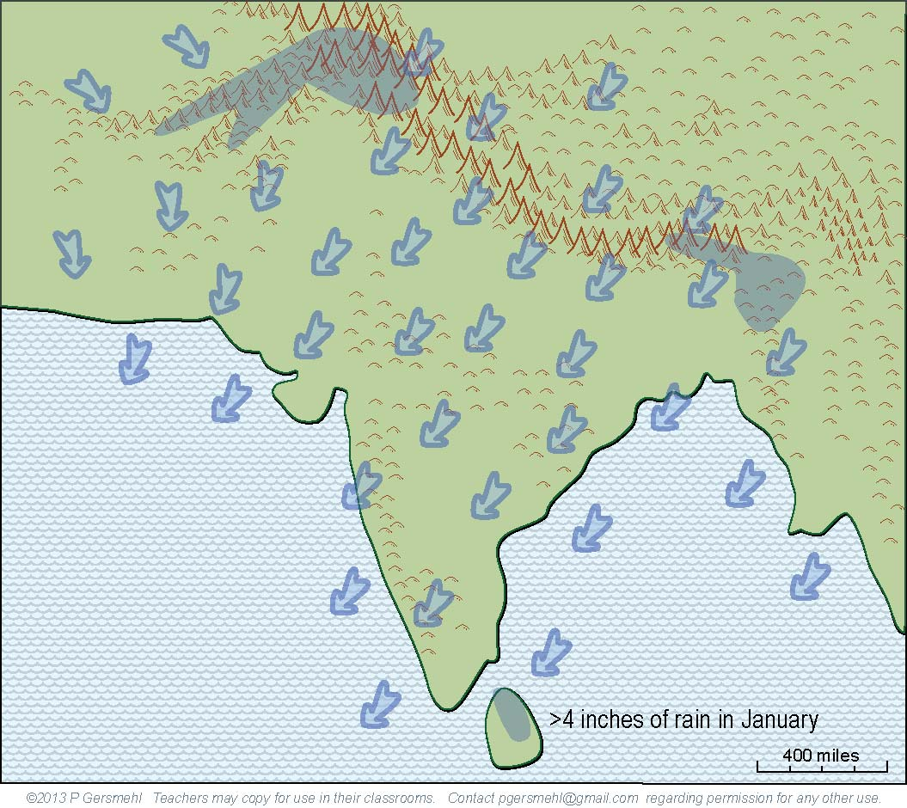
Here is how the monsoon works:
1. In winter, the continent is cold.
2. The jet stream is pushed to
the south side of the mountains.
3. Air pressure is high, and
4. Winds blow toward the southwest,
from the land to the ocean.

Slide 20
Here is how the monsoon works:
1. In winter, the continent is cold.
2. The jet stream is pushed to
the south side of the mountains.
3. Air pressure is high, and
4. Winds blow toward the southwest,
from the land to the ocean.
As a result, it rains or snows
only on the offshore islands
and a few high mountains.
Most of the subcontinent
is extremely dry.

Slide 21
Here is how the monsoon works:
1. In winter, the continent is cold.
2. The jet stream is pushed to
the south side of the mountains.
3. Air pressure is high, and
4. Winds blow toward the southwest,
from the land to the ocean.
NOTE:
The cold air is way up north.
Remember, most of India
is closer to the equator
than Texas, so India itself
is really quite warm
as well as dry in “winter.”
As a result, it rains or snows
only on the offshore islands
and a few high mountains.
Most of the subcontinent
is extremely dry.

Slide 22
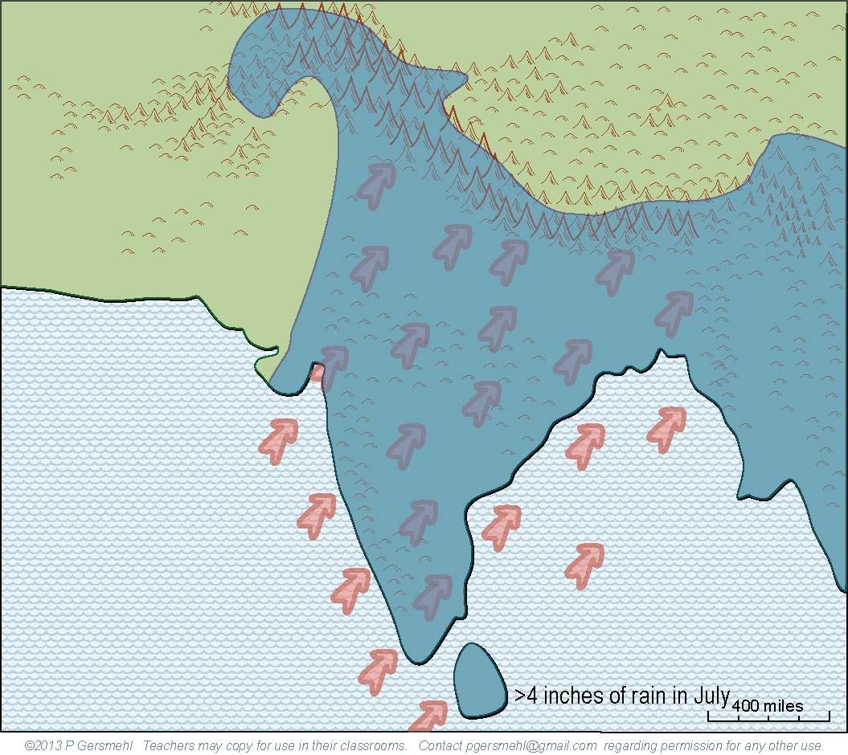
Then:
1. In summer, the continent is warm.
2. The jet stream flows around
the north side of the mountains.
3. Air pressure is low, and
4. Winds blow toward the northeast,
from the ocean to the land.

Slide 23
Then:
1. In summer, the continent is warm.
2. The jet stream flows around
the north side of the mountains.
3. Air pressure is low, and
4. Winds blow toward the northeast,
from the ocean to the land.
As a result, heavy rains
fall on most of the land,
especially on the hills
and high mountains.

Slide 24
Some places can get
more than 30 feet of rain in mid-summer –
that’s twice as much as Atlanta, Boston,
Chicago, and Houston put together.

Slide 25
Here is another look
at the winter map
of wind and rain,
without all the
explanations.

Slide 26
Here is another look at the summer map.
Note how this area
remains dry.

Slide 27
Where the jet stream
(blowing from west to east) “piles up” against
the high mountains,
air is pushed downward
and makes a desert.
Here is another look at the summer map.
Note how this area
remains dry.

Slide 28
This combination
of conditions
makes this area
one of the hottest
and driest deserts
in the world.
Satellites have recorded
surface temperatures
above 150 degrees!

Slide 29
This combination
of conditions
makes this area
one of the hottest
and driest deserts
in the world.
Satellites have recorded
surface temperatures
above 150 degrees!
Hold that thought
for a few minutes.

Slide 30
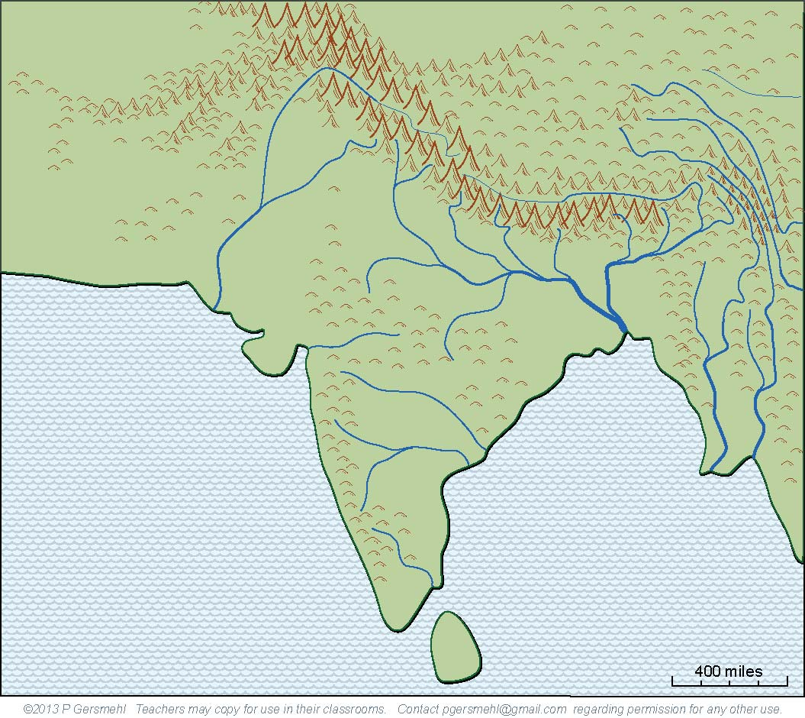
The heavy summer rains
combine with the high mountains
to make some really big rivers.
really big rivers.

Slide 31
And remember, since the rains
come in less than half the year,
these rivers often flood in summer
and can almost disappear in winter.
The heavy summer rains
combine with the high mountains
to make some really big rivers.
really big rivers.

Slide 32
Parallel ridges separated by deep canyons
make travel very difficult in this area.

Slide 33
The combination
of an extremely dry desert,
the world’s highest mountains,
and the parallel canyons
form a very effective
“natural fence”
around South Asia.

Slide 34
The combination
of an extremely dry desert,
the world’s highest mountains,
and the parallel canyons
form a very effective
“natural fence”
around South Asia.
With travel difficult,
overland trade almost impossible,
and even military action unlikely,
it is not surprising
that South Asia developed
a kind of cultural independence.

Slide 35
The combination
of an extremely dry desert,
the world’s highest mountains,
and the parallel canyons
form a very effective
“natural fence”
around South Asia.
With travel difficult,
overland trade almost impossible,
and even military action unlikely,
it is not surprising
that South Asia developed
a kind of cultural independence.
This part of the world had
its own religion – Hinduism –
and many unique cultural ideas,
including the idea of caste,
as well as distinctive styles
of art, architecture, cooking,
music, theater, and dance.

Slide 36
There is one big exception
to this idea of cultural isolation.
maritime trade
(trade across oceans)

Slide 37
There is one big exception
to this idea of cultural isolation.
The combination of peninsular shape
and seasonally reversing winds
made it possible for sailors to cross
the Arabian Sea and Bay of Bengal
(even way back in Roman times).

Slide 38
Curriculum note.
There is a student activity
and presentation called
“Sailing the Arabian Sea”
There is one big exception
to this idea of cultural isolation.
The combination of peninsular shape
and seasonally reversing winds
made it possible for sailors to cross
the Arabian Sea and Bay of Bengal
(even way back in Roman times).

Slide 39
There is one big exception
to this idea of cultural isolation.
The combination of peninsular shape
and seasonally reversing winds
made it possible for sailors to cross
the Arabian Sea and Bay of Bengal
(even way back in Roman times).
These traders carried
silks and fine pottery from China,
glass, cloth, and iron from Rome,
spices from Arabia and Indonesia,
and gold and ivory from Africa.

Slide 40
Curriculum note.
This topic is explored
in a student activity
and presentation called
“The Belitung Shipwreck”
There is one big exception
to this idea of cultural isolation.
The combination of peninsular shape
and seasonally reversing winds
made it possible for sailors to cross
the Arabian Sea and Bay of Bengal
(even way back in Roman times).
These traders carried
silks and fine pottery from China,
glass, cloth, and iron from Rome,
spices from Arabia and Indonesia,
and gold and ivory from Africa.

Slide 41
There is one big exception
to this idea of cultural isolation.
The combination of peninsular shape
and seasonally reversing winds
made it possible for sailors to cross
the Arabian Sea and Bay of Bengal
(even way back in Roman times).
These traders carried
silks and fine pottery from China,
glass, cloth, and iron from Rome,
spices from Arabia and Indonesia,
and gold and ivory from Africa.
At the time of the Islamic caliphs
(say around the year 900)
some trading ports in Arabia
and along the coast of South Asia
were among the richest cities
in the entire world.

Slide 42
Meanwhile, in Europe,
Spain finally drove
the Islamic Moors out.
Europeans began
to sail around the world,
making colonies overseas
and factories at home.
A different combination
of conditions gave
South Asia a new role.

Slide 43
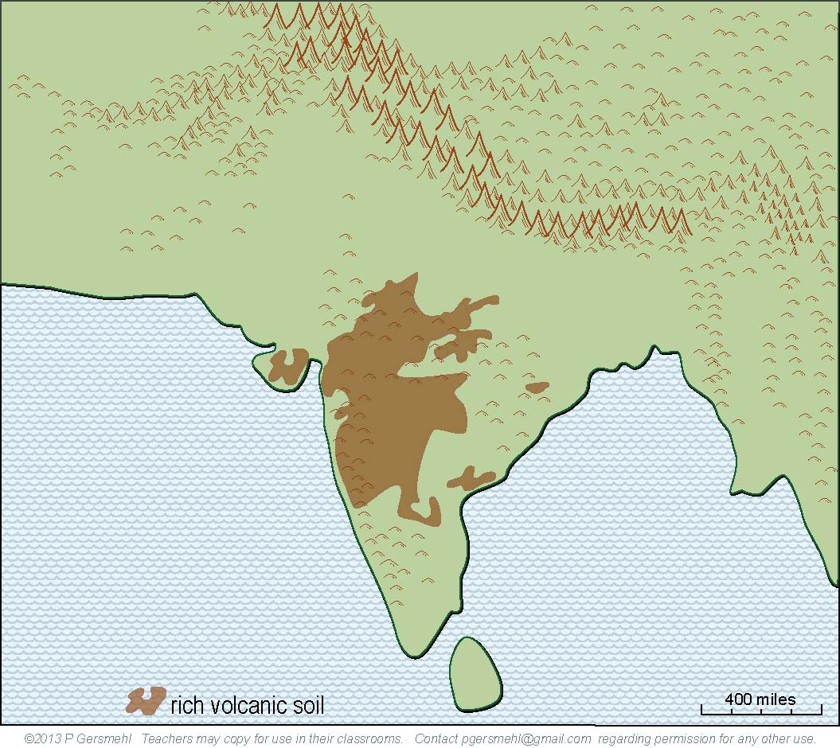
Remember that
the crustal plate
that holds South Asia
is moving northward.
As it crossed a hot spot
deep inside the earth,
volcanoes erupted
and spread lava
over a large area.

Slide 44
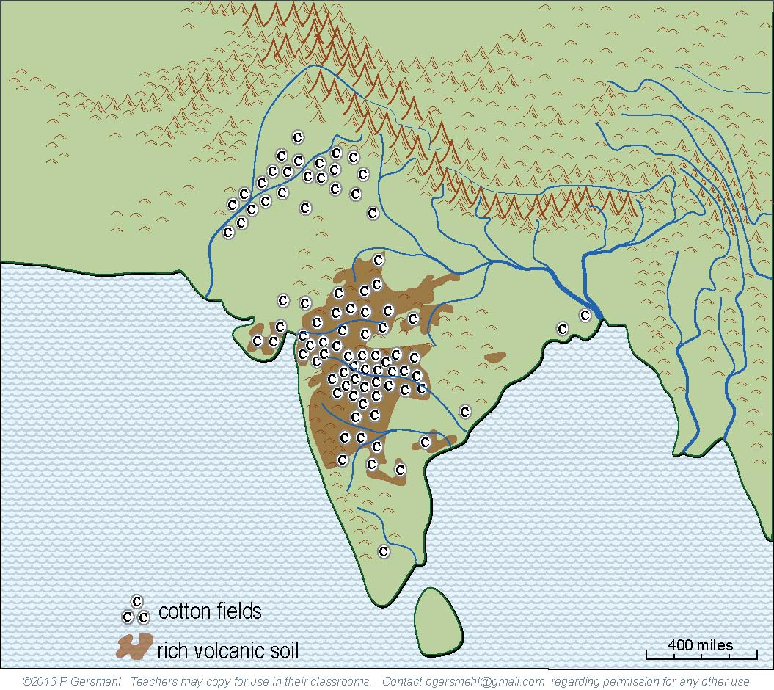
When combined with
a long growing season
and monsoon rain,
volcanic soils
make excellent fields
for crops like cotton.

Slide 45
When combined with
a long growing season
and monsoon rain,
volcanic soils
make excellent fields
for crops like cotton.
And England needed
a lot of cotton
for its new factories.

Slide 46
With its powerful navy,
England conquered
South Asia and made
it into a colony.

Slide 47
Curriculum note.
There is a clickable map
about European Colonialism
With its powerful navy,
England conquered
South Asia and made
it into a colony.

Slide 48
After a very long struggle, South Asia finally
gained independence.
You can read about Gandhi
and other resistance leaders
on the internet.
But there was a problem.

Slide 49
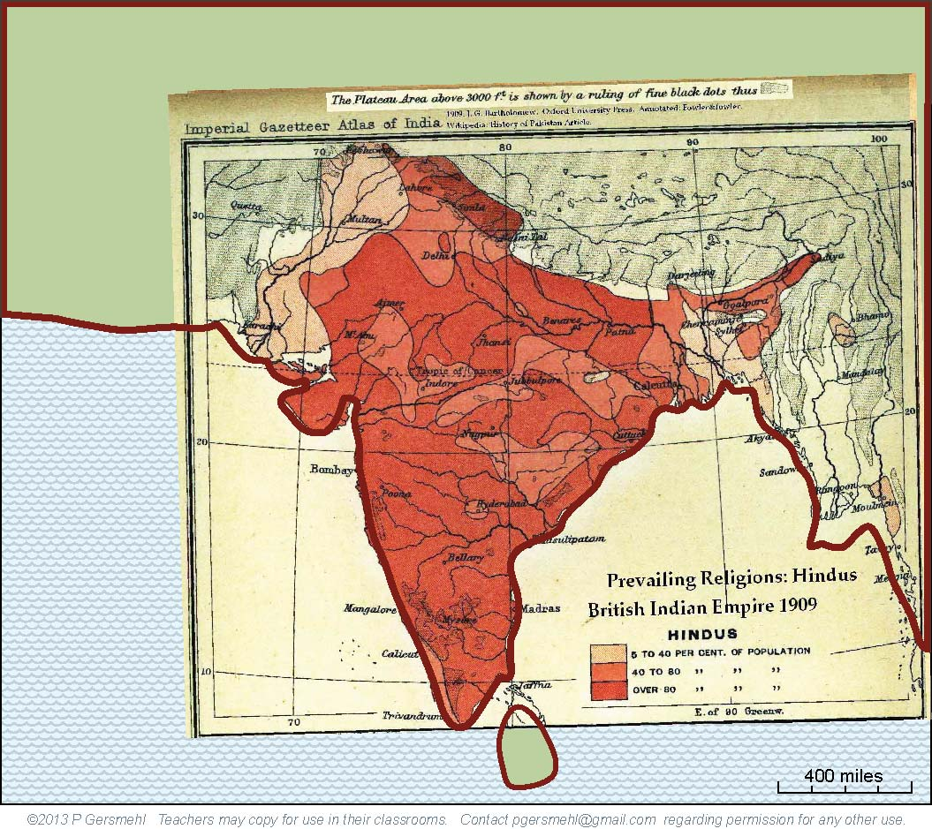
This old map
(from the Imperial
Gazetteer of India)
shows the areas
of South Asia
where Hinduism
was the main religion.

Slide 50
This old map
(from the Imperial
Gazetteer of India)
shows the areas
of South Asia
where Hinduism
was the main religion.
Note that Hindus
are less than
40 percent
of the population
in several places.
Note that Hindus
were less than
40 percent
of the population
in several places.

Slide 51
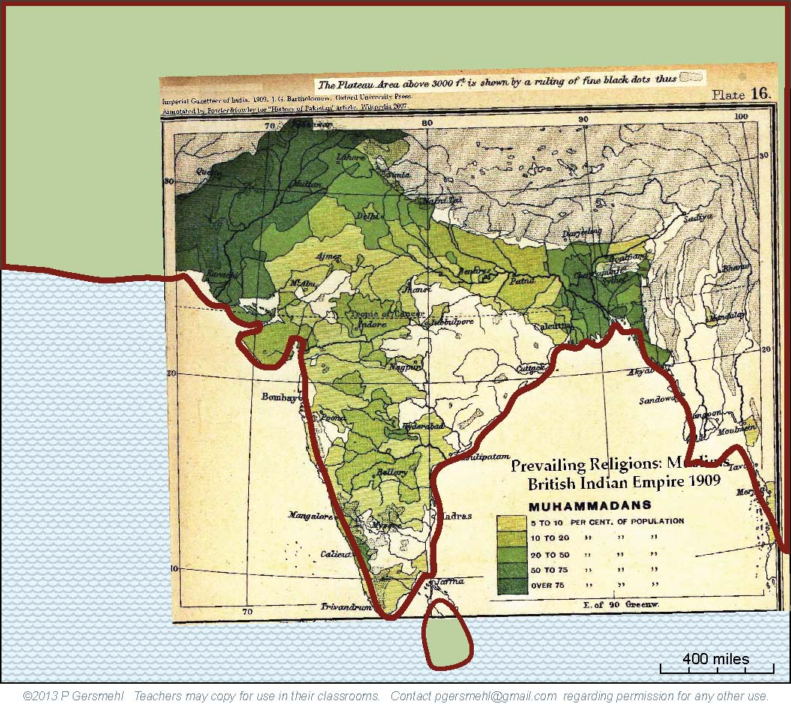
This old map
(from the same
Imperial Gazetteer)
shows the areas
where Islam was
the main religion.

Slide 52
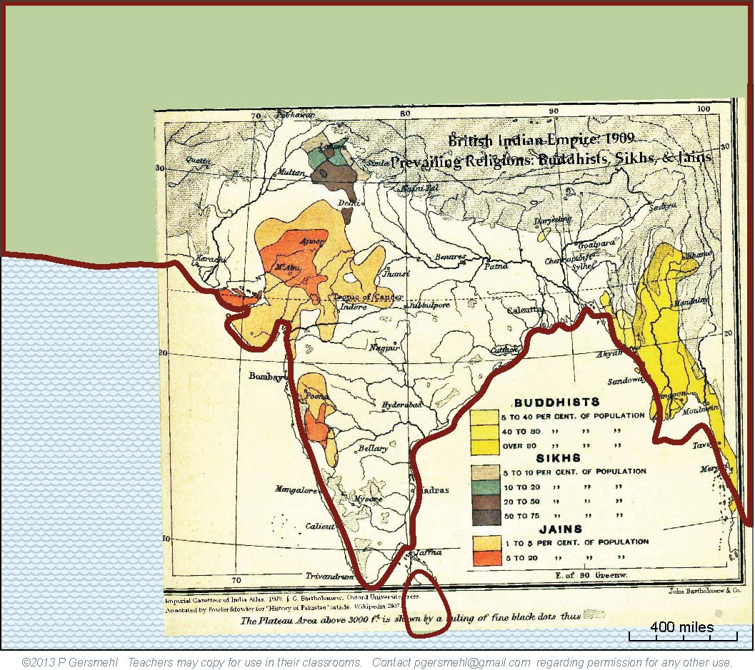
Hinduism and Islam
were the most important religions in South Asia,
but other religions
were locally important
in several areas.

Slide 53
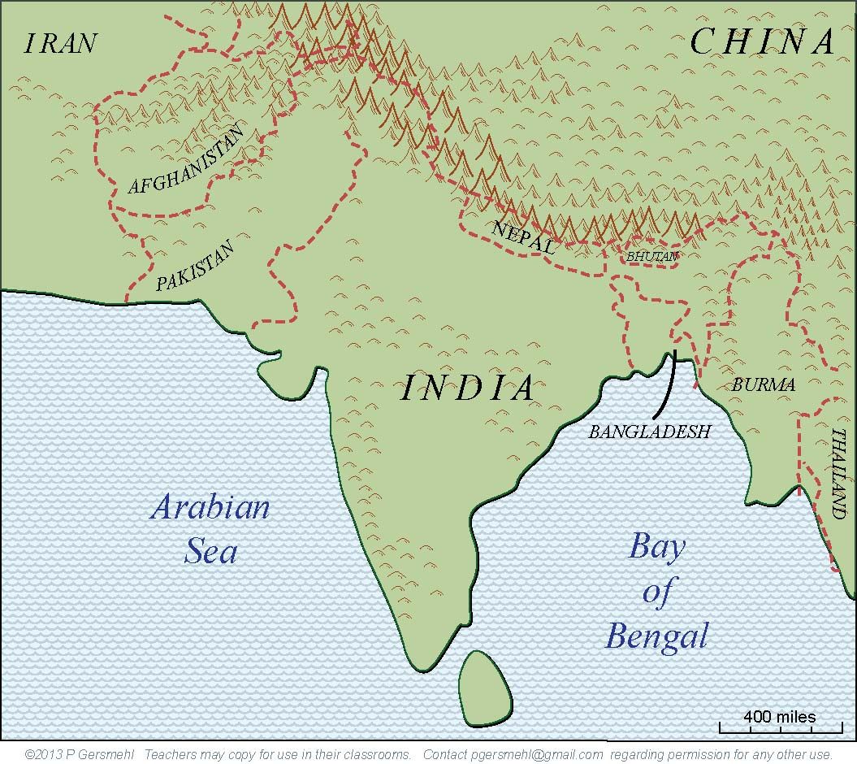
The political leaders
tried to solve the problem
of religious differences
by “partitioning” the area
into several separate countries.

Slide 54
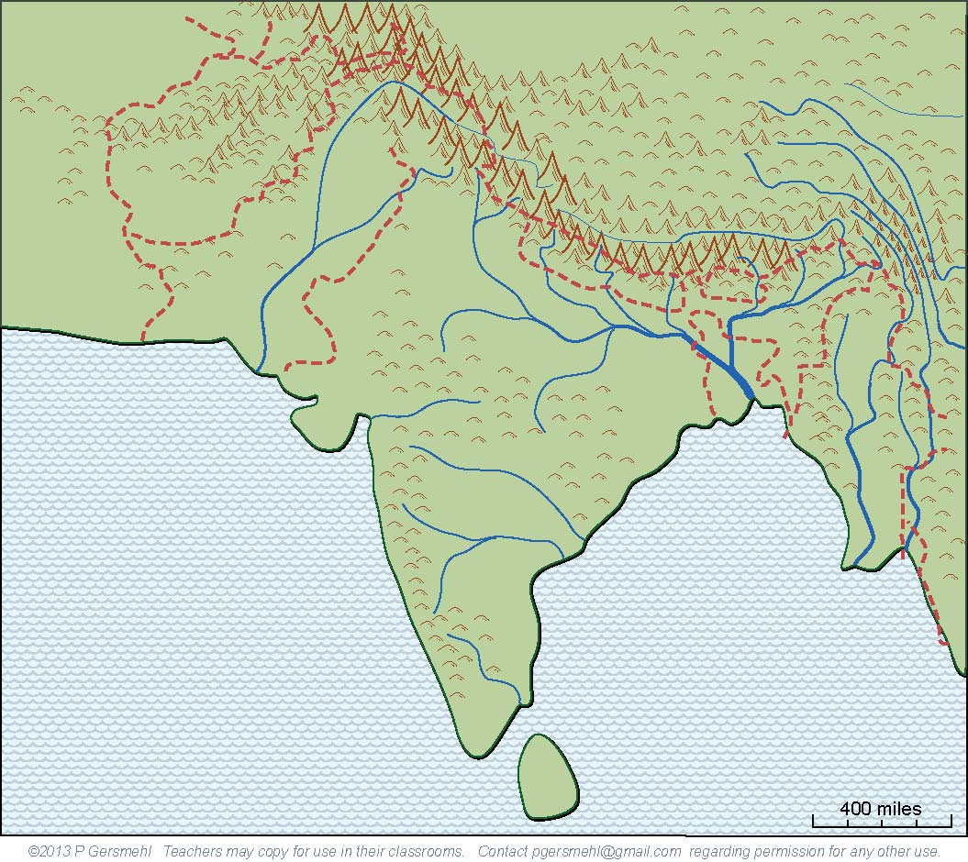
Unfortunately,
the resulting borders
do not pay much attention
to things like language
or the flow of water.

Slide 55
Unfortunately,
the resulting borders
do not pay much attention
to things like language
or the flow of water.
For example, every major river
in the region starts in one country
and goes through another
on its way to the ocean.

Slide 56
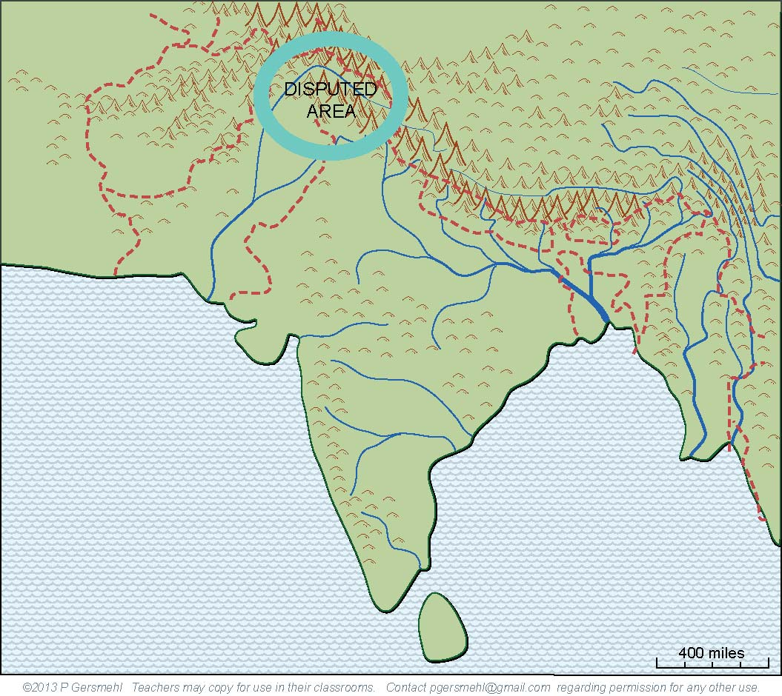
The area called Kashmir
is the focus of one dispute
over how the land and water
should be divided.
Part of the border
is deliberately left off of this map –
a university colleague of mine,
an well-known expert on South Asia,
was barred from traveling in this area
because he drew one of the borders
in a way the government called wrong.

Slide 57
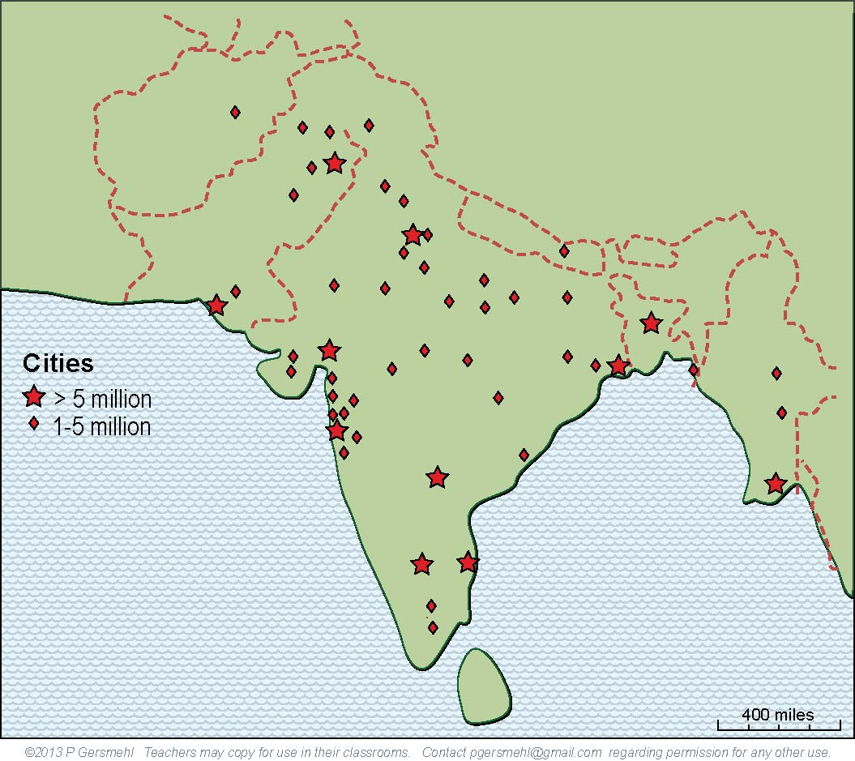
South Asia today is a region
with more than a billion people
(more than 4 times as many as the U.S.)
and a rapidly growing economy.

Slide 58
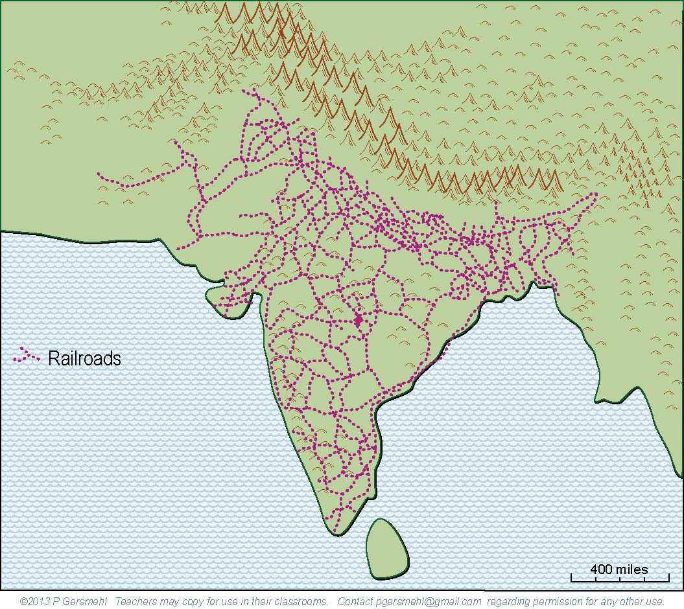
Unlike some colonial regions,
South Asia “inherited”
two valuable legacies -
a good railroad network
and strong technical universities.

Slide 59
These have helped South Asia
to become a prominent “player”
in several hi-tech industries,
such as software design,
movie and music production,
and computer-telecom help desks.

Slide 60
This presentation showed one way to use
the clickable map of India - to help us investigate
some consequences of the big idea of culture.
Cultural differences can arise as a result of:

Slide 61
This presentation showed one way to use
the clickable map of India - to help us investigate
some consequences of the big idea of culture.
Cultural differences can arise as a result of:
Isolation – people who seldom interact with other cultures can develop their own unique cultural ideas

Slide 62
This presentation showed one way to use
the clickable map of India - to help us investigate
some consequences of the big idea of culture.
Cultural differences can arise as a result of:
Isolation – people who seldom interact with other cultures can develop their own unique cultural ideas
Trade connections – people can adopt cultural ideas from traders who come to their land

Slide 63
This presentation showed one way to use
the clickable map of India - to help us investigate
some consequences of the big idea of culture.
Cultural differences can arise as a result of:
Isolation – people who seldom interact with other cultures can develop their own unique cultural ideas
Trade connections – people can adopt cultural ideas from traders who come to their land
Invasions – armies that invade an area often bring different cultural ideas with them

Slide 64
This presentation showed one way to use
the clickable map of India - to help us investigate
some consequences of the big idea of culture.
Cultural differences can arise as a result of:
Isolation – people who seldom interact with other cultures can develop their own unique cultural ideas
Trade connections – people can adopt cultural ideas from traders who come to their land
Invasions – armies that invade an area often bring different cultural ideas with them
Religions – monks, scholars, and missionaries can convince people to adopt new cultural ideas

Slide 65
This presentation showed one way to use
the clickable map of India - to help us investigate
some consequences of the big idea of culture.
Cultural differences can arise as a result of:
Isolation – people who seldom interact with other cultures can develop their own unique cultural ideas
Trade connections – people can adopt cultural ideas from traders who come to their land
Invasions – armies that invade an area often bring different cultural ideas with them
Religions – monks, scholars, and missionaries can convince people to adopt new cultural ideas
Colonialism – countries that claim colonies often try to change the culture there

Slide 66
This presentation showed one way to use
the clickable map of India - to help us investigate
some consequences of the big idea of culture.
Cultural differences can arise as a result of:
Isolation – people who seldom interact with other cultures can develop their own unique cultural ideas
Trade connections – people can adopt cultural ideas from traders who come to their land
Invasions – armies that invade an area often bring different cultural ideas with them
Religions – monks, scholars, and missionaries can convince people to adopt new cultural ideas
Colonialism – countries that claim colonies often try to change the culture there
Migration – people who move can bring cultural ideas
and mix them with ideas held by people around them

Slide 68
questions section

Slide 69
How does the size
of South Asia compare
with Europe?

Slide 70
What do you call
a landform that
sticks out into an ocean,
like a large nose or thumb?

Slide 71
What are some consequences
of the fact that most of India
is closer to the equator
than Texas?

Slide 72
We think of this
as part of Asia,
but what land
was it part of
in the distant
geologic past?

Slide 73
How fast
is this part
of the crust
moving?

Slide 74
What is the main
consequence
of this “collision”
between
crustal plates?

Slide 75
How do the Himalayas compare
with the highest mountains
in the United States?

Slide 76
What is a monsoon
and how can a mountain range
help cause it to occur?

Slide 77
What is a monsoon
and how can a mountain range
help cause it to occur?
Definition: a monsoon is
a seasonal reversal of wind direction
that brings heavy rain in summer
and very dry weather in winter

Slide 78
Describe the situation in winter:
1. air temperature?
2. position of the jet stream?
3. air pressure?
4. wind direction?
5. rainfall?

Slide 79
Describe the situation in summer:
1. air temperature?
2. position of the jet stream?
3. air pressure?
4. wind direction?
5. rainfall?

Slide 80
What is the result
in this area when
the jet stream runs into
the high mountains?

Slide 81
What happens in this area
when the monsoon winds
hit the slopes of the Himalayas?

Slide 82
What causes these rivers
to flow parallel to each other?
What is the main effect of that?

Slide 83
What is the consequence
of this combination
of a very dry desert,
the world’s highest mountains,
and the parallel canyons?

Slide 84
What is the consequence
of this combination
of a very dry desert,
the world’s highest mountains,
and the parallel canyons?
Describe some of the
unique cultural features
that developed as a result.

Slide 85
What is the big exception
to the generalization
about cultural isolation
in South Asia?

Slide 86
What is the big exception
to the generalization
about cultural isolation
in South Asia?
What commodities
were carried
by the traders
in each direction?

Slide 87
What is the big exception
to the generalization
about cultural isolation
in South Asia?
What commodities
were carried
by the traders
in each direction?
What were some consequences
of those trading links?

Slide 88
What happened
after Spanish armies
were finally able to drive
the Moors out?
How did this affect
South Asia?

Slide 89
How can the motion
of the crustal plates
cause the formation
of a large area
of rich volcanic soil?

Slide 90
Describe how
this volcanic soil
helped make India
a valuable colony
for Great Britain?

Slide 91
Describe how Gandhi
and other resistance leaders
finally helped India
gain independence
from Great Britain.

Slide 92
What is the
significance
of this old map
showing the areas
where most people
follow Hinduism?

Slide 93
What is the
significance
of this old map
showing the areas
where most people
follow Islam?

Slide 94
What is the
significance
of this old map
showing the areas
where most people
follow Buddhism,
Jainism, or Sikhism?

Slide 95
Describe the Partition
(the process of dividing South Asia into several
independent countries).

Slide 96
What are some problems
caused by the fact
that the country borders
were drawn primarily
on the basis of religion?

Slide 97
Describe the dispute
over the region
called Kashmir.

Slide 98
How large is the population
of South Asia today, compared to the
United States?

Slide 99
Describe two valuable “legacies”
that South Asia “inherited”
from the British colonists.

Slide 100
Describe two valuable “legacies”
that South Asia “inherited”
from the British colonists.
What modern economic activities
are favored by this history?

Slide 101
What unique geopolitical problem
faces the people in South Asia?

Slide 102
Here are a few questions for individual inquiry:
1. What was the “Aryan Invasion” and why was it important?
2. What is “caste” and why is it important?
3. What trade goods did Roman people buy from India?
4. What major religions started in India? How did they spread?
5. What is the Maritime Silk Road and why was it important?
6. What are some lasting effects of the Delhi Sultanates?
7. What were some key events in the struggle for independence?
8. Why is the Kashmir Question a threat to world peace?

Slide 104
Copyright 2019, Phil and Carol Gersmehl
Teachers who saw this presentation at a workshop
or downloaded it from our internet site have permission
to make a copy on their own computers for these purposes:
1. to help them review the workshop,
2. to show the presentation in their own classrooms, at sessions they present at teacher conferences, or to administrators in their own school or district,
3. to use individual frames (with attribution) in their own class or conference presentations.
For permission for any other use,
including posting frames on a personal blog or uploading to any network or website that can be accessed from outside your school,
contact pgersmehl@gmail.com

