Slide 1
Regional or Topical?
An interesting question

Slide 2
Regional or Topical?
Administrators think it is really important.
An interesting question
Standards writers debate it at length.
Textbook writers obsess about it.
Teachers of successful classes
don’t consider it very important.

Slide 3
Topical Organization of a Geography Class
Following a logical sequence of conceptual topics.
C O U R S E C A L E N D A R
September
October
November
December
January
February
. . .
Geographic skills
Physical geography
Population geography
Cultural geography
Natural resources
Economic geography
. . .

Slide 4
Regional Organization of a Geography Class
Going around the world, one major region at a time.
C O U R S E C A L E N D A R
September
October
November
December
January
February
. . .
World patterns
N America, Australia
South America
Africa
Southwest Asia
Russia
. . .

Slide 6
If you use a Regional Organization, . . .
you will have to insert some topical discussions
in order to explain key conceptual ideas,
- demographic transition
- domestication of crops
- push-pull theory of migration
- modes of transportation
- strategic straits and passes
- BIGJobs and multipliers
. . .

Slide 7
If you use a Topical Organization, . . .
you will have to insert some regional examples
to keep things from becoming too abstract,
- Jamestown
- Mongolian herders
- Nujiang, China
- Yasenevo, a neighborhood of Moscow
- Crossing the Andes during the Revolucion
. . .

Slide 13
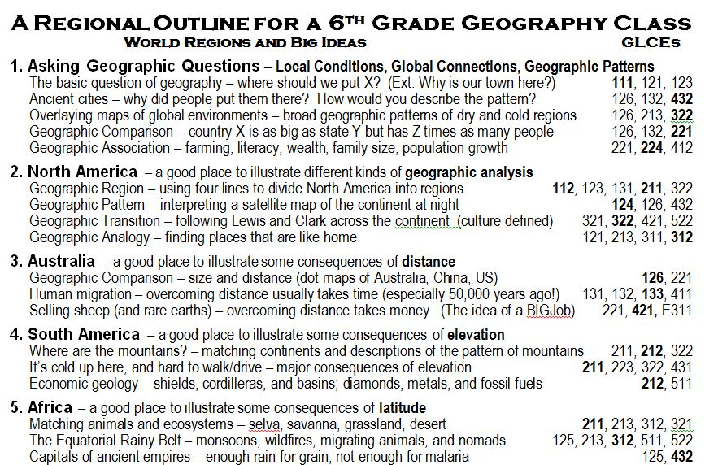

Slide 14
