Slide 1
Making Iron
What happens when technology changes?
GLCE 6-G2.2.2 Explain how places are affected by changes in technology.

Slide 2
To cut down a tree,
would you rather use:
1. your hands,
2. a sharp rock,
3. a steel saw ?

Slide 3
To dig a hole,
would you rather use:
1. your hands,
2. a wooden stick,
3. a steel shovel ?

Slide 4
To fight a battle,
would you rather use:
1. your hands,
2. a wooden club,
3. a steel sword ?

Slide 5
For all these reasons
(and many more)
iron and steel are perhaps
the most important materials
in human history.

Slide 6
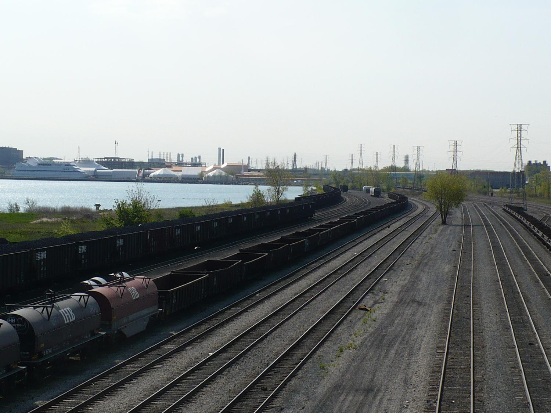
Railroads need steel
for rails and cars.

Slide 7
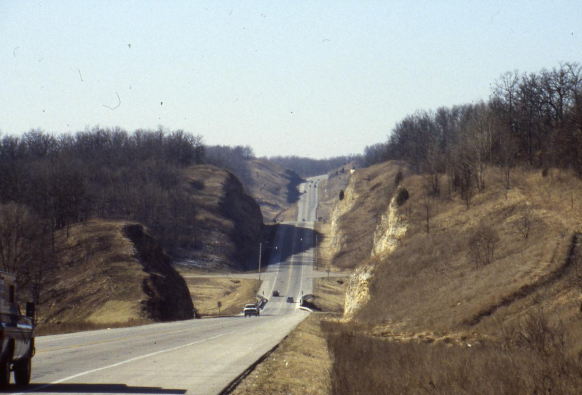
Highways need even more steel,
but it’s hidden inside the concrete.

Slide 8
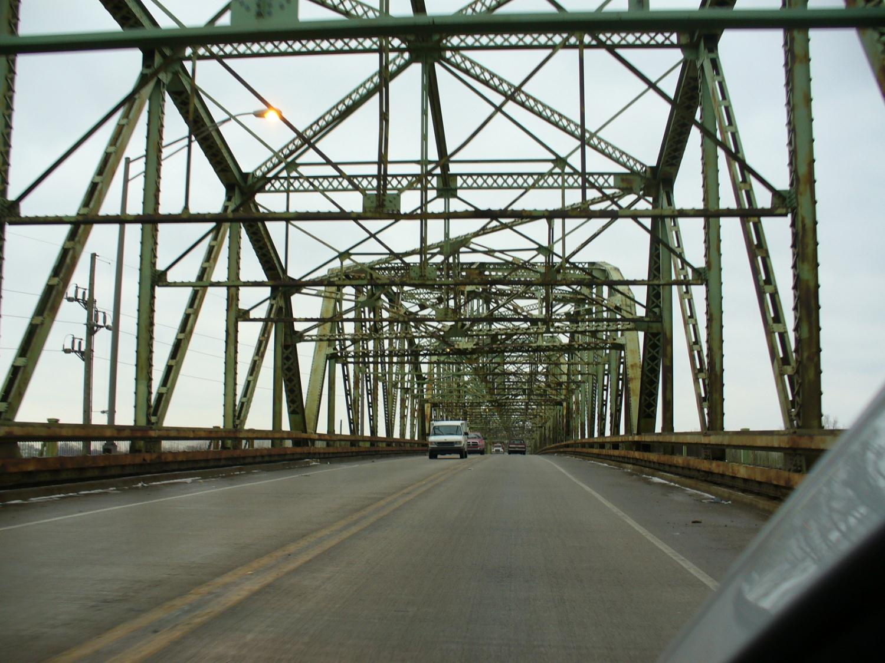
Bridges need a lot of steel,
both above and below the road.

Slide 9
Tall buildings need a lot of steel.

Slide 10
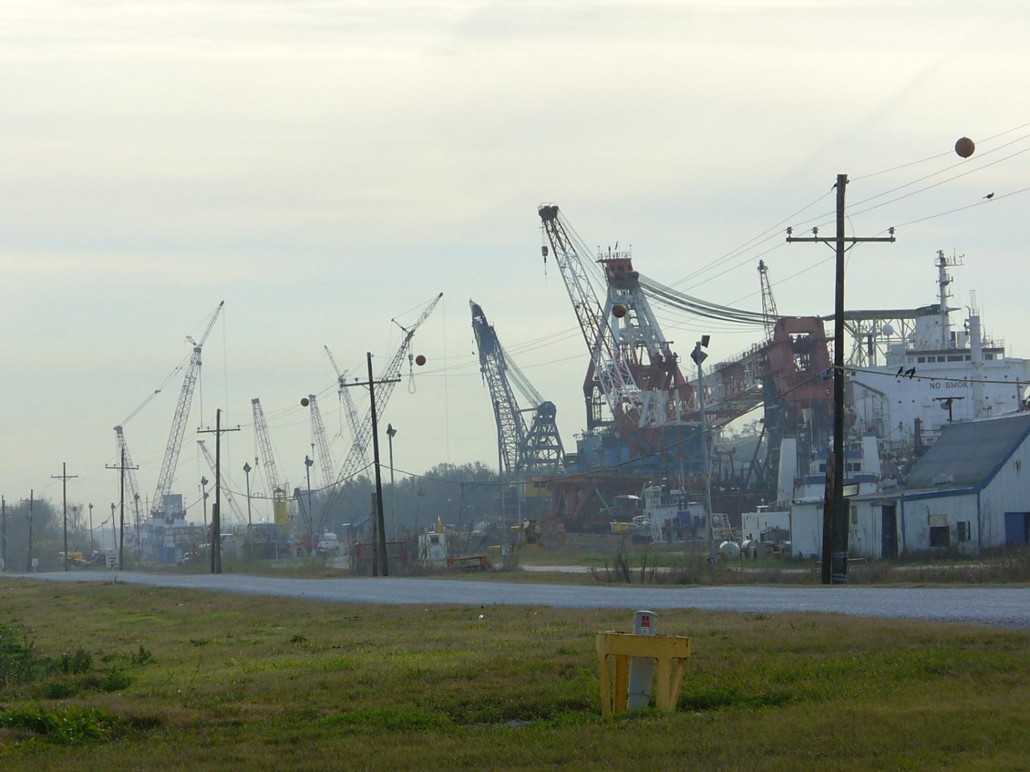
Construction needs
a lot of steel.

Slide 11
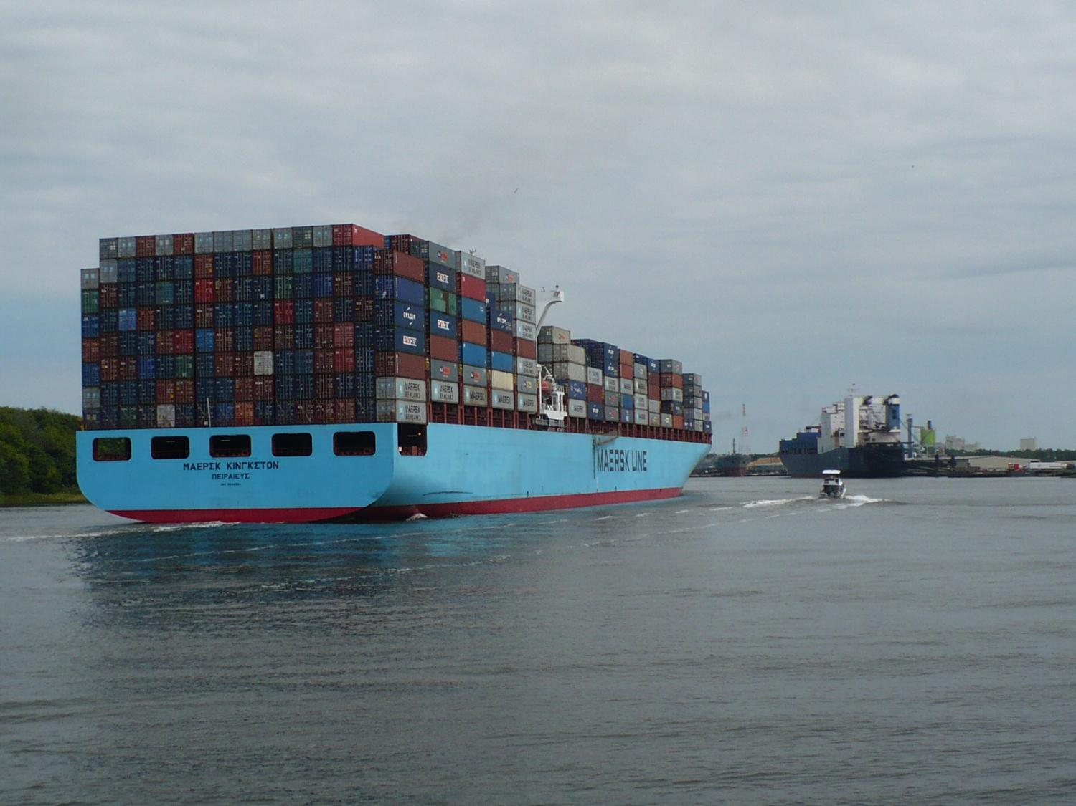
Ships need
a lot of steel.

Slide 12
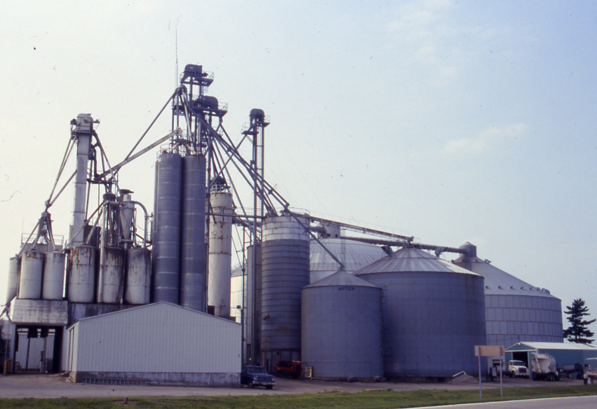
Grain storage needs
a lot of steel.

Slide 13
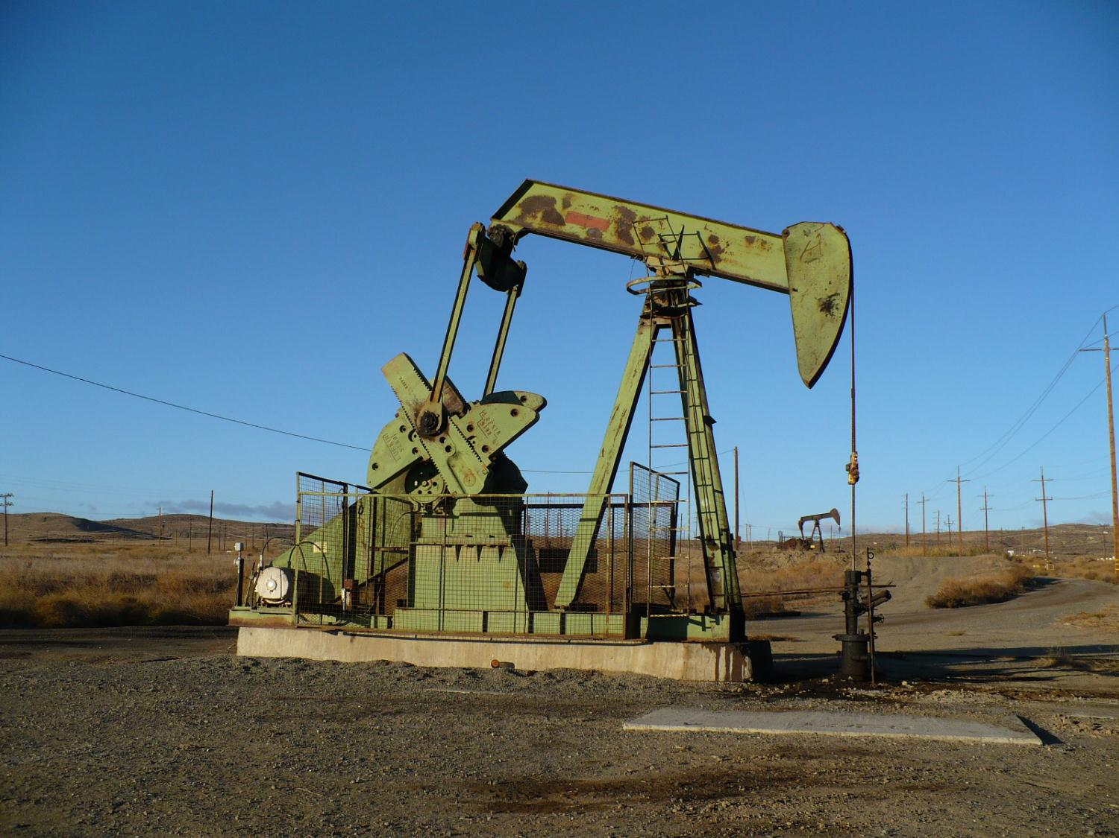
Oil wells need
a lot of steel,
especially
below ground.

Slide 14
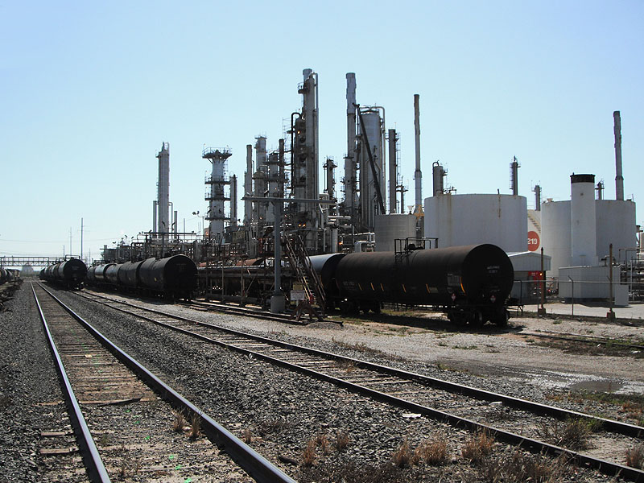
Oil refineries need
a lot of steel.

Slide 15
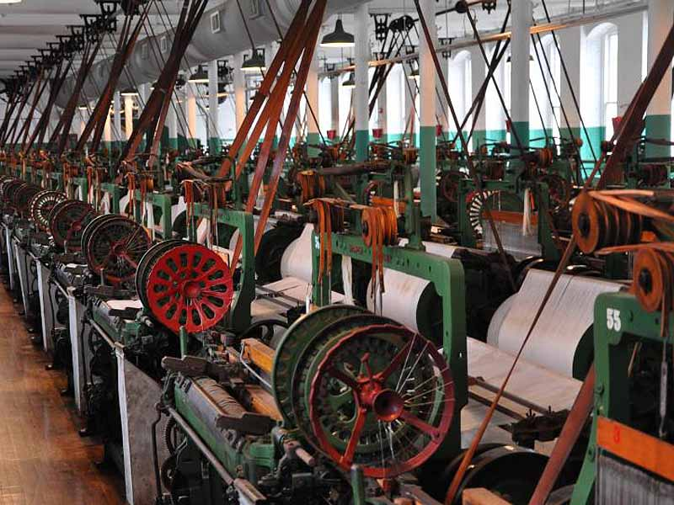
Old factories needed
a lot of iron and steel.

Slide 16
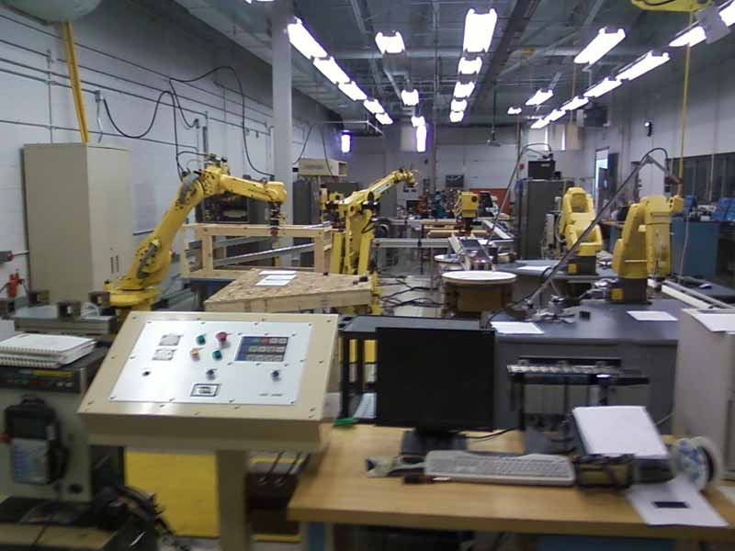
New factories need
steel for robots
and the building.

Slide 17
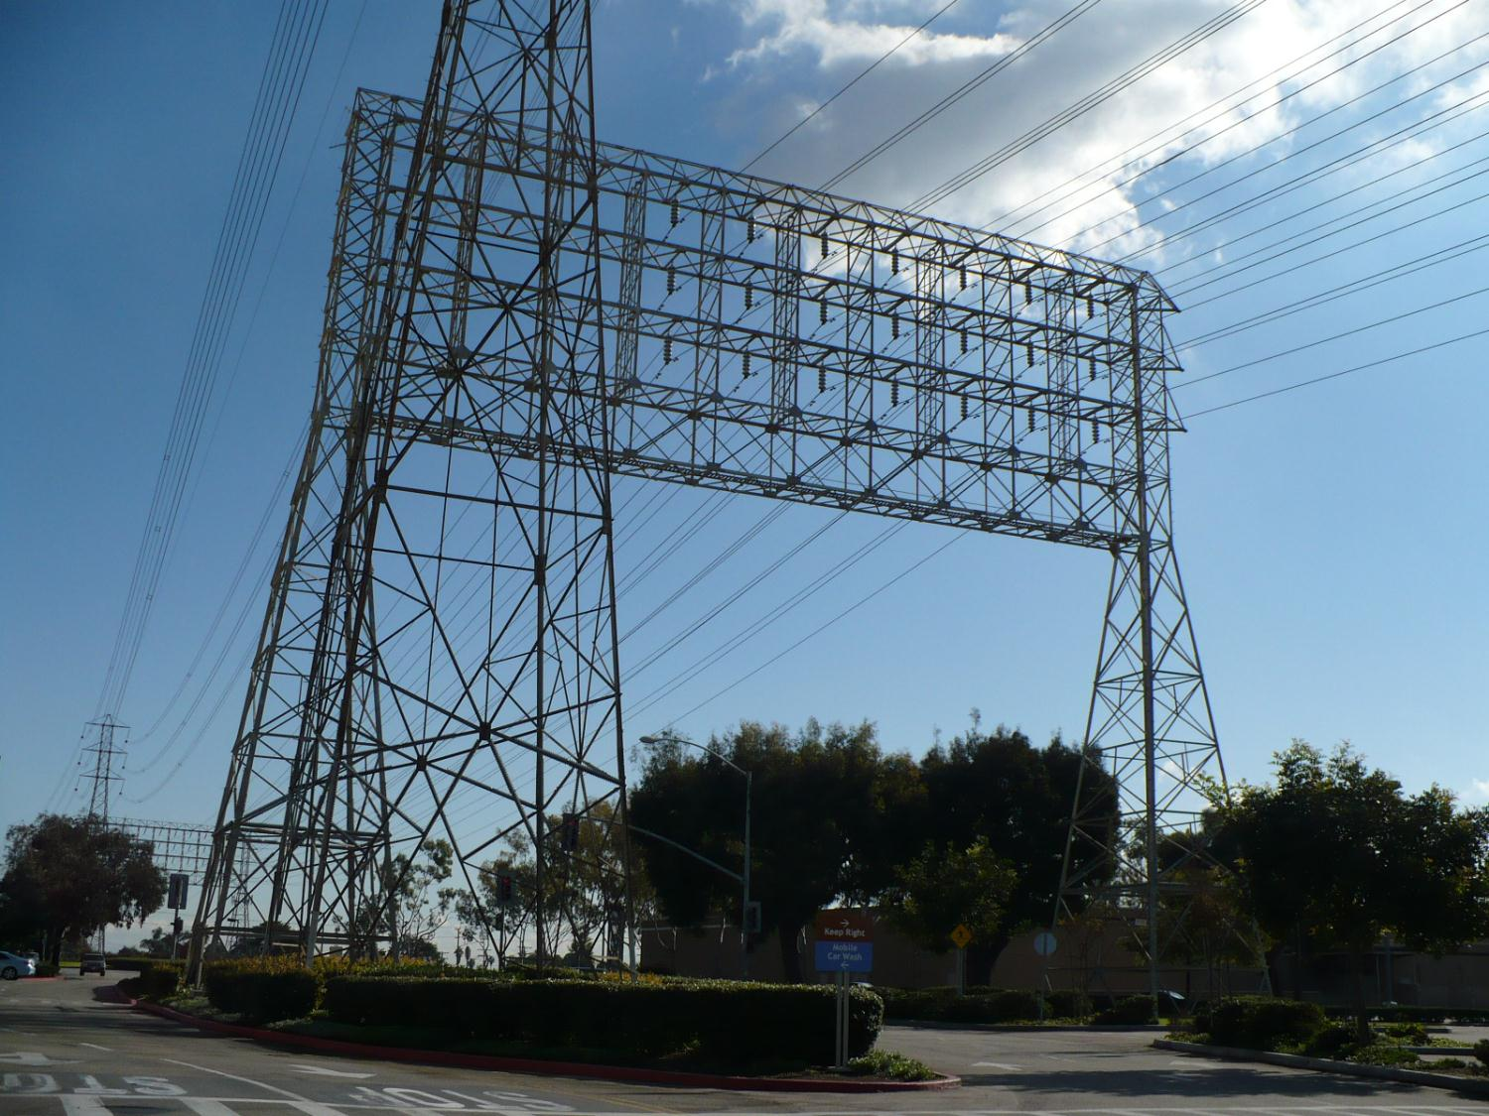
Electric powerlines need a lot of steel.

Slide 18
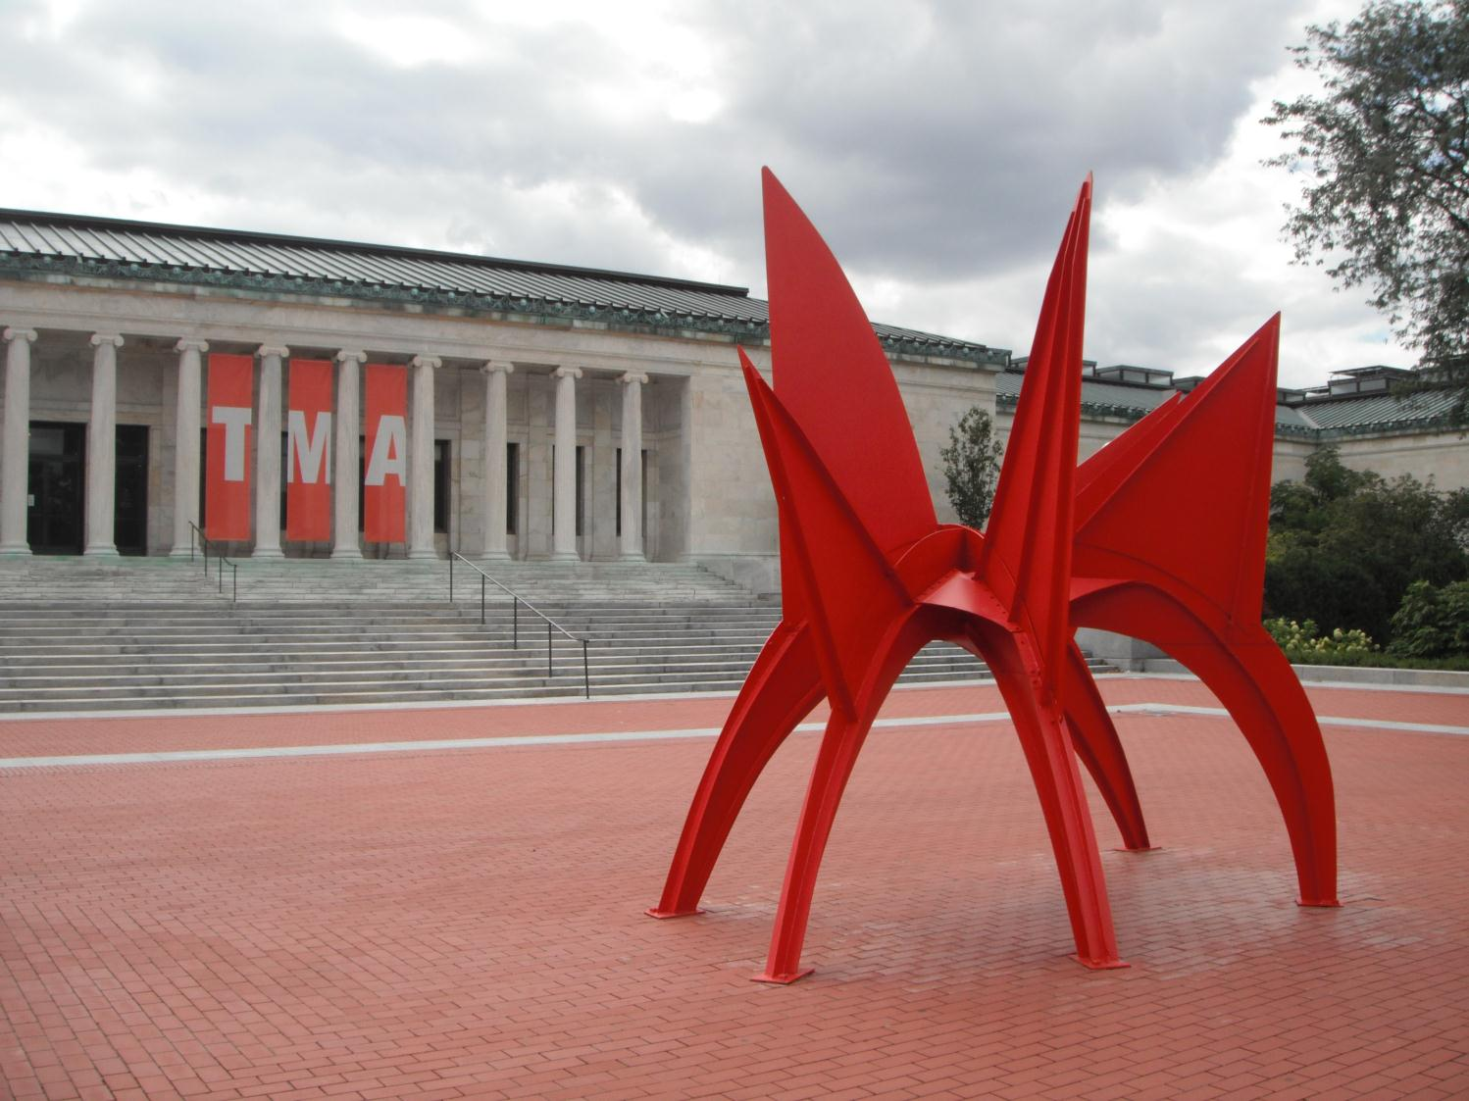
Even some art
requires steel.

Slide 19
Here’s the issue:
Several times in history,
people learned new ways
to make iron and steel.
Every time that happened,
thousands of new jobs were created,
but thousands of other people
lost their jobs.

Slide 20
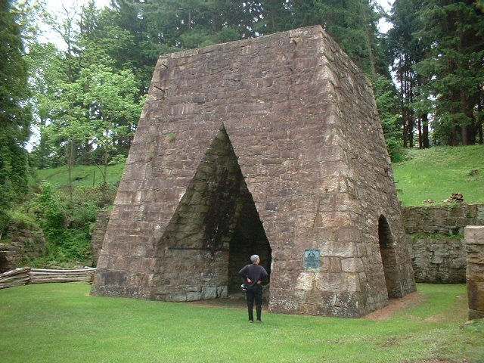
A charcoal oven
is one way
to make iron.
What is this?
(click to find out)

Slide 21
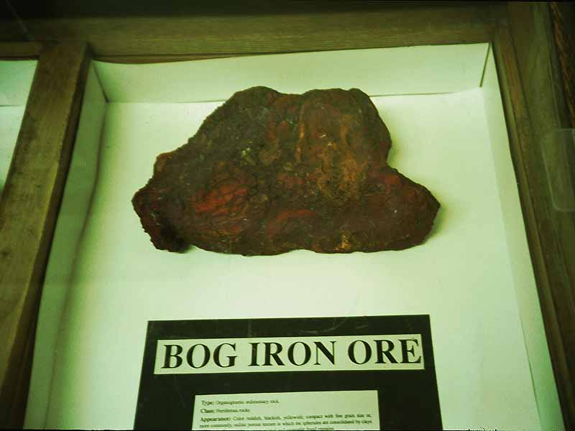
Charcoal ovens
use bog iron ore,
found in swamps.

Slide 22
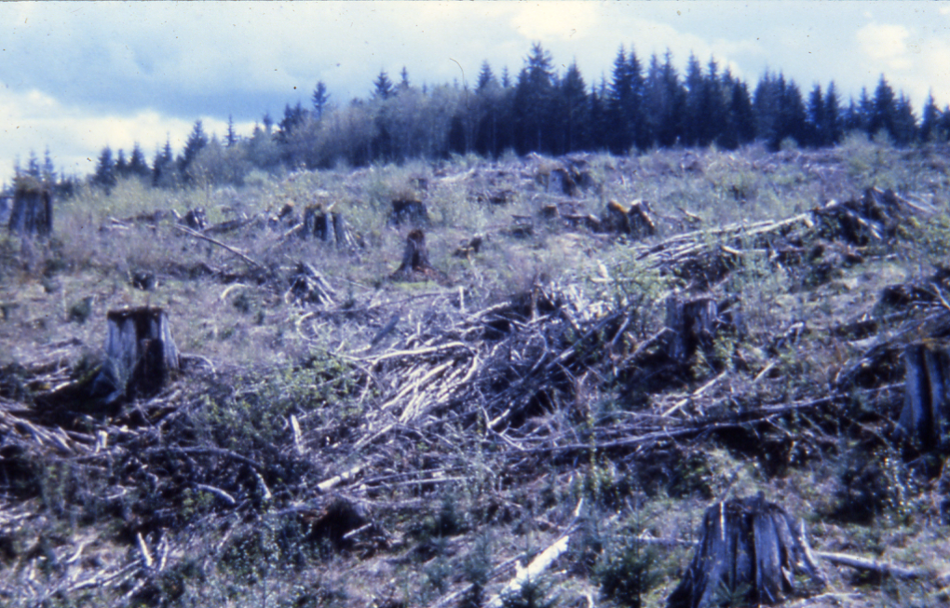
They also use
a lot of trees
to make the fires.

Slide 23
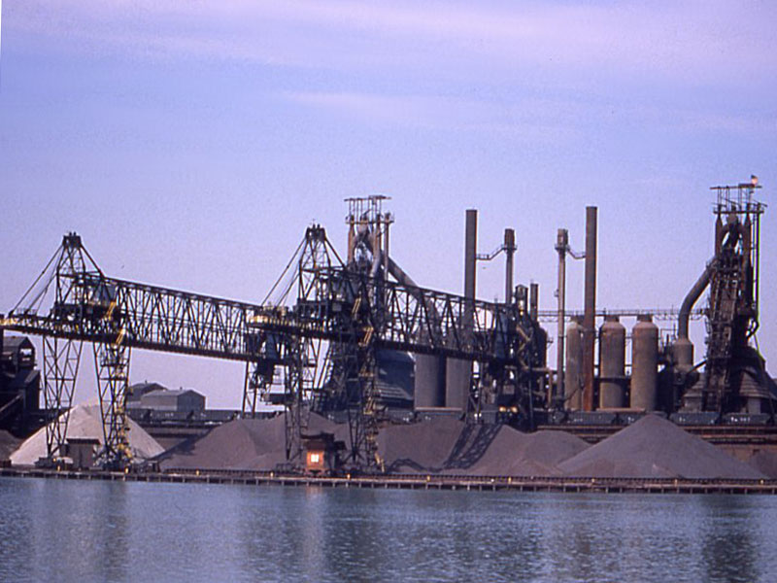
A blast furnace
is another way
to make iron.

Slide 24
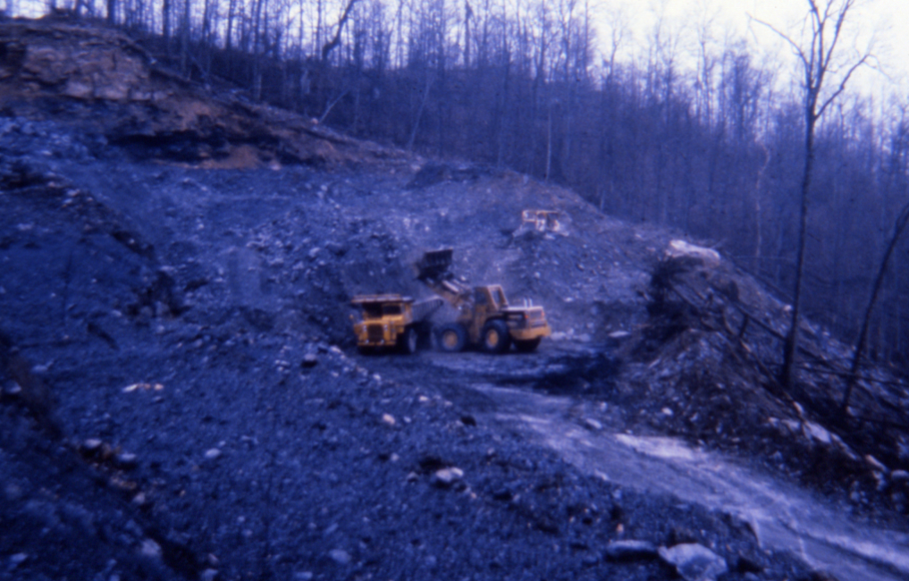
Blast furnaces
use a lot of coal.
They also use
a different kind
of iron ore.

Slide 25
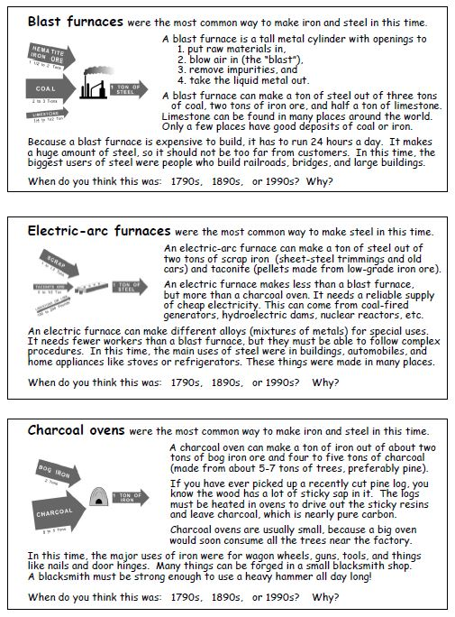
Try to decide
what date
each reading
is describing.
You have
some readings
about inputs
and outputs
from several
different ways
to make steel.

Slide 26
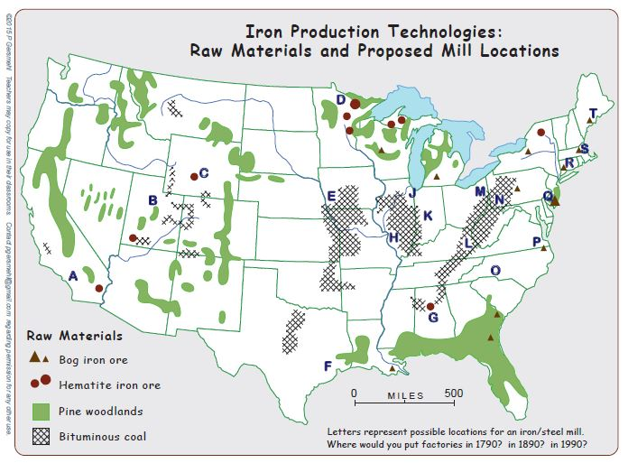
Now choose
good locations
for steel mills
in each time period.

Slide 27
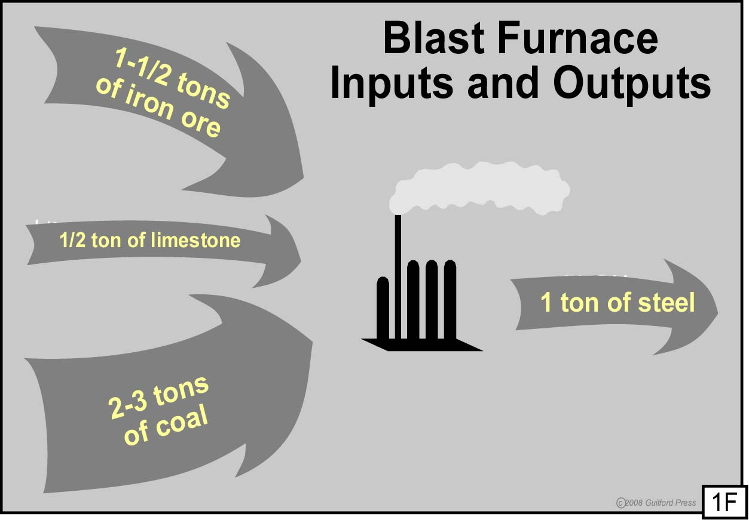
An input-output diagram
is a good tool to help people
choose a good location
for a given kind of factory.

Slide 28
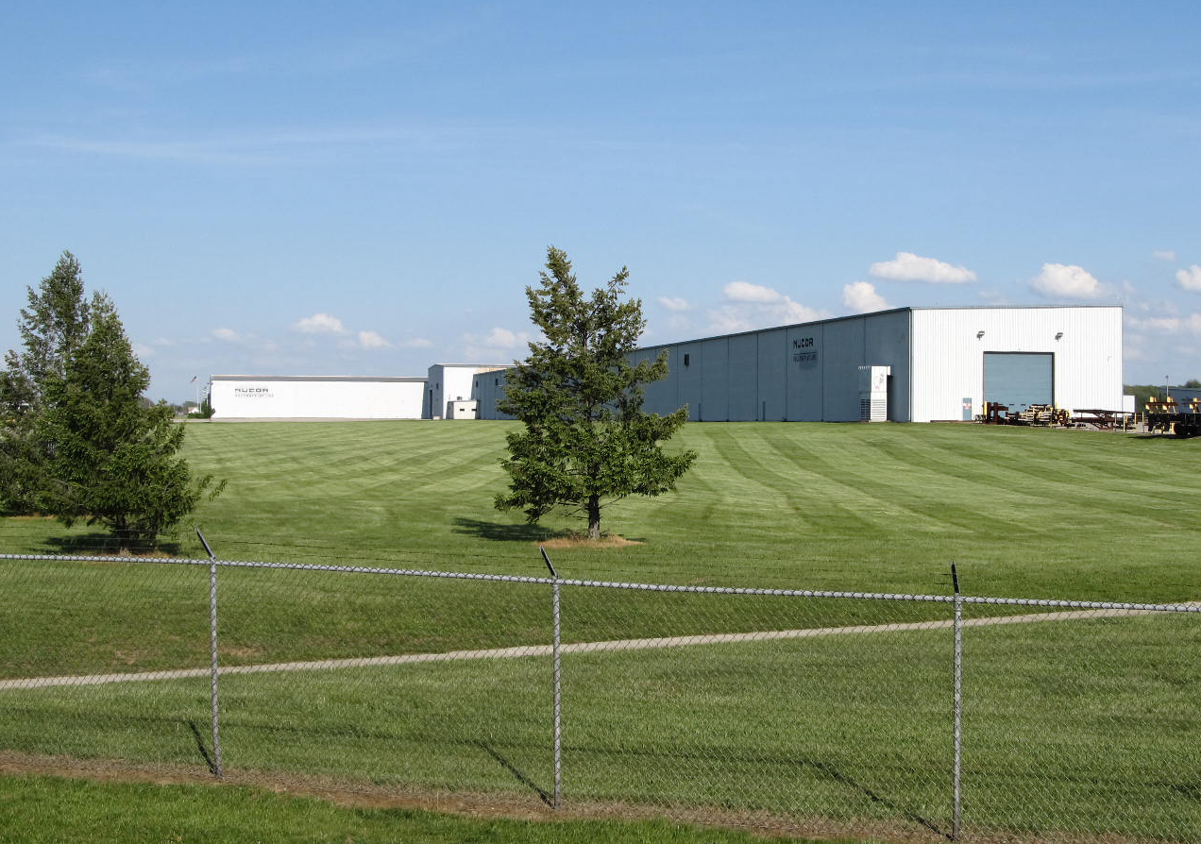
An electric steel mill
does not look at all
like a blast furnace.

Slide 29
It has a different mix
of inputs and outputs.

Slide 30
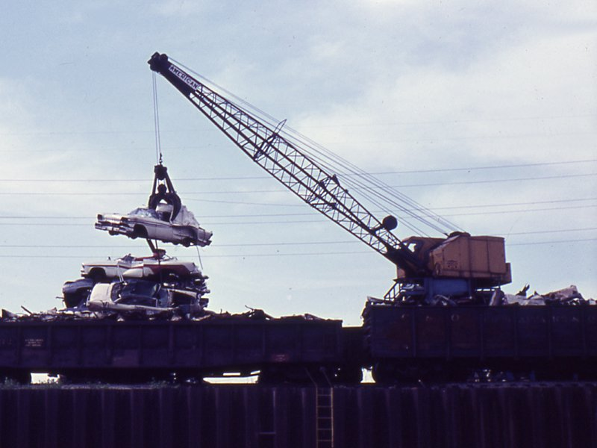
Electric hearths
can recycle scrap metal.

Slide 31
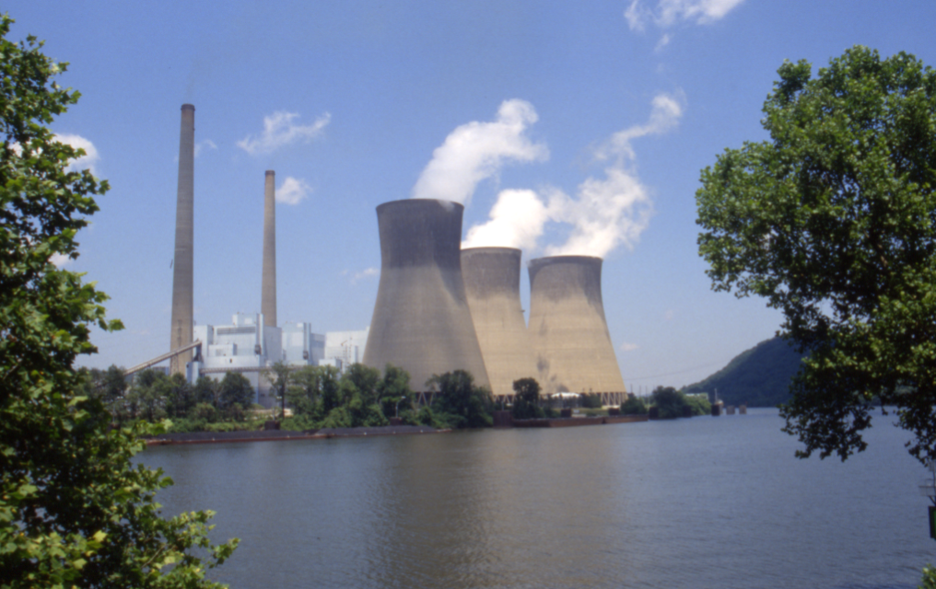
They use a different
source of energy.

Slide 32
The Question is . . .

Slide 33
The Question is . . .
What places are helped
(and what places are hurt)
by a big technological change ?
(like the shift from blast furnaces
to electric hearths in steelmaking?)

Slide 34
And if we can predict
the answer to that question,
What can we do to avoid the pain ?

Slide 35
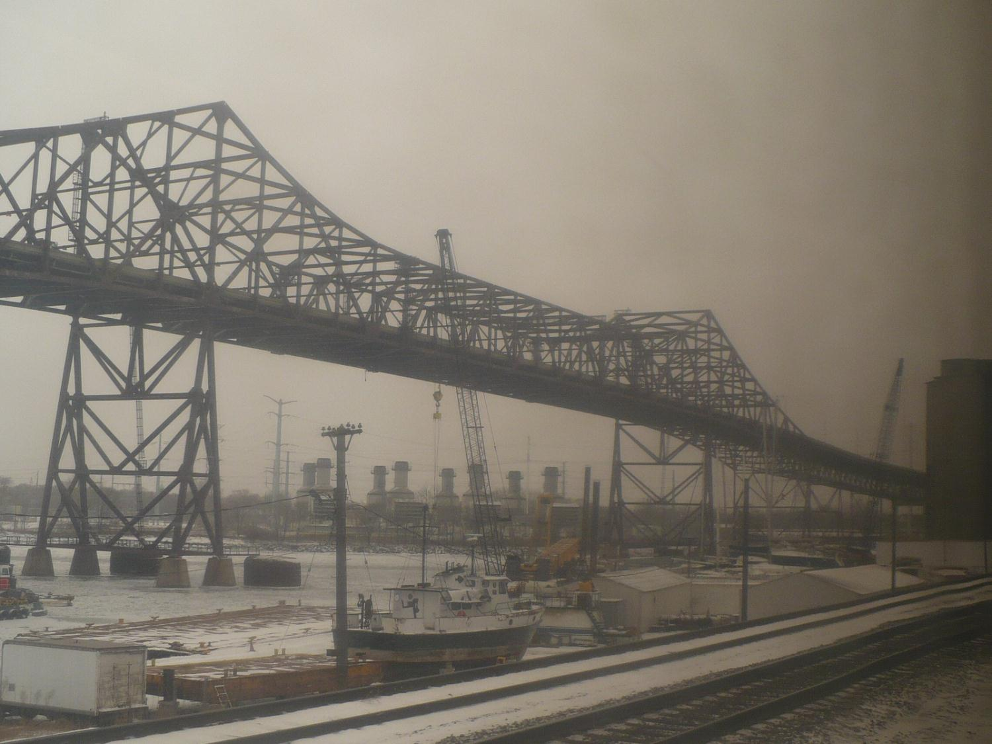
Steelmaking is big business. When technology changes,
thousands of jobs can be lost.

Slide 36
This is a town
in Pennsylvania
before and after
the steel mill closed.

Slide 37
Scenes after the
steel mill closed

Slide 38
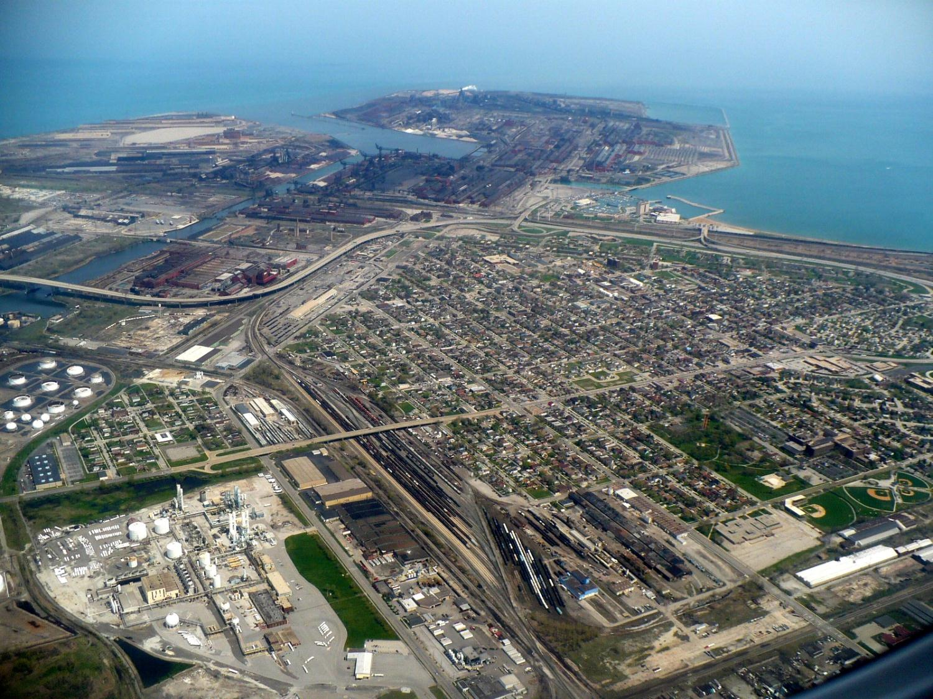
Steel mill
Workers’ housing
Oil refinery
Railroad yard

Slide 39
Very important point:
If people lose their jobs
because technology changes,
it is not their fault.
Discussion question:
Should the people who gain
when technology changes
do anything to help those who lose?

Slide 40
Copyright 2016, Phil Gersmehl
Teachers who saw this presentation at a workshop
or downloaded it from our internet site have permission
to make a copy on their own computers for these purposes:
1. to help them review the workshop,
2. to show to colleagues or administrators,
3. to show the presentation in their own classrooms or at sessions they lead at teacher conferences,
4. to use individual frames (with attribution) in their own class or conference presentations.
For permission for any other use,
including posting frames on a personal blog or uploading to any network or website,
contact pgersmehl@gmail.com

