Slide 1
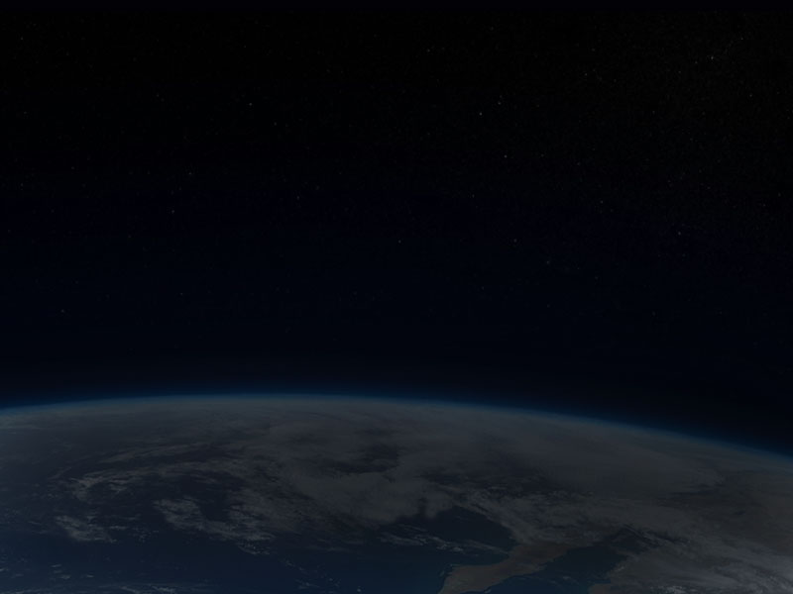
The Moveable “Desert Maker”
Climate Change in History
Phil Gersmehl
Michigan Geographic Alliance
pgersmehl@gmail.com

Slide 2
To understand the role of climate in history,
students should be aware of three things:
1. the system that makes tropical deserts,
2. the systems that cause natural climate cycles,
3. the difference between weather and climate.

Slide 3
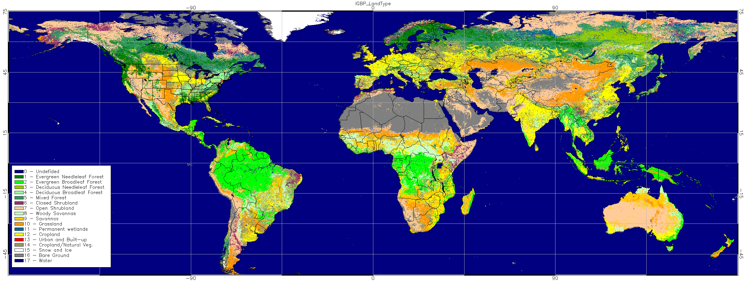
A typical climate map has a lot of info.
It’s almost impossible to remember.

Slide 4
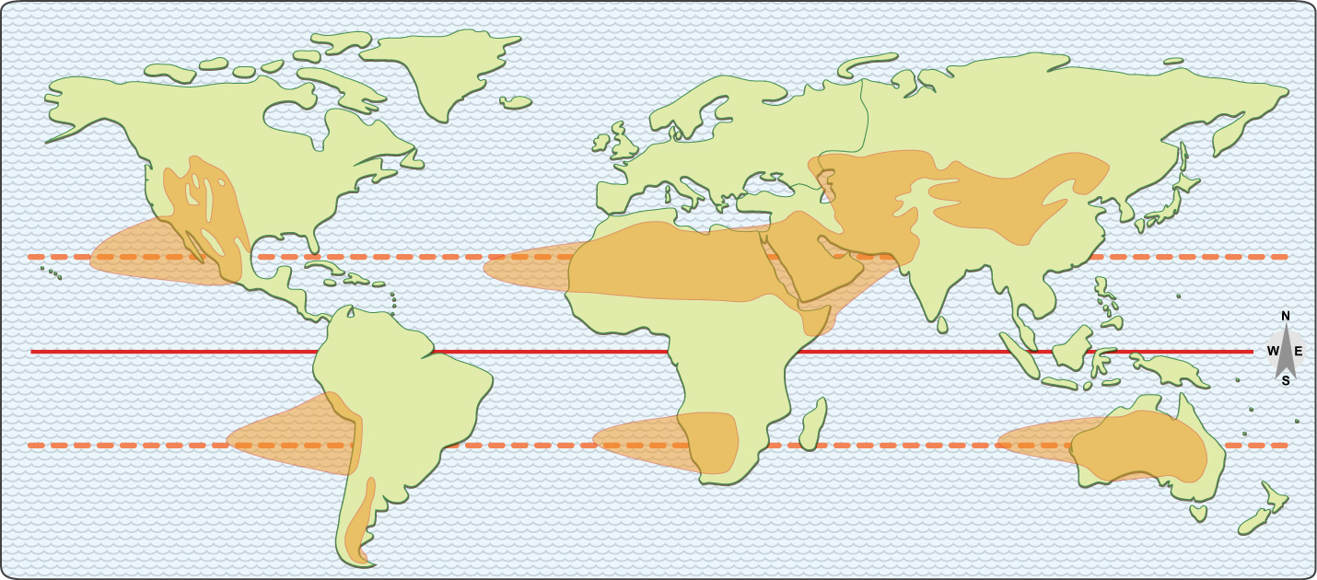
Let’s “declutter” and focus.
“Describe the pattern of dry climates.”

Slide 5
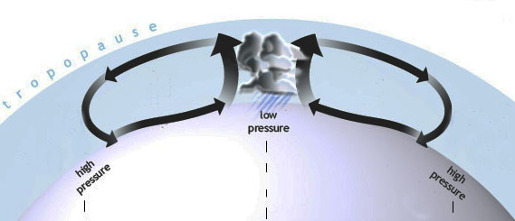
Q. What causes tropical deserts?
A. Rain near the equator.
Sun-heated air
rises and makes rain
over the equator . . .
AND
This globe is turned
so the equator is up.
it has to come down somewhere.

Slide 6
Given the present facts:
size, rotation, distance from sun, thickness of atmosphere, etc.
“down” is about 20-30 degrees north or south of where it went up.

Slide 7
Given the present facts:
size, rotation, distance from sun, thickness of atmosphere, etc.
“down” is about 20-30 degrees north or south of where it went up.
And where the air comes down, it makes a desert.

Slide 8
Given the present facts:
size, rotation, distance from sun, thickness of atmosphere, etc.
“down” is about 20-30 degrees north or south of where it went up.
Given the present facts:
size, rotation, distance from sun, thickness of atmosphere, etc.
“down” is 20-30 degrees north or south of where it went up.
How would you describe the geographic pattern of deserts?
“Start 1000 miles west of each continent on the Tropic line.
Spread to about 20 latitude degrees; stop when you hit mountains.”
How would you describe the geographic pattern of deserts?
And where the air comes down, it makes a desert.

Slide 9
Given the present facts:
size, rotation, distance from sun, thickness of atmosphere, etc.
“down” is about 20-30 degrees north or south of where it went up.
“Rainshadow” deserts
east of the mountains
in the westerly wind area
Another
rainshadow
here
But none here
(no continent!)
How would you describe the geographic pattern of deserts?
“Start 1000 miles west of each continent on the Tropic line.
Spread to about 20 latitude degrees; stop at the mountains.”
How would you describe the geographic pattern of deserts?
And where the air comes down, it makes a desert.

Slide 10
How does this
relate to history
(and our GLCEs)?

Slide 11
Well, for one thing,
we now have
a fairly accurate record
of global temperatures
for the past 10,000 years.

Slide 12
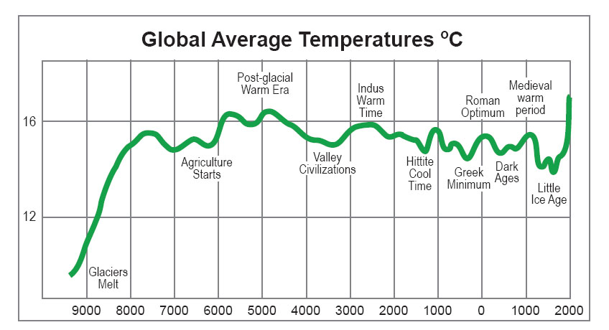
South Asia
flourishes
Vikings,
Mongols
Agriculture
starts
Rome expands
into Europe
Hunters thrive
Anatolia
(Turkey) is rainy
Ming
dynasty
collapses
This is a simple graph
of temperature thru time.
Greece
is rainy
Barbarians
invade Rome,
Han dynasty
collapses

Slide 13
To remember these facts,
put them on a world map of deserts.
Remember, Tropical deserts form
where air that rose at the equator
is pushed back down.
This downward air movement
(called the Subsidence)
will be farther from the equator
if warmer air makes storms
stronger near the Equator.

Slide 14
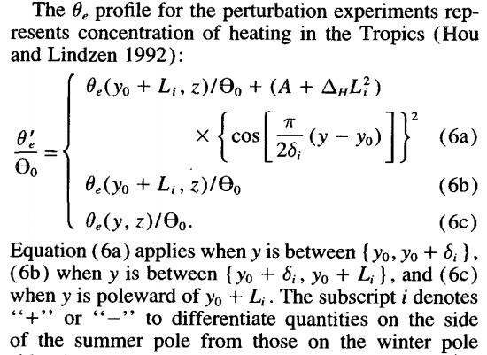
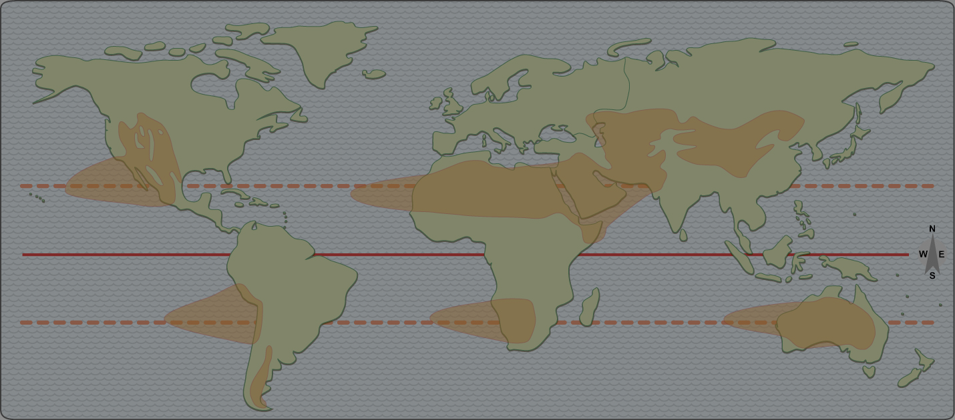
The science is not
“easily accessible”
to ordinary citizens.
This downward air movement
(called the Subsidence)
will be farther from the equator
if warmer air makes storms
stronger near the Equator.

Slide 15
It does, however, make
some specific predictions.

Slide 16
When the global average temperature is HIGH,
the “desert-maker” is pushed away from the equator.
Which places are likely to be helped?
???
?

Slide 17
When the global average temperature is HIGH,
the “desert-maker” is pushed away from the equator.
Which places are likely to be helped?
Plus some northern areas that might get warm enough for farming.

Slide 18
When the global average temperature is HIGH,
the “desert-maker” is pushed away from the equator.
Which places are likely to be hurt?
All of these areas have had serious droughts over at least the last ten years.

Slide 19
When the global average temperature is LOW,
the “desert-maker” shifts toward the equator.
Which places are likely to be helped?

Slide 20
When the global average temperature is LOW,
the “desert-maker” shifts toward the equator.
Which places are likely to be hurt?

Slide 21
When the global average temperature is LOW,
the “desert-maker” shifts toward the equator.
Which places are likely to be hurt?
Plus some large areas that still
have plenty of rain but are colder.

Slide 22
South Asia
flourishes
Vikings,
Mongols
Irrigation
needed
Agriculture
starts
Rome expands
into Europe
Hunters thrive
That’s the science
behind a simple fact:
Climate changes had
a big impact on history.
Anatolia
is rainy
Ming
dynasty
collapses
Greece
is rainy
Global warming is
bad for some places
and good for others.
Barbarians
invade Rome,
Han dynasty
collapses

Slide 23
What
about
today?

Slide 24
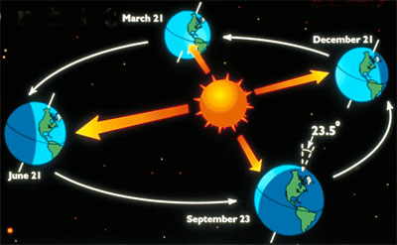
Here’s why climate has “natural” cycles:
Earth’s orbit is not a perfect circle.
It’s a wobbly tilt on a wobbly oval.

Slide 25
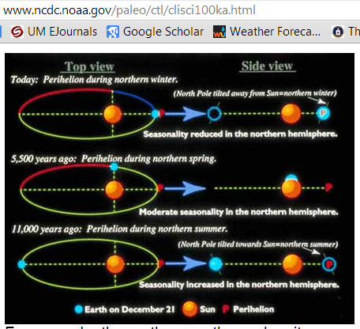
You can find the details on a lot of web sites:
www.ncdc.noaa.gov/paleo/ctl/clisci100ka.html

Slide 26
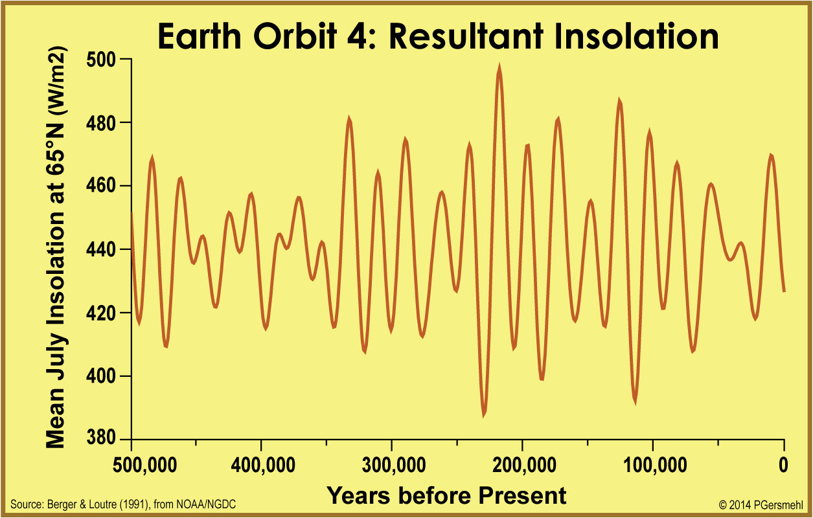
Bottom line – incoming solar energy varies a lot.
A high point
in solar radiation
comes roughly once
every 100,000 years.

Slide 27
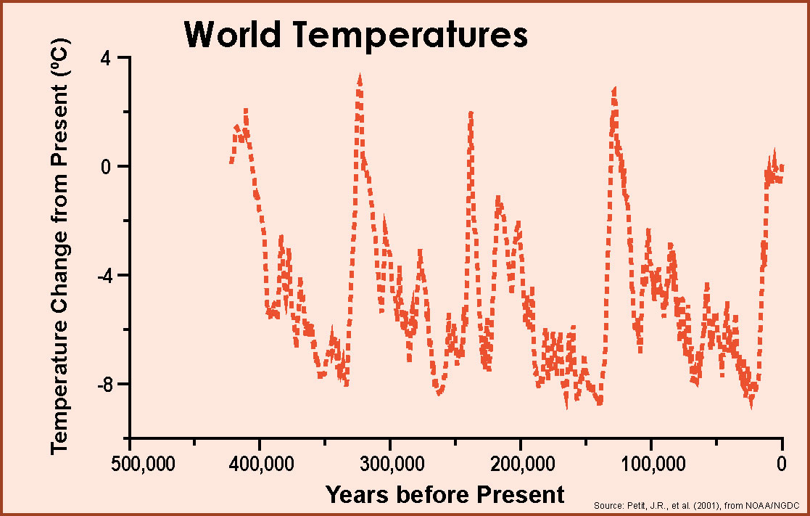
A high point
in temperature
roughly once every
100,000 years.
We also have
450,000 years of
temperature data
from ice cores
in Antarctica.

Slide 28
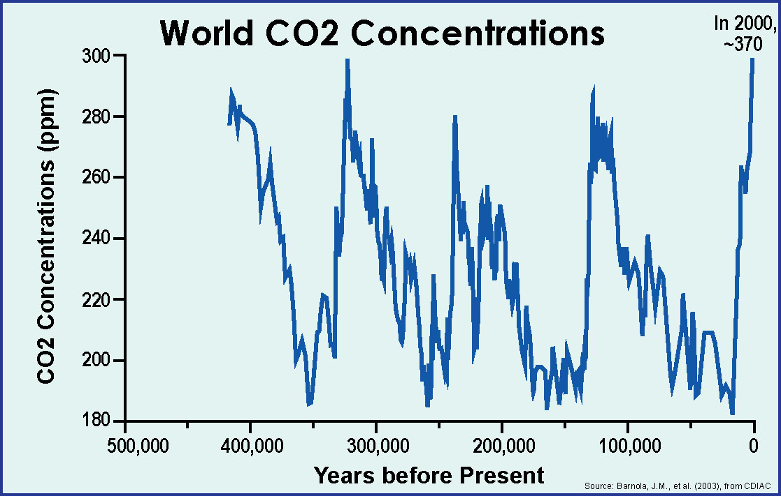
The record
of carbon dioxide
also has a high point
every 100,000 years.

Slide 29
S U N S H I N E
Let’s compare
all three graphs.
C A R B O N D I O X I D E
Solar energy,
temperature, and
carbon dioxide are obviously related
(but it’s complicated).
T E M P E R A T U R E

Slide 30
One conclusion
is beyond doubt:
temperatures
have been higher
in the past
than they are today.

Slide 31
Temperatures
were much higher
in the distant past
and a little higher
quite recently.
PRESENT AVERAGE

Slide 32
The most recent
measurements
do not fit
on the scale.
BUT,
there is a
big problem
with these graphs.

Slide 33
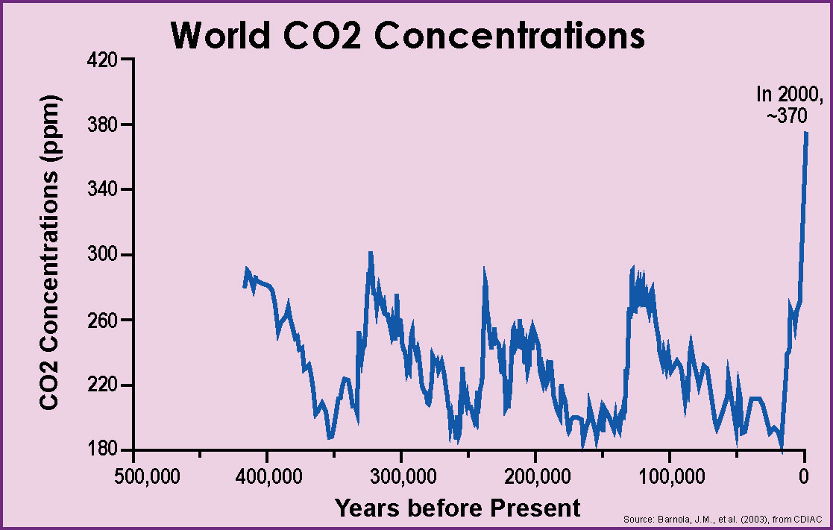
When we adjust
the vertical scale
so the numbers
all can fit,
you can see that
carbon dioxide is
WAY above
its “normal” range.

Slide 34
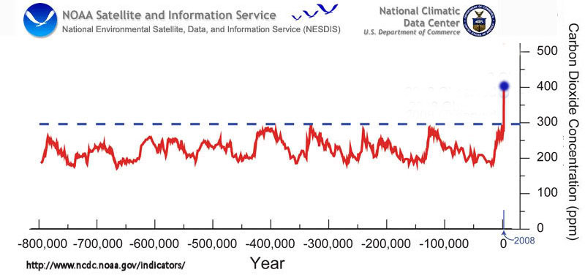
In 2015, 402
In just
a few hundred years,
humans have “pushed”
the climate system
way out of line
with “normal” cycles.
Ask students to describe this graph
in their own words.
Here’s our analogy - It’s like your heart rate stayed between 70 and 130 beats per minute for 20 years, and then suddenly went up to 200 –
if you’re smart, you’d want to know why, and if there are any consequences!

Slide 35
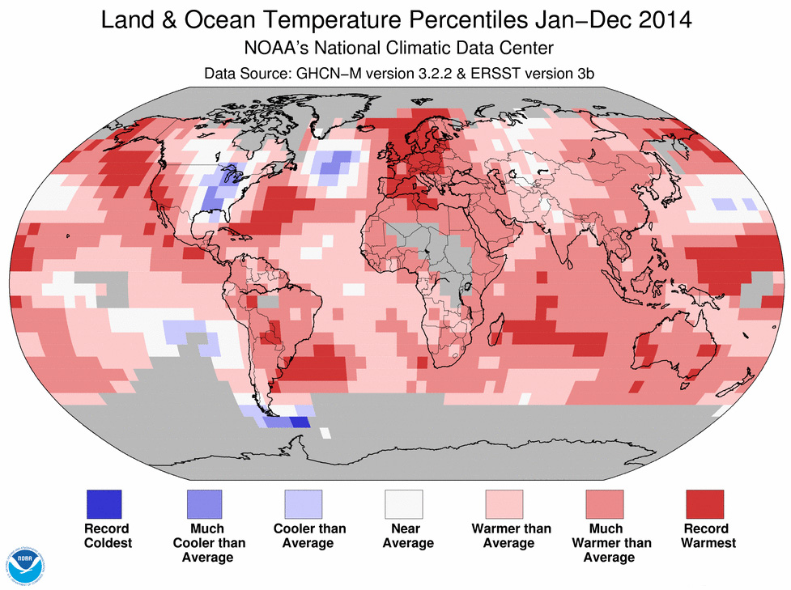
Michigan was colder than normal in 2014.
But look at the map for the whole world!

Slide 36
As one Blogger asked:
Can global warming
be real
if it is unusually cold
in the United States?

Slide 37
Eh
Aye
Aap
Hwa’a
A
Oui
Ja
Han
Da
Hai
As one Blogger asked:
Can global warming
be real
if it is unusually cold
in the United States?
Tak
‘Ae
Di
Shi
Si
Ia
Ya
Evet
Yin
Oo
Haa’n
Si
Na’am
Chai
To
Ae
Sim
Yao
Ndiyo
Ee
Ngee
E
Tamo
Eni

Slide 38
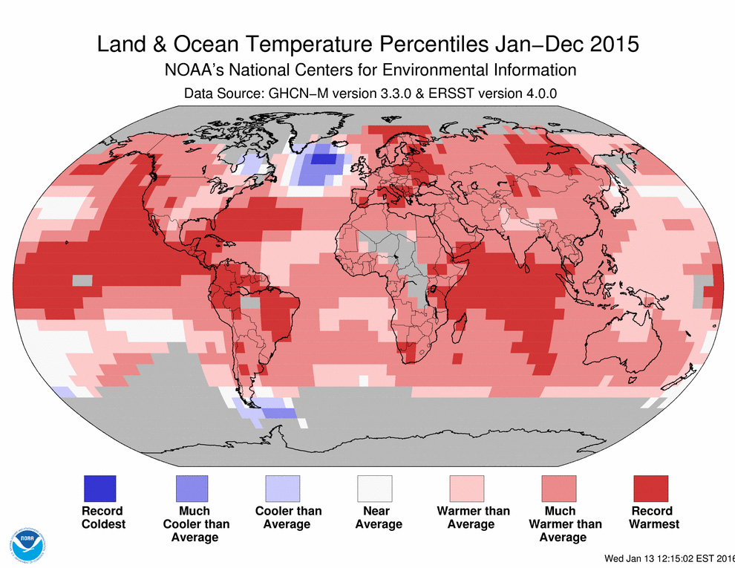
Eh
Aye
Aap
Hwa’a
A
Oui
Ja
Han
Da
Hai
As one Blogger asked:
Can global warming
be real
if it is unusually cold
in the United States?
Tak
‘Ae
Di
Shi
Si
Ia
Ya
Evet
Yin
Oo
Haa’n
Si
Na’am
And in 2015, Michigan was just slightly above normal –
but hundreds of Michigan-sized areas had record highs.
To
Chai
Ae
Sim
Yao
Ndiyo
Ee
Ngee
E
Tamo
Eni

Slide 39
Here’s the big point - global climate change
is not just about temperature. It’s also about deserts.
When the global average temperature is HIGH,
the “desert-maker” is pushed away from the equator.
Which places are likely to be hurt?

Slide 40
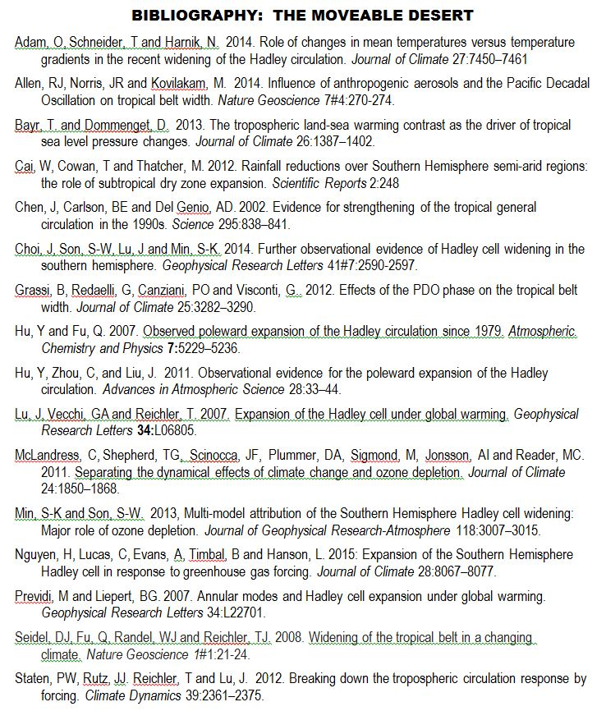
Here are a few of the key studies about moveable deserts.
Note that these researchers are based in
Australia, Argentina, Canada, China, England,
Germany, Israel, Italy, Korea, and South Africa,
as well as NCAR, NOAA, and 3 U.S. universities.

Slide 41
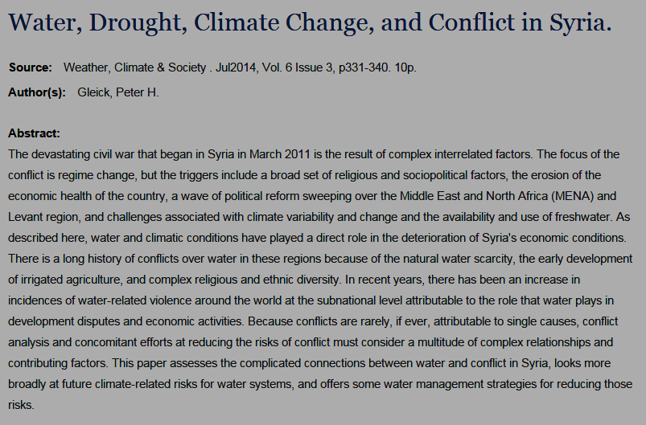
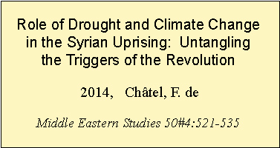
When the global average temperature is HIGH,
the “desert-maker” is pushed away from the equator.
Which places are likely to be hurt?

Slide 42
Climate change is
one of many “forces”
that we should consider
when we look at the history
of resource use and conflict
in Southwest Asia.
The Crossroads
of History

Slide 43
Copyright 2015, Phil Gersmehl
Teachers who saw this presentation at a workshop
or downloaded it from our internet site have permission
to make a copy on their own computers for these purposes:
1. to help them review the workshop,
2. to show the presentation in their own classrooms, at sessions they present at teacher conferences, or to administrators in their own school or district,
3. to use individual frames (with attribution) in their own class or conference presentations.
For permission for any other use,
including posting frames on a personal blog or uploading to any network or website that can be accessed from outside your school,
contact pgersmehl@gmail.com

