Slide 1
AFRICA MATRIX
A tool to organize
information about Africa

Slide 2
“Culture is a set of shared values that manifest themselves in the behavior and artifacts of a given group.”
“Culture is the thoughts, behaviors, customs, and things we produce and the methods we use to produce them.”
MCCC SuppMaterials.SS060401 Page 5
GLCE 6-G2.2.1 Describe the human characteristics of different regions (language, religion, economic system, cultural traditions).
GLCE 6-G2.2.2 Explain how places are affected by changes in technology.
GLCE 6-G4.1.1 Define culture and describe examples of cultural change through diffusion, including what has spread, why and where it spread, and consequences.
GLCE 6-G4.1.3 Describe the cultures of the region being studied
GLCE 6-G4.1.4 Explain how cultural patterns influence environments.
“Culture is a set of shared values that manifest themselves in the behavior and artifacts of a given group.”
“Culture is the thoughts, behaviors, customs, and things we produce and the methods we use to produce them.”
MCCC SuppMaterials.SS060401 Page 5

Slide 3
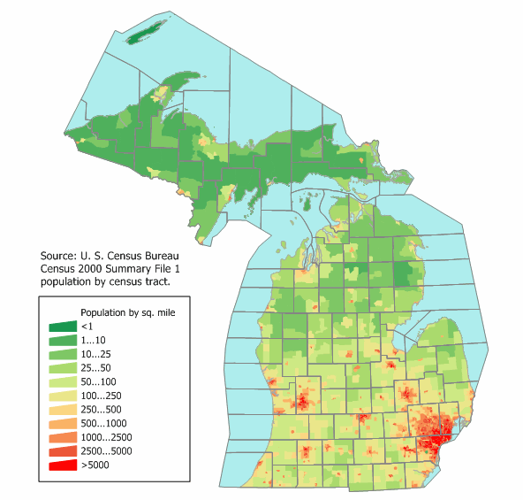
“The Cultures
of Michigan”
(one person’s idea)
Yooper
Lake
Dutch
Capitol
Motown
UM

Slide 4
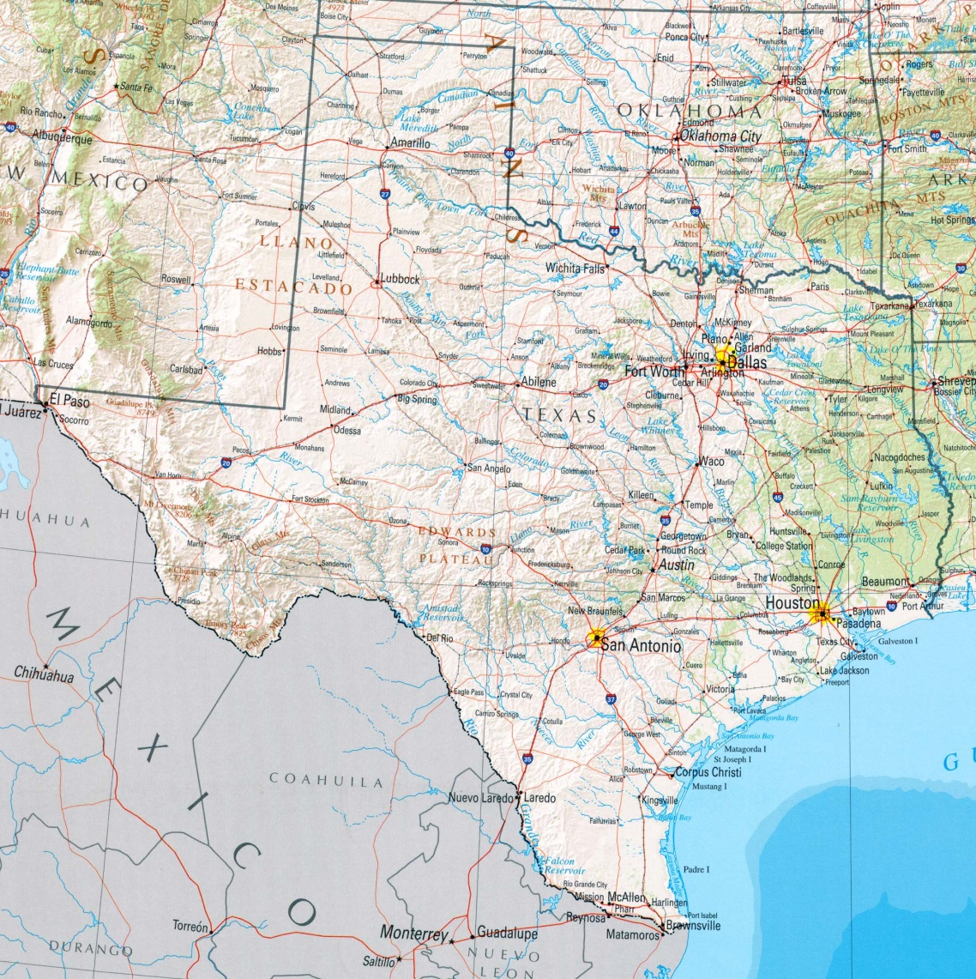
“The Cultures
of Texas”
(one person’s idea)
High
Plains
Metroplex
Piney
Woods
Hill
Country
A
Houston
T E X M E X

Slide 5
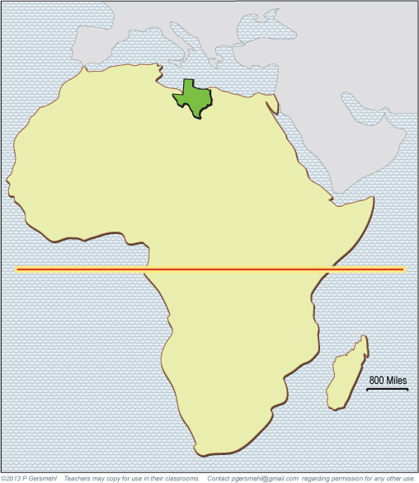
Here’s Texas,
at the right size
and latitude.
If we say there can be
notably different cultures
inside a large state like Texas,
(or even a medium-sized state like Michigan)
isn’t it a bit absurd to talk about
“the culture of Africa”?

Slide 6
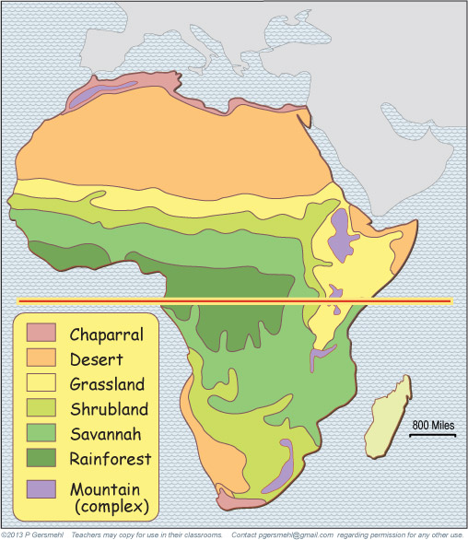
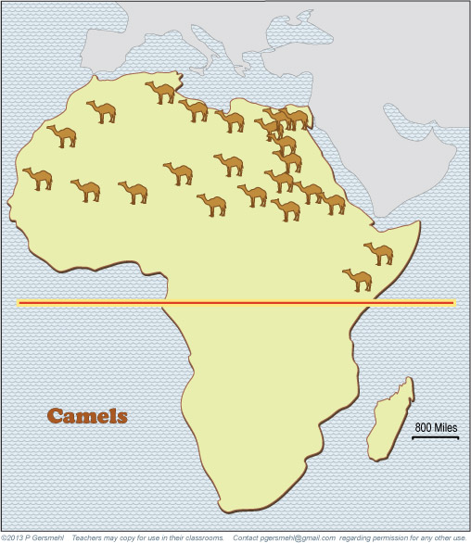
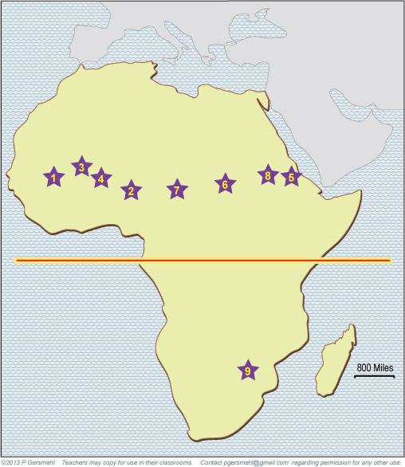
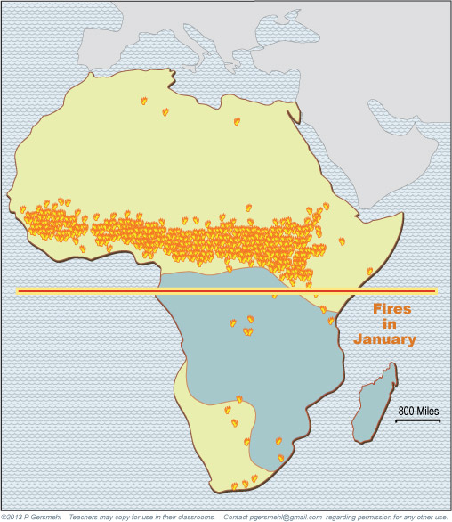
These maps came
from the clickable
mini-atlas of Africa.
Many cultural ideas
(like camel riding,
millet growing,
tree cutting,
house-building
(wood or stone?),
fire-setting,
cattle raising,
even empire building)
have their roots
in the environments
in different places.

Slide 7
“Memorizing
is what people resort to
when they do not understand
what they are trying to learn.”

Slide 8
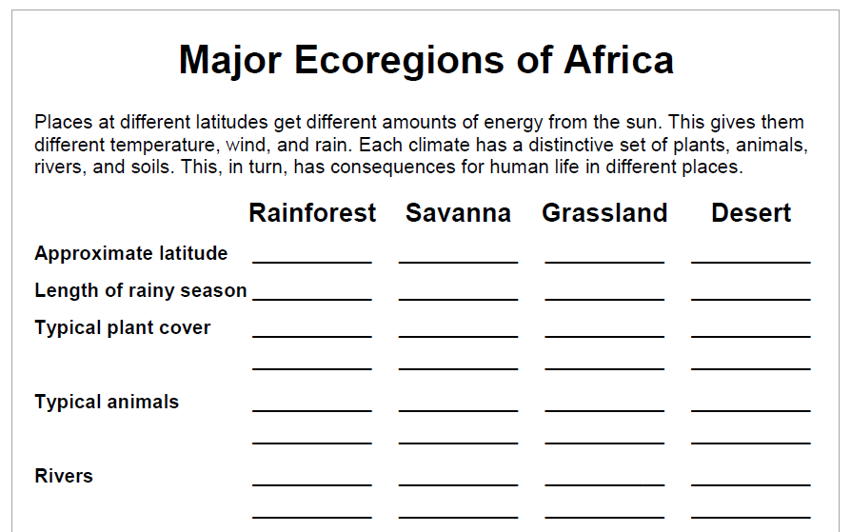
0-5
trees
camels

Slide 9
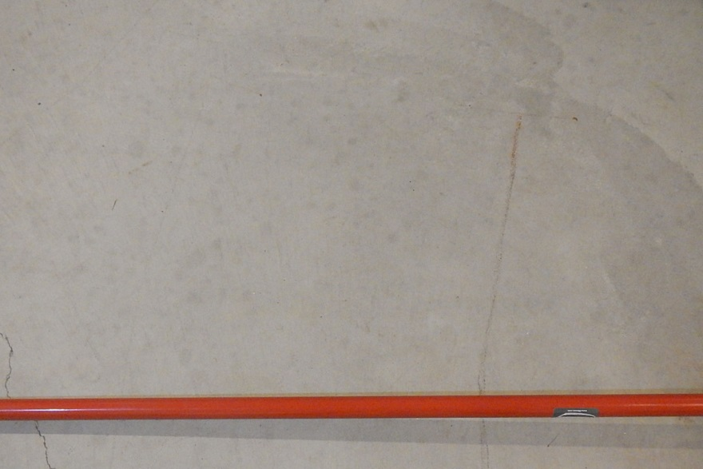
Put a line on a piece of paper,
or a string on a table,
or a broomstick on the floor.
This represents the equator.

Slide 10
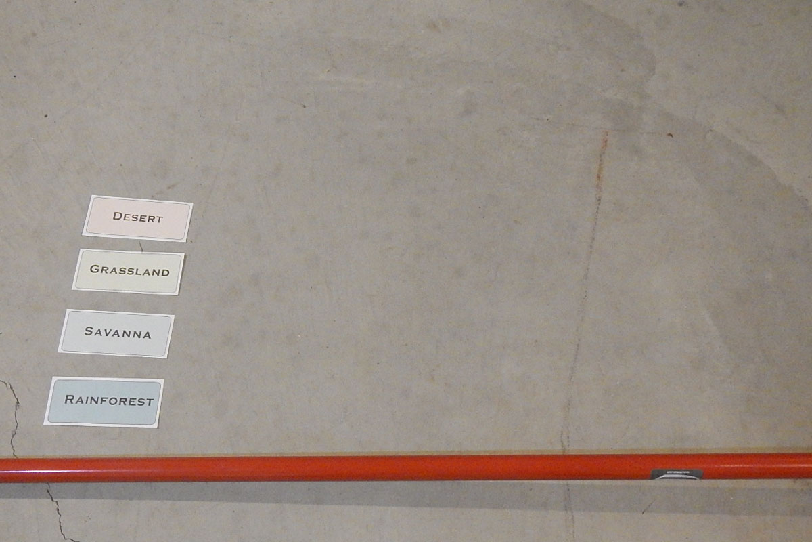
Arrange the cards
for the four main ecoregions
(rainforest, savanna, grassland, desert)
in proper relative position
going north from the equator.

Slide 11
Then put a heading
above a column,
and put each card
in the right place
under the heading.

Slide 12
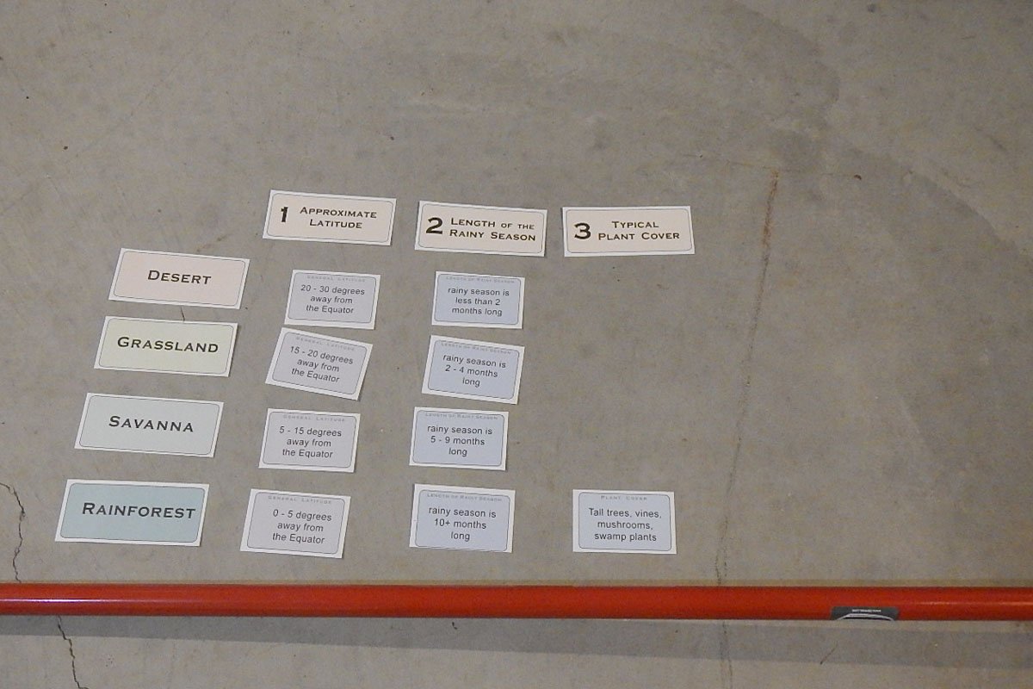
Keep adding
headings and cards
to fill the matrix.

Slide 13
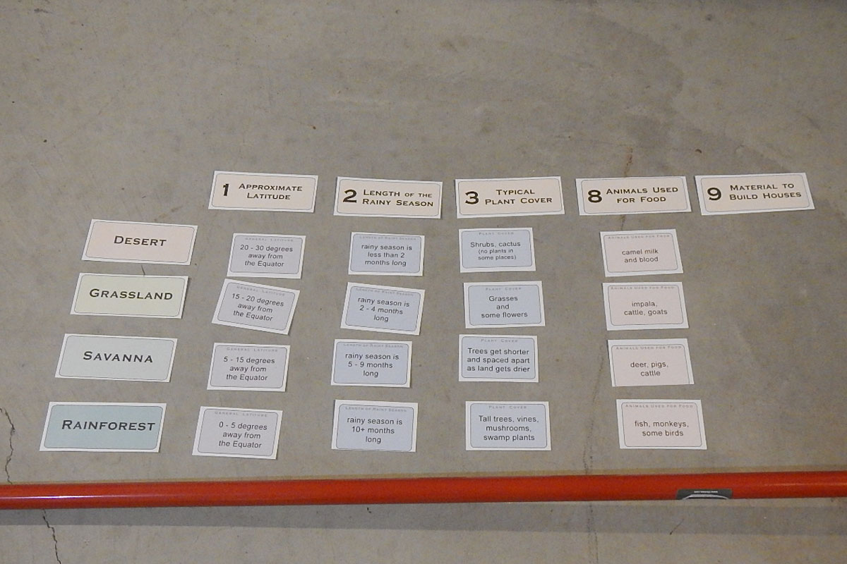
You can choose
what headings
you want to use.

Slide 14
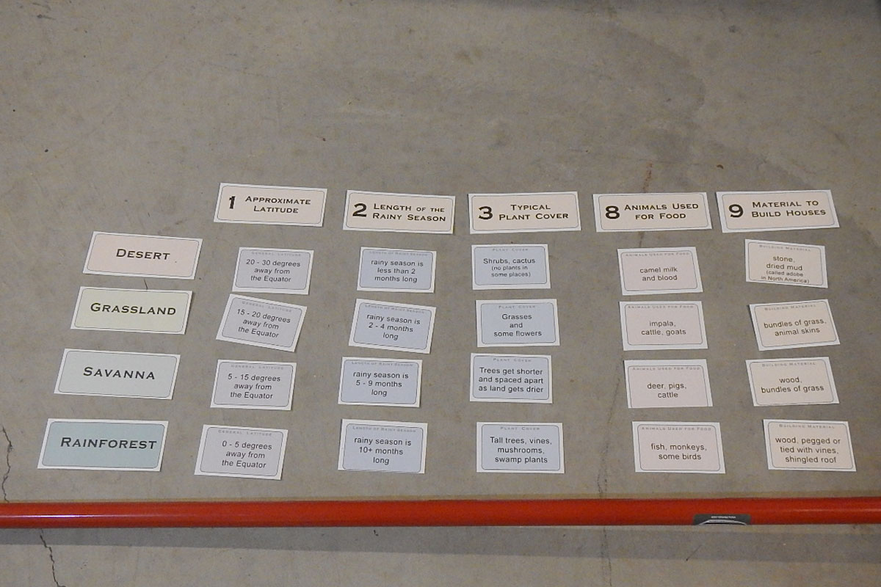
You can do
as many as
you want.

Slide 15
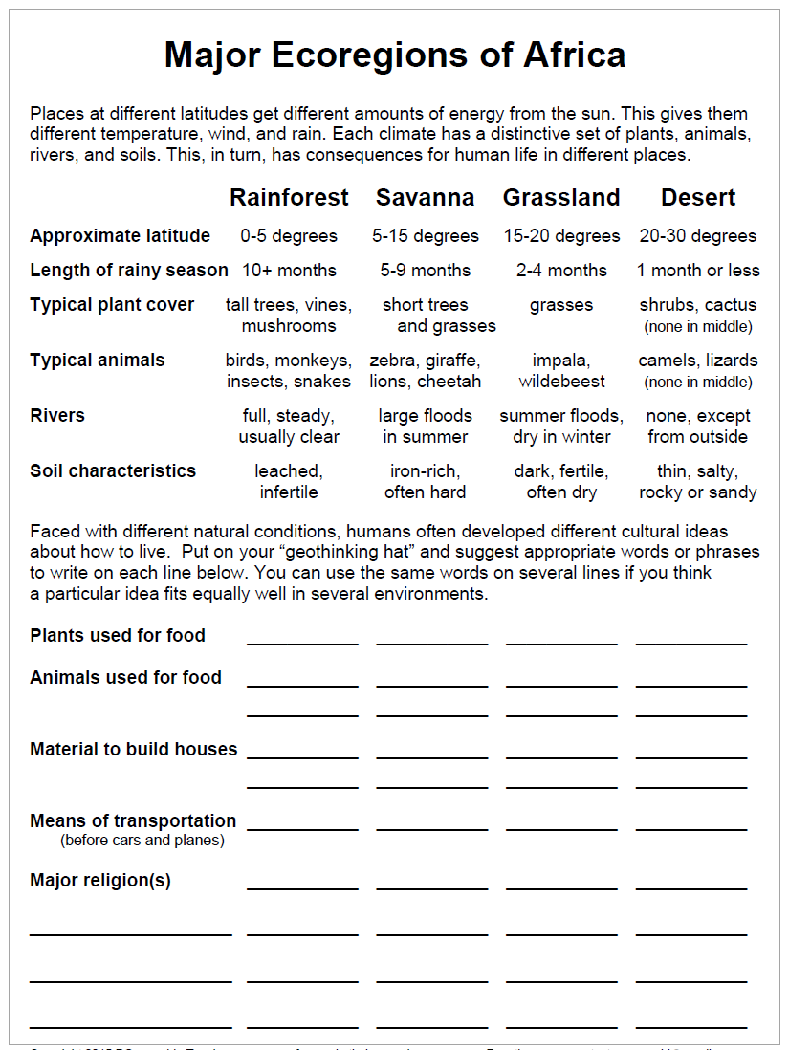
Alternatively,
you can use
the matrix forms
the bare one
or the half-done one.

Slide 16
This is not
a cool new way to learn about Africa.
It is not
the proven best way to teach about Africa.
It’s just a way
to organize information
that you get from videos,
pictures, readings, etc.

Slide 17
This is not
a cool new way to learn about Africa.
It is not
the proven best way to teach about Africa.
It’s just a way
to organize information
that you get from videos,
pictures, readings, etc.
You can get images from the web
to help you fill in the matrix.
Here are some suggested keywords:
Rainforest in Congo
Savanna in Nigeria
Grassland in Sudan
Sahara in Mali

